Slide 1
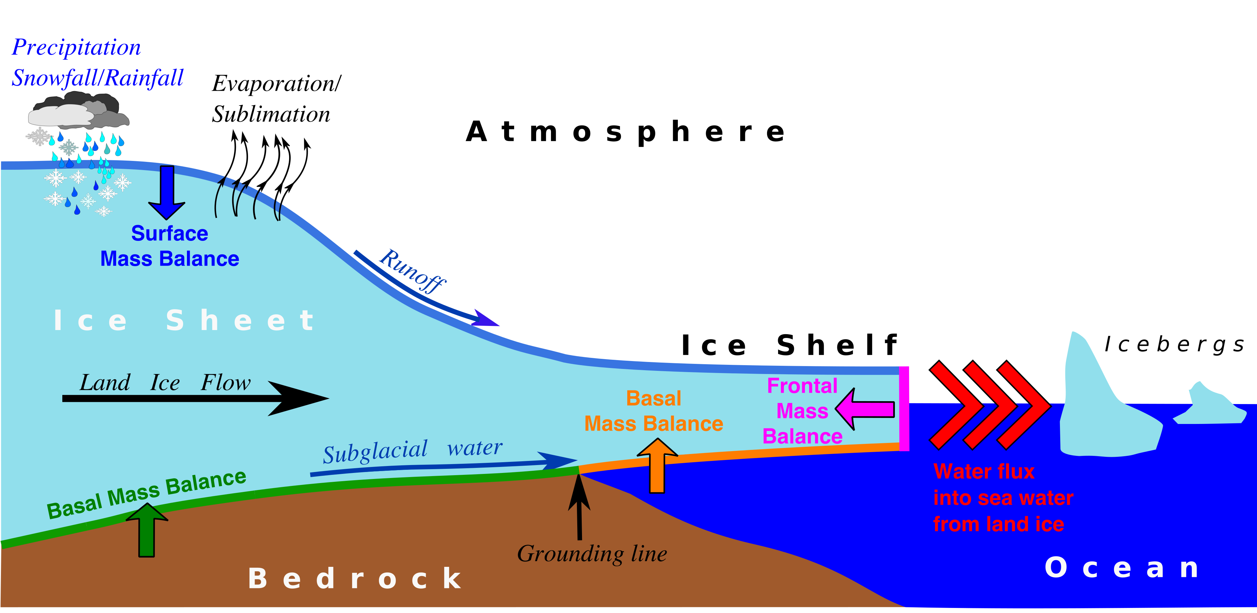
The Ice Sheet Model Intercomparison Project for CMIP6 (ISMIP6)
Objective
Provide the ice-sheet and climate modeling communities with an integrated framework for projecting ice- sheet mass changes, climate system feedbacks, and future sea-level rise.
,
Research
Designed three modeling efforts for studying ice-sheet/climate changes:
Analysis of ice-sheet-relevant variables from traditional climate simulations
Standalone ice sheet simulations driven by CMIP-derived forcing fields
Simulations with atmosphere-ocean climate models coupled dynamically to ice sheet models
Schematic illustration of ice sheet interactions with the climate system.
Impact
ISMIP6 is the first Coupled Model Intercomparison Project (CMIP) component to focus on ice sheets
Brings together the world’s leading glaciology and climate modeling groups to provide best estimates of ice-sheet mass loss and sea-level rise
Reference: Nowicki, S. M. J., T. Payne, E. Larour, H. Seroussi, H. Goelzer, W. Lipscomb, J. Gregory, A. Abe-Ouchi, and A. Shepherd (2016), Ice Sheet Model Intercomparison Project (ISMIP6) contribution to CMIP6, Geosci. Model Dev., 9, 4521-4545, doi:10.5194/gmd-9-4521-2016.
Notes:
Wanda says that this is a general slide with no specific reference

