Slide 1
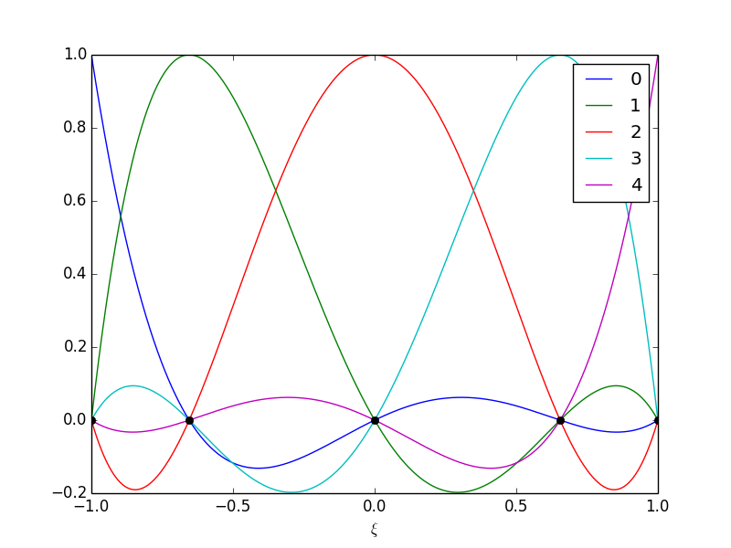
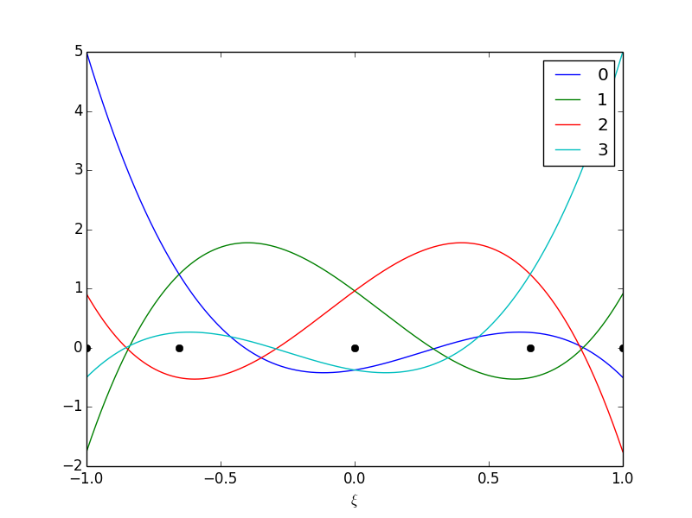
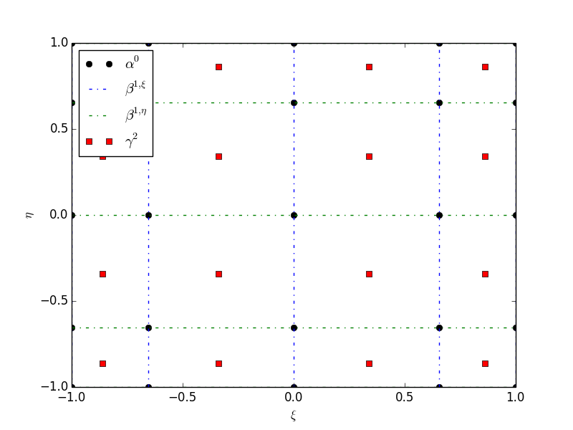
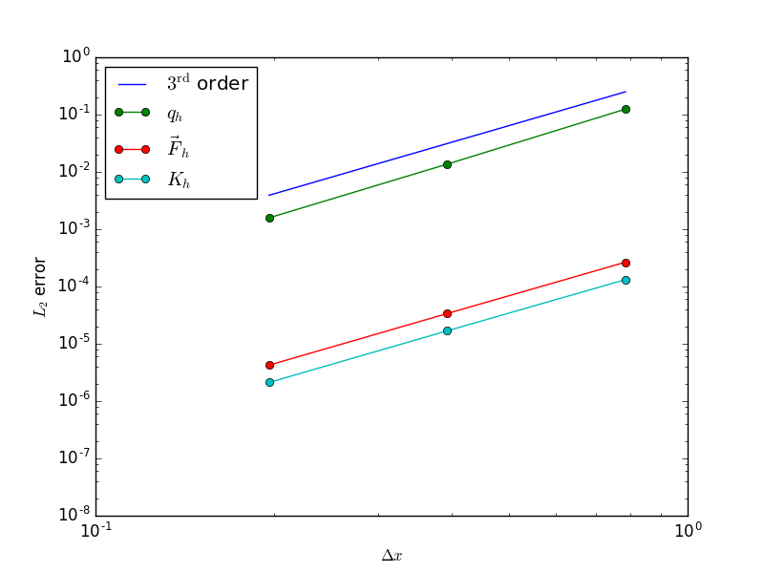
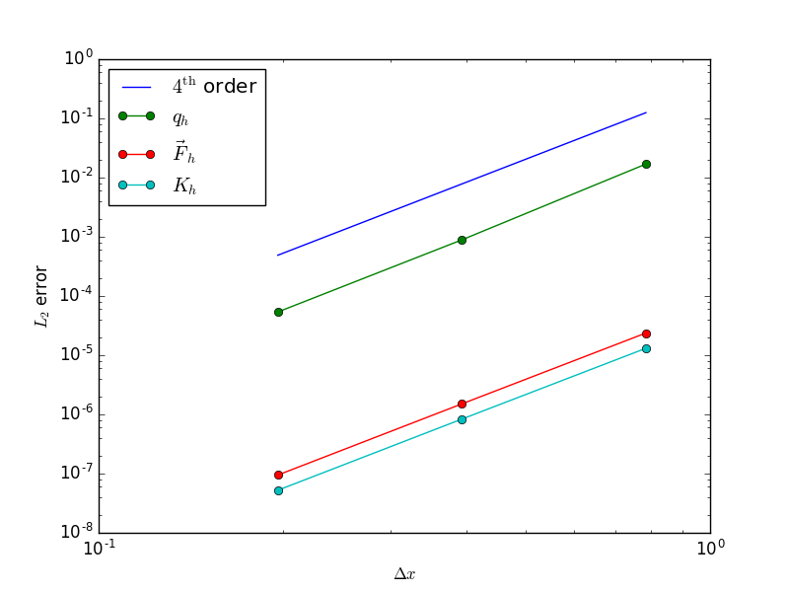
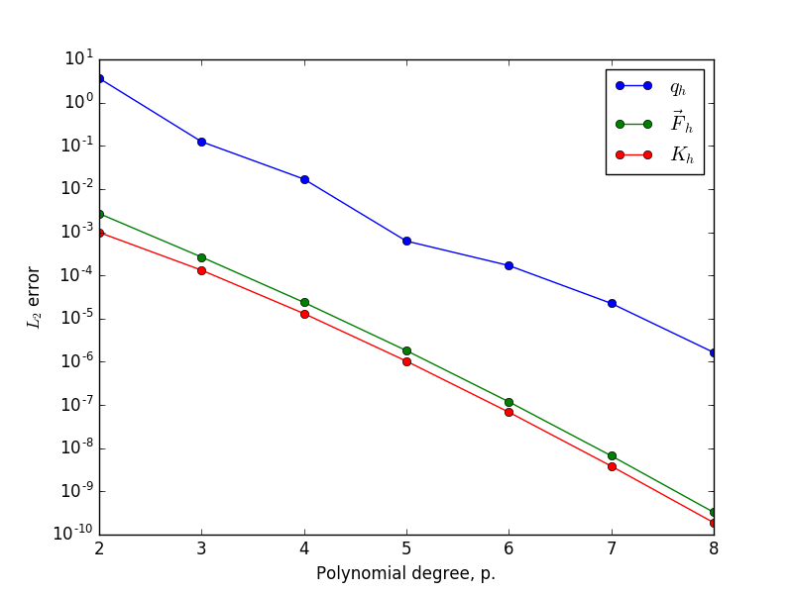
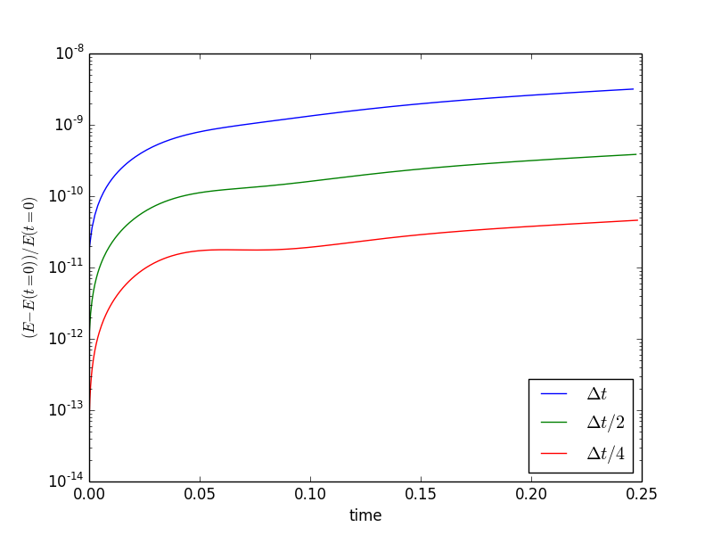
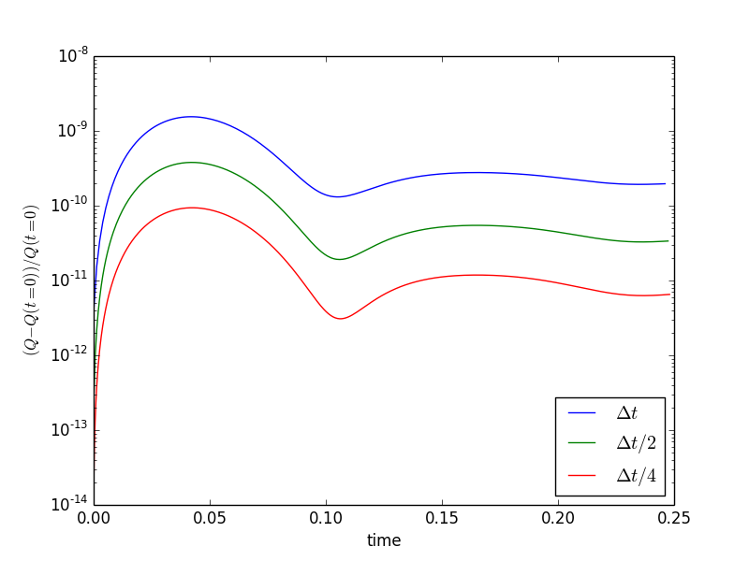
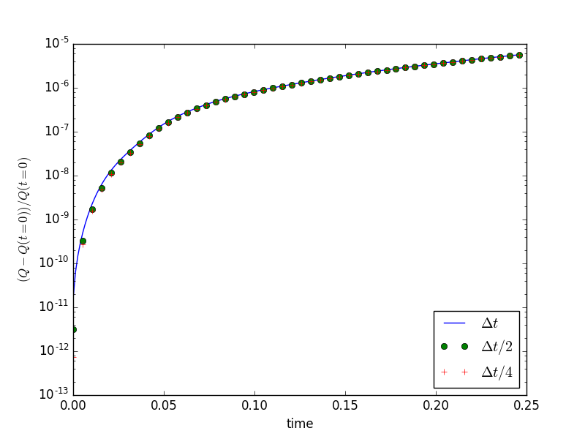
A Mixed Mimetic Spectral Element Method for Geophysical Flows
Objective
Develop a solver for the rotating shallow water equations that conserves mass, vorticity, energy and potential enstrophy using mixed mimetic spectral elements.
Demonstrate spectral convergence of errors with polynomial degree.
Evaluate limitations of conservation properties.
Fourth order nodal (left) and edge (center) basis functions and tensor product element (right).
Research
Introduce a secondary set of edge based basis functions which are orthogonal with respect to their integral between two quadrature points, and so satisfy the fundamental th. of calculus with respect to the nodal basis functions.
Construct tensor product function spaces from nodal and edge functions which satisfy the divergence th. in the strong form and the circulation th. in the weak form.
Algebraic convergence of errors for 3rd order (left) and 4th order (center) bases, and spectral converge with polynomial degree (right) for potential vorticity, mass flux and kinetic energy diagnostic equations.
Energy conservation (left) and potential enstrophy (center) errors converge with time step truncation error, while potential enstrophy conservation error convergence fails for inexact quadrature (right).
Impact
Exact conservation of mass (pointwise) and vorticity. Energy and potential enstrophy conservation subject to truncation error of time stepping scheme.
Reference: Lee, Palha and Gerritsma “Discrete conservation properties for shallow water flows using mixed mimetic spectral elements”, Journal of Computational Physics (2017) https://doi.org/10.1016/j.jcp.2017.12.022
Notes:
<number>

