Slide 1
“The Polar Project”
Improving the Characterization of Clouds, Aerosols and the Cryosphere in Climate Models
Parameterization development
How have changing forcing agents influenced sea ice over the last few decades?
How do improvements to process level representation influence our interpretation of that climate change?
Phil Rasch (PNNL),
Phil Jones (LANL),
Steve Klein (LLNL),
Surabi Menon (LBNL)
Support from the DOE Earth System Modeling Program

Slide 2
Project evolution
3 year Polar project was continue as a collaborative activity in individual labs, with an evolution in focus (e.g. broadening to global issues at PNNL)
→ Part of ACME
Brief highlights from each of the labs

Slide 3
PNNL Activities
Philip Rasch, Susannah Burrows, Dick Easter, Steve Ghan, Xiaohong Liu, Po-Lun Ma, Yun Qian, V. Vinoj, Hailong Wang, Minghuai Wang, Jin-ho Yoon, Kai Zhang
Primary focus on
  Improvement of treatment of aerosols and clouds
  Exploration of impact on atmosphere and coupled system
  Climate change consequences.

Slide 4
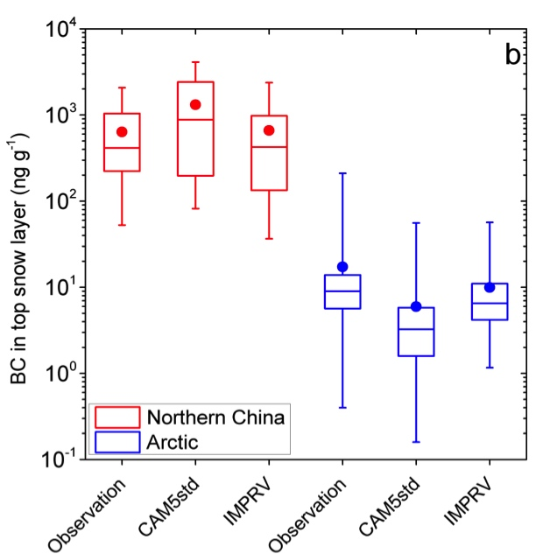
Sensitivity of remote aerosol distributions to the representation of cloud–aerosol interactions in CAM5: modifications to improve model fidelity
Revised aerosol transformation, wet scavenging, convective transport and removal in CAM5 improves fidelity
Evaluated using surface and aircraft measurements of aerosol properties and process-oriented MMF model results
Explore role of aerosols in the climate system (e.g., direct radiative effect, aerosol-cloud interactions, aerosol effect in snow, etc.
Observation
MMF
CAM5
Improved CAM5
The best combination of improvements to CAM5 gives much better Arctic monthly mean near-surface black carbon (left; Wang et al., 2013) and BC in snow over Northern China and the Arctic (right; Qian et al., 2014). Other aerosol species are also improved
Some remaining discrepancies are likely to be due to BC emission uncertainties
H Wang, Easter RC, Rasch PJ, Wang M, Liu X, Ghan SJ, Qian Y, Yoon J-H, Ma PL, and Vinoj V. 2013. “Sensitivity of remote aerosol distributions to representation of cloud–aerosol interactions in a global climate model.” Geoscientific Model Development 6, 765-782. DOI:10.5194/gmd-6-765-2013.
Qian Y, H Wang, R Zhang, M Flanner, and PJ Rasch 2014. “A sensitivity study on modeling the black carbon in snow and its radiative forcing over the Arctic and Northern China. (Submitted)
Notes:
Bill, note the figures show problems with high latitude aerosols in the standard CAM5, and recent progress made in improving cloud and aerosol processes (to be included in CAM6 and ACME)

Slide 5
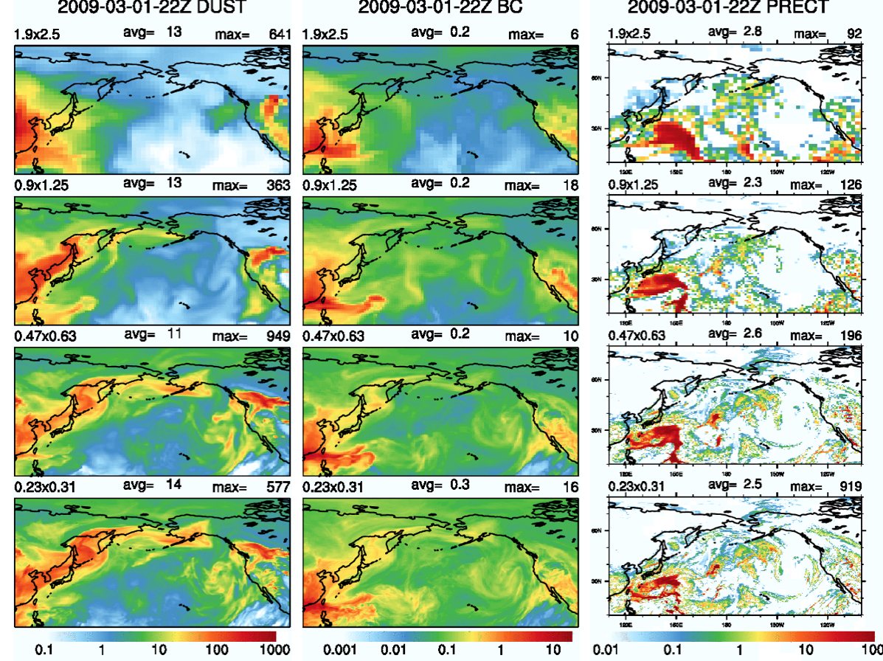
Brute Force resolution Increases may help in Aerosol Cloud Interactions
Rasch and Ma, in prep

Slide 6
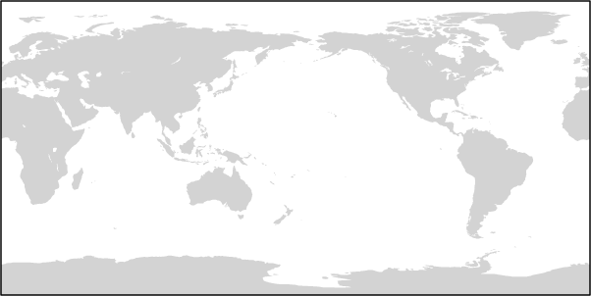
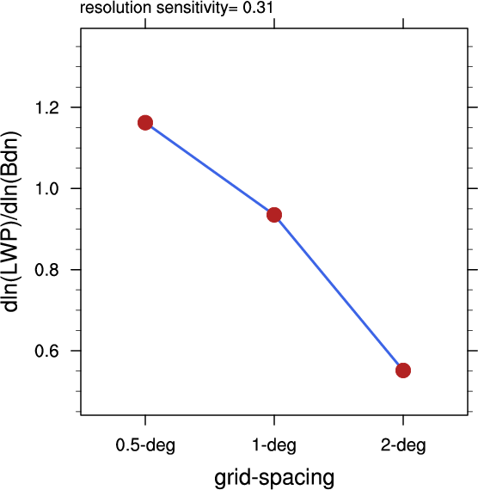
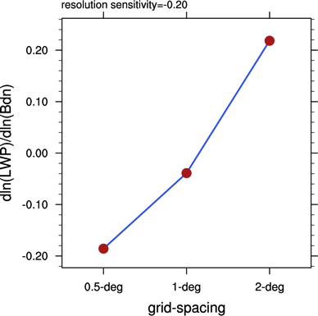
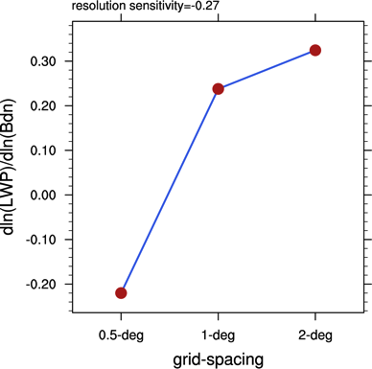
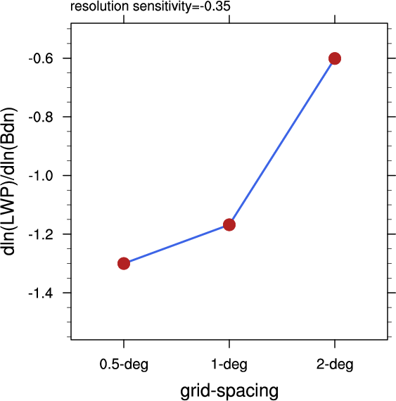
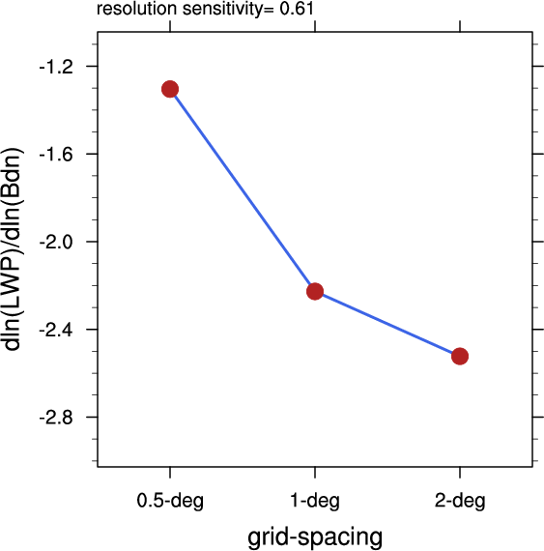
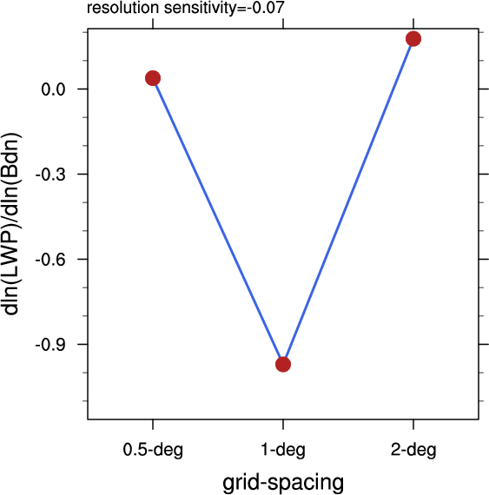
Measures of the Susceptibility of cloud to changes in aerosols (Rasch and Ma, 2014, in prep)
Global cloud susceptibility decreases with resolution,
ie the Aerosol Indirect goes down
Cloud susceptibility varies by region.
Notes:
Illustrates that the processes that control cloud’s response to aerosols are regional and regime dependent, at least as estimated by the model.

Slide 7
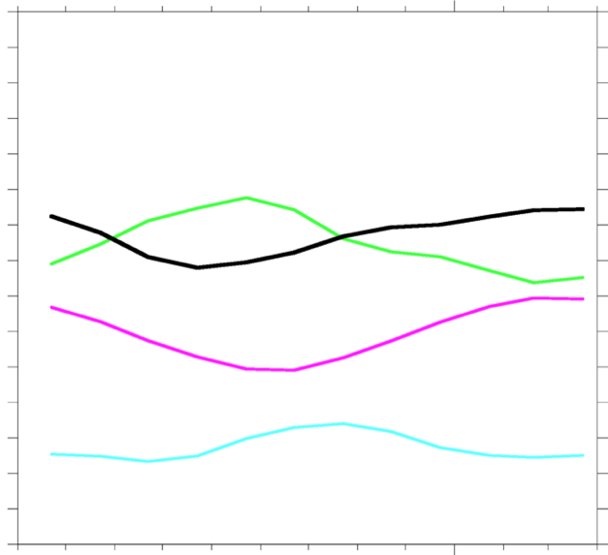
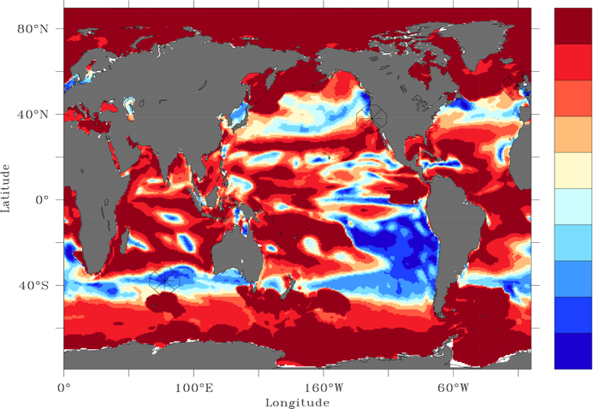
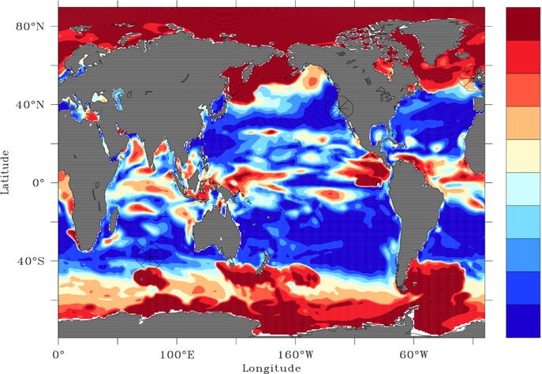
Characterizing the organic content of sea spray aerosols:
Correlation of monthly mean Chl-a and submicron OM fraction
POP-simulated Chl-a
Submicron SSA OM fraction
Lipid fraction
Polysaccharide+Protein fraction
Burrows et al, 2014, submitted
Seasonal variability in the Southeast Pacific
0.28
0.24
0.20.
0.16
0.12
0.08
0.04
0.00
Apr
Months
Mar
Correlation of monthly mean Chl-a and submicron OM fraction
Baseline case
10x lower lipids, 20x higher polysaccharides
1.0
0.8
0.6
0.4
0.2
0.0
-0.2
-0.4
-0.6
-0.8
-1.0
1.0
0.8
0.6
0.4
0.2
0.0
-0.2
-0.4
-0.6
-0.8
-1.0
Notes:
ocean carbon pool can be divided into classes with different lifetimes (against photochemical and biological transformation and removal).
Different ocean regions have different dominant organic classes with different seasonal cycles.
Relationships between chl-a and sea spray OM that are currently used in GCMs are derived from observed relationships in the "red" areas, and are largely related to seasonal cycles.
In the "blue" areas, the seasonal cycles in sea spray OM may be driven by longer-lived species (e.g., "polysaccharides and proteins" on my figure), which peak later in the season. Their seasonal cycle is out of phase with chl-a, so in those regions chl-a and sea spray OM may be anti-correlated.
relationships derived from obs in red areas to the global ocean may lead to erroneous conclusions The amount and composition of the OM fraction of sea spray likely modifies the number of CCN available to clouds, but
researchers currently disagree on whether CCN are increased, decreased, or even unaffected by OM. We we exploring various assumptions

Slide 8
Polar Project: LLNL
Clouds
Steve Klein, Peter Caldwell, Neil Barton , Shaocheng Xie,
Chuanfeng Zhao, and Yuying Zhang
Diagnosis of Arctic cloud and radiation in CESM
Sensitivity of Simulated Arctic Cloud and Radiation to parameterization changes
Improved representation of clouds (by consideration of physics and numerics)

Slide 9

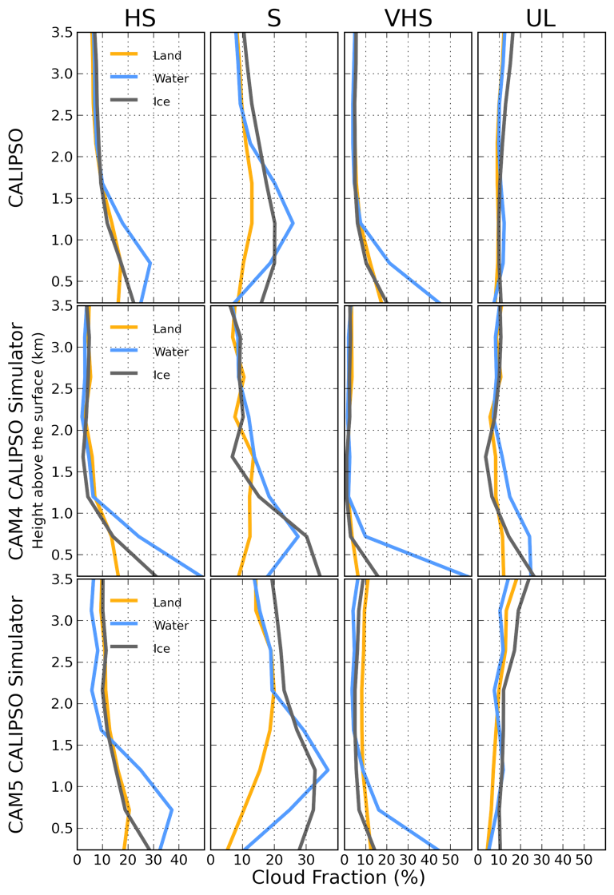
Arctic Synoptic Regimes: Comparing domain wide Arctic cloud observations with CAM4 and CAM5 during similar dynamics
Neil P. Barton (LLNL), Stephen A. Klein (LLNL),
James S. Boyle (LLNL), and Yuying Zhang (LLNL)
Science Question:
Is there an improvement in Arctic cloud production from the Community Atmospheric Model Version 4 (CAM4) to Version 5 (CAM5)?
Approach:
• Evaluate Arctic clouds during similar dynamics and thermodynamics
• Evaluate Arctic clouds using data from CAM4 and CAM5 CAPT runs. CAPT runs are initialized everyday from May 2008 to March 2010
• Evaluate Arctic clouds using high temporal frequency (3 hour) model output
• Evaluate Arctic clouds using CALIPSO observations compared to the CALIPSO simulator output in CAM4 and CAM5
Achievements:
• Statistical analysis separated Arctic dynamics and thermodynamics into 4 distinct regimes
• 4 distinct Arctic cloud profiles occurred during these regimes
• The Arctic cloud response to changes in surface type is dependent on the thermodynamics
• The improved boundary layer and microphysical schemes in CAM5 produced more accurate Arctic boundary clouds compared to CAM4
Publication:
Barton, N. P. S. A. Klein, J. S. Boyle, Y. Y. Zhang, 2012: Arctic Synoptic Regimes: Comparing domain wide Arctic cloud observations with CAM4 and CAM5 during similar dynamics. J. Geophys. Res.-Atmos., 117, doi:10.1029/2012JD017589.
Figure: The cloud percentages for each synoptic regime separated for periods that occurred over (blue line) water, (orange line) land, and (gray line) sea ice locations in the (top) CALIPSO observations and the (middle) CAM4 and (bottom) CAM5 CALIPSO simulator output The synoptic regimes from left to right are the High Stability (HS), Stable (S), Very-High Stability (VHS), and Uplift (UL).

Slide 10


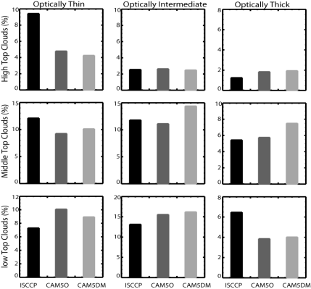
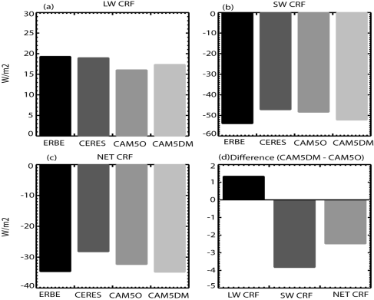
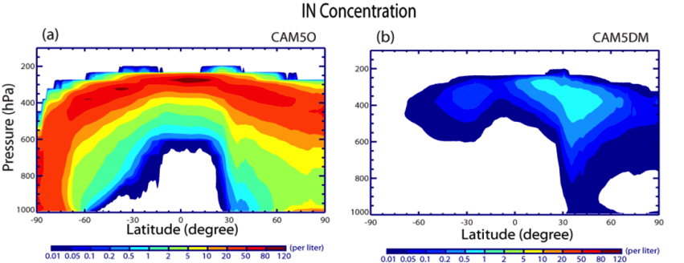
Linking Ice Nucleation to Aerosols and Its Impacts on CAM5 Simulated Arctic Clouds
Shaocheng Xie, Xiaohong Liu, Chuanfeng Zhao, and Yuying Zhang
Science Questions
In the Arctic, a large increase is seen in middle-top clouds and optically intermediate and thick clouds, which results in a stronger cloud radiative forcing (net cooling) at TOA.
  How do climate model simulated cloud types vary with different treatments of the ice nucleation process and how these changes impact Earth’s radiative budget?
Arctic Clouds: Model vs. ISCCP
Cloud Radiative Forcing at TOA
Approach
A new physically based ice nucleation scheme (DeMott et al. 2010) that links the variation of ice nuclei (IN) number concentration to aerosol properties was implemented into the Community Atmospheric Model version 5 (CAM5) and compared with its default scheme that parameterizes the IN concentration simply as a function of ice supersaturation.
Simulated IN concentrations in mixed-phase clouds are significantly reduced with the new scheme
Fig. 2. Left panel: the nine ISCCP cloud types in ISCCP and the ISCCP simulator; Right panel: cloud radiative forcing at TOA.
IN Concentration
Conclusions
OLD
NEW
The significant reduction in simulated IN number concentrations in mixed-phase clouds results in a considerable changes in Arctic clouds and their properties. Overall, there is an increase of the optical depth of Arctic clouds, which leads to a stronger cloud radiative forcing (net cooling) at TOA compared to the default model.
Publication
Xie, Liu, Zhao, and Zhang, 2013: Sensitivity of CAM5 Simulated Arctic Clouds and Radiation to Ice Nucleation Parameterization. J. Clim. In press, http://journals.ametsoc.org/doi/abs/10.1175/JCLI-D-12-00517.1.
Fig. 1. IN number concentrations in mixed-phase clouds produced by the default CAM5 (left panel) and the CAM5 with the new IN scheme developed by DeMott et al. (2010)(right panel).

Slide 11
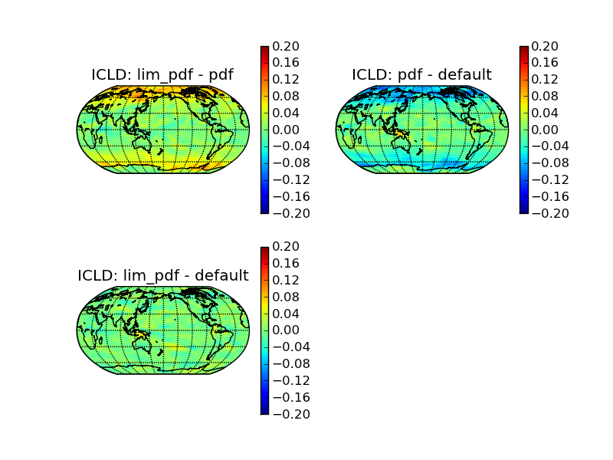
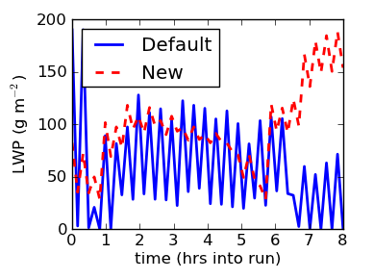
Cloud Parameterization (1)
Caldwell et al (2014, in prep)
1. Macrophysics: Based on a truncated Gaussian PDF for subgrid variations in saturation excess (s) following Sommeria and Deardorff (1977):
PDF(s)
Untruncated PDF – CAM5
Truncated PDF – CAM5
s
Fig: Truncation is necessary to avoid sensitivity to PDF tail, illustrated here using ice cloud fraction from 5 year AGCM runs.
2. Sub-stepping is expanded to include macrophysics + microphysics, which removes artificial “push/pull” problems related to sequential splitting in CAM5
Fig: LWP before and after microphysics differ markedly in MPACE-B single column runs (blue line). Substepping helps (red line).

Slide 12
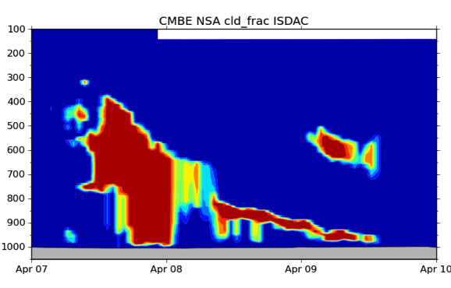
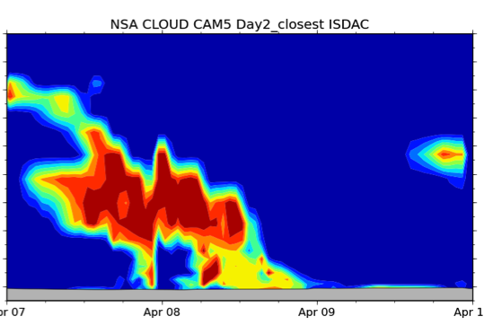
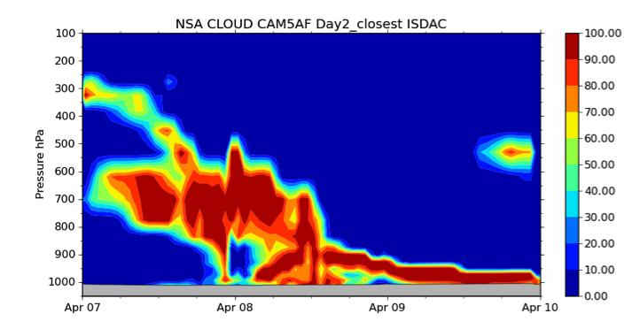
Cloud Parameterization (2)
3. Microphysics: modified to use the same subgrid PDF as used for macro; adds newly activated droplets at the beginning rather than end of microphysics for consistency with new condensate
ARSCL Obs Cloud Frac
CAM5 Cloud Frac
Cloud Frac w/activation fix
Fig: Activation fix improves low clouds on ISDAC “Golden Day” in 24-48 hr global forecast runs
Impact: changes increase supercooled liquid water, which increases downwelling LW radiation and reduces surface temperature bias
LWP Bias
(g/m²)
Surf LW↓ bias
(W/m²)
Surf T bias
(K)
Fig: Cloud changes improve bias relative to CAM5. Other colors are R-1, R-2, ERA-I, and GISS.
Ref: de Boer et al. 2014: Near-surface meteorology during the Arctic Summer Cloud Ocean Study (ASCOS): Evaluation of reanalyses and global climate models, Atmos. Chem. Phys., 14, 427-445, doi:10.5194/acp-14-427-2014.

Slide 13
Polar Project: LANL
Ocean/Cryosphere Summary
Phil Jones, Elizabeth Hunke, Nicole Jeffery, Adrian Turner, Matthew Hecht, Scott Elliott, Beth Wingate

Slide 14
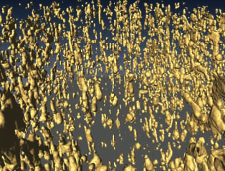
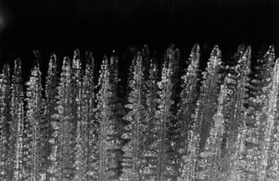
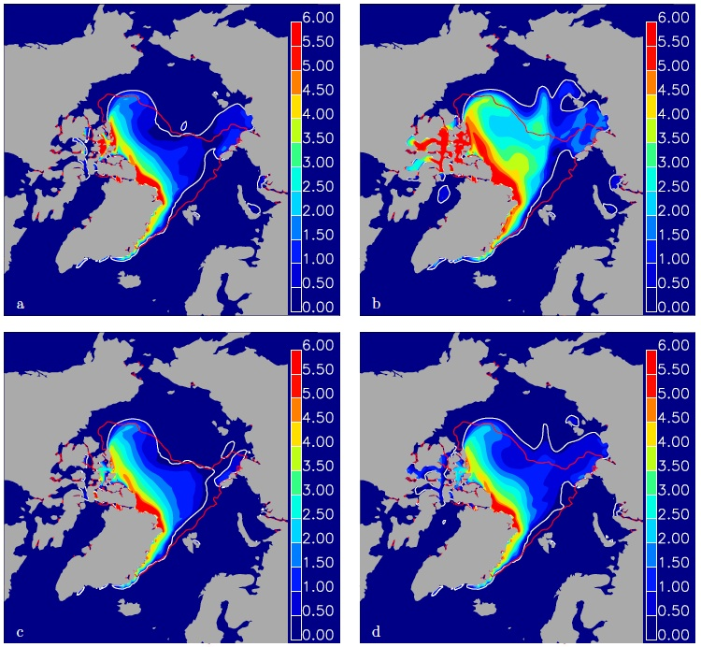
Cryosphere – Sea Ice
Multiphase (Hydrology)
  Addition of salinity transport, brine channels, mushy layer
  Flooding, melt ponds
  Snow-ice formation
CICE5 release
  Prognostic salinity, gravity drainage, mushy layer parameterization
  Two new melt pond parameterizations
  Improved snow-ice formation
  Transport of salt, other species (BGC)
Notes:
Bulk of the work in the Polar project was on a variety of physics related to multi-phase sea ice (flow of water and salt through brine channels in ice, surface melt ponds, etc.)

Slide 15
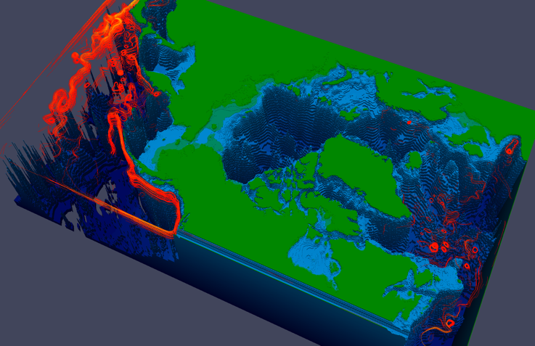
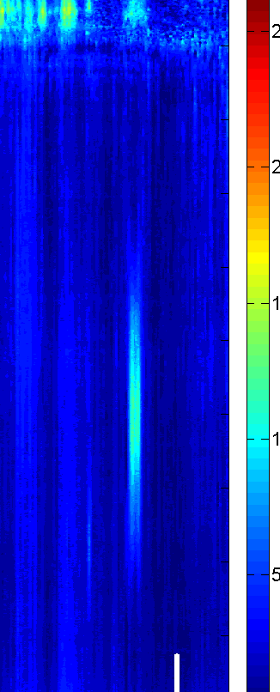
Arctic Ocean Characterization
Characterize eddies in Arctic
  New tools for extracting eddy information from simulations (with UV-CDAT project)
  Exploration of coherent structures from asymptotic analysis of Navier-Stokes
  Insight into potential time-splitting for Arctic dynamics
Work on new vertical coord
  Better ocean/ice coupling
  POP implementation for CESM
Notes:
Some work was done in analyzing ocean eddies in the Arctic. Work by Beth Wingate to investigate the structure of coherent Arctic features observed (figure is from buoy data showing a coherent eddy extending to large depths), also identified slow and fast modes in the same Arctic regime. Last bullet included one last modification to POP for CESM.

Slide 16
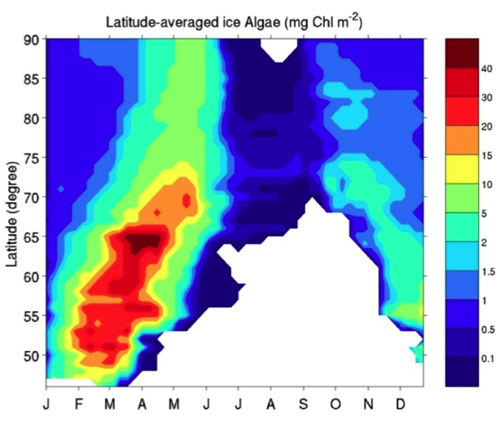
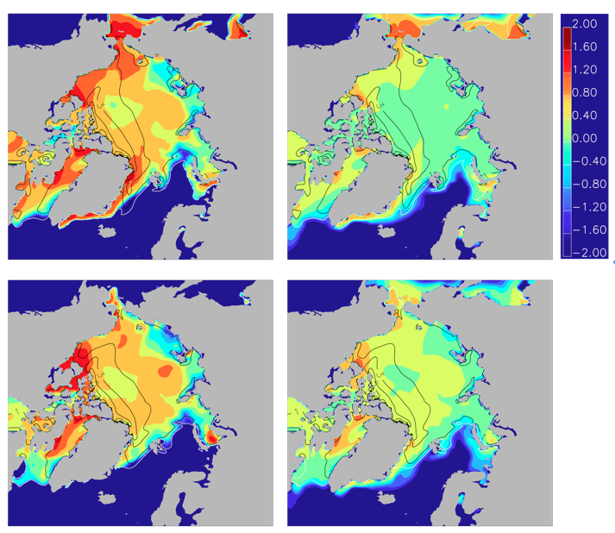
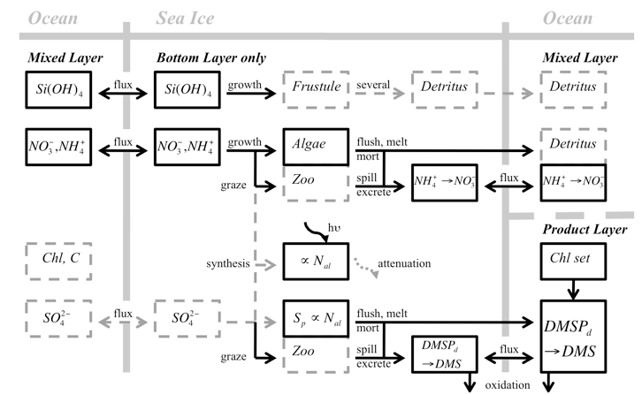
High-lat ocean/ice BGC
New CICE BGC
  Use new transport
  Added ice algal ecosystems
  CICE5
log₁₀Chl (l), mg/m² log₁₀DMS (r), nM
May 1992 (upper)
|June 1992 (lower)
Notes:
Added ice biogeochemistry to sea ice model to include ice algae an related ecosystems, including sulfur cycle/DMS

Slide 17
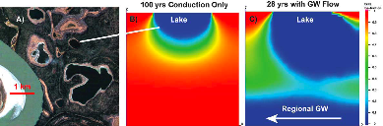
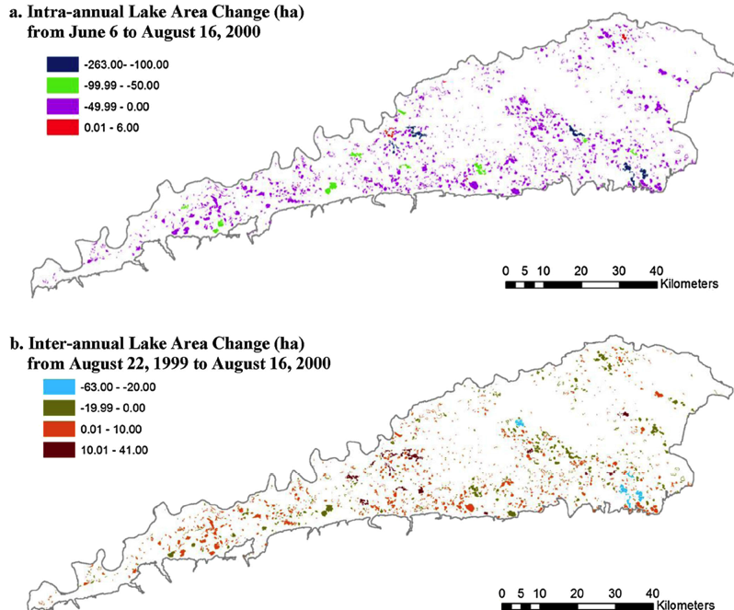
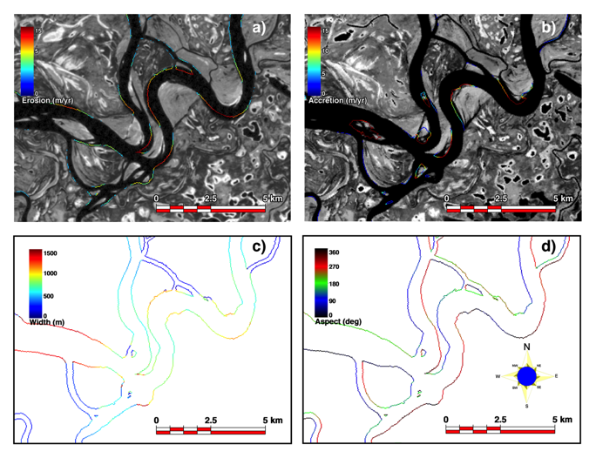
Land Processes
Permafrost melt
  Expansion of thermokarstic terrain
  Increase in river outflows
  Reduction in size, number of Arctic lakes
Surface, sub-surface hydrology
  Coupled groundwater/heat flow model (ARCHY)
Lake area in permafrost environment
  Natural variability at intra- and interannual scales exceeds long-term climate changes
River dynamics, fluxes to ocean
  First pan-Arctic assessment of river erosion, floodplain exchange, river planform
Joel Rowland – 2014 Early Career
Notes:
Top figure is subsurface model of heat, groundwater flow that can connect lake networks in permafrost regions,

Slide 18
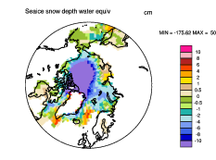
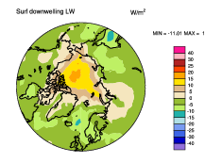
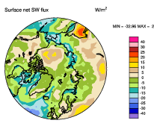
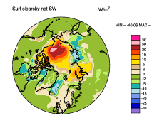
Summary
Decreasing
Snow
Increased
Downward
LW
Summary
Lots of progress
on parameterization development
Coupled runs are stable
  Improved fidelity of clouds and aerosols
  New capabilities in cryosphere & atmosphere
Studies providing insight on role of processes and forcing agents on climate features ranging from monsoons to NAO
Many of the parameterization improvements have been contributed to the CESM
Anticipate that most will be folded into the new ACME project
Increasing
Allsky SW
Increasing
Downward
Clear SW

