Slide 1
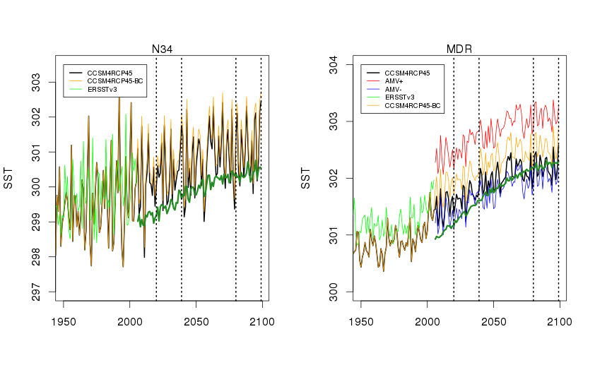
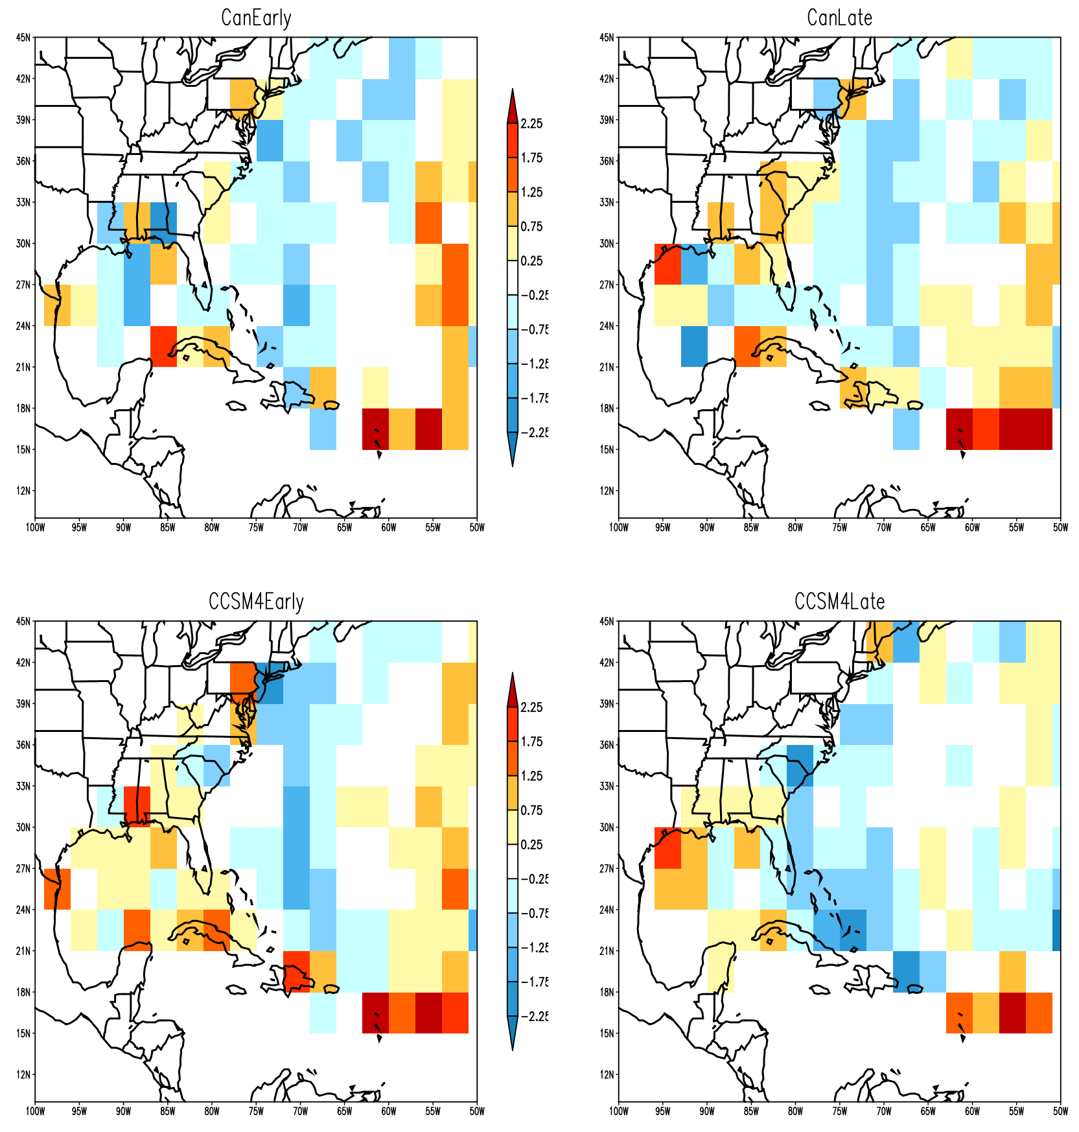
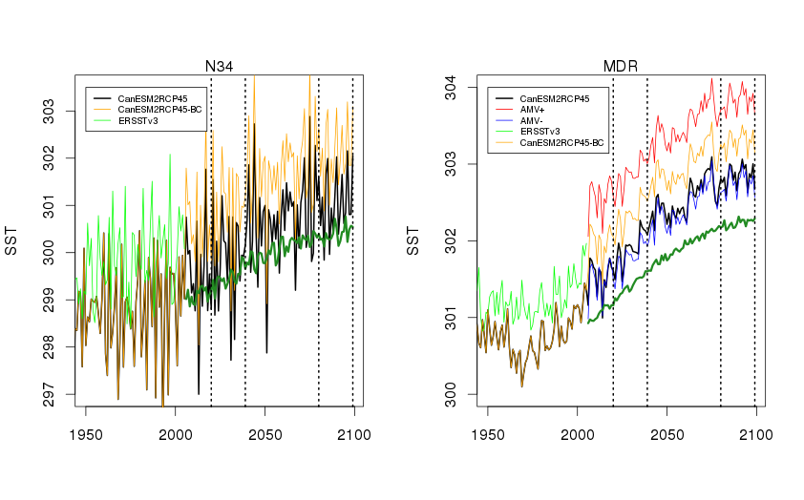
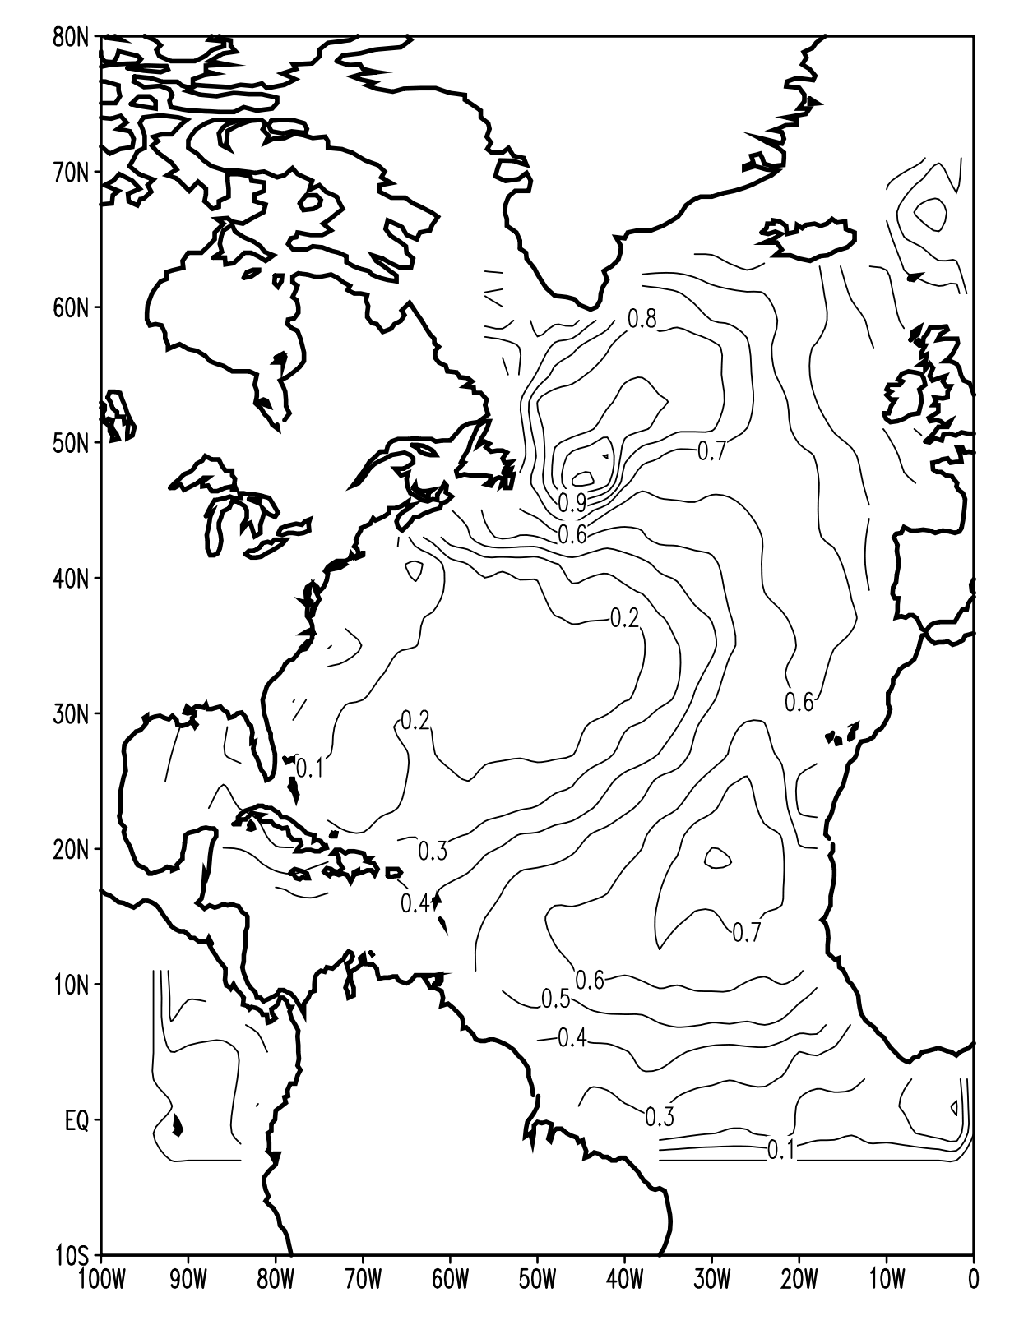
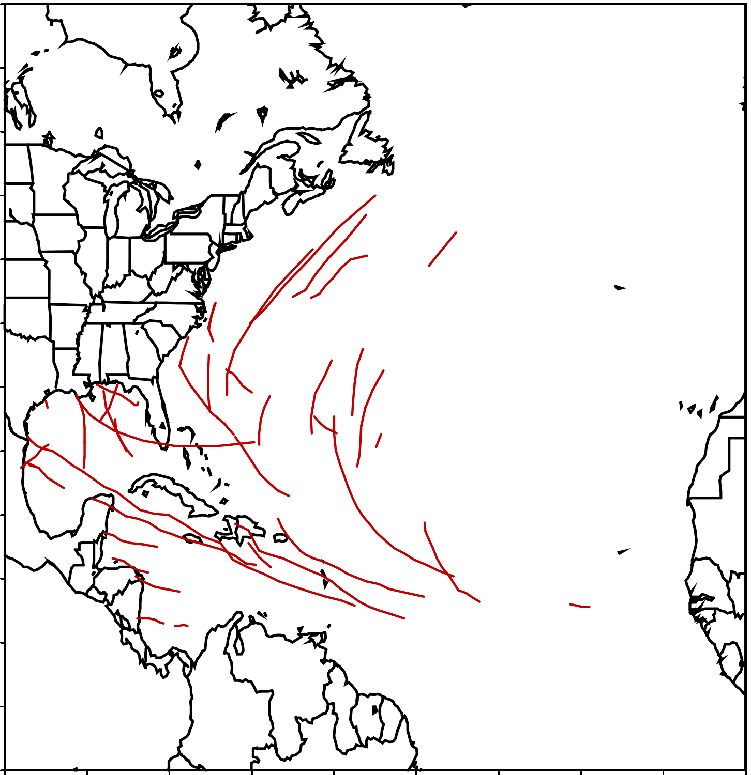
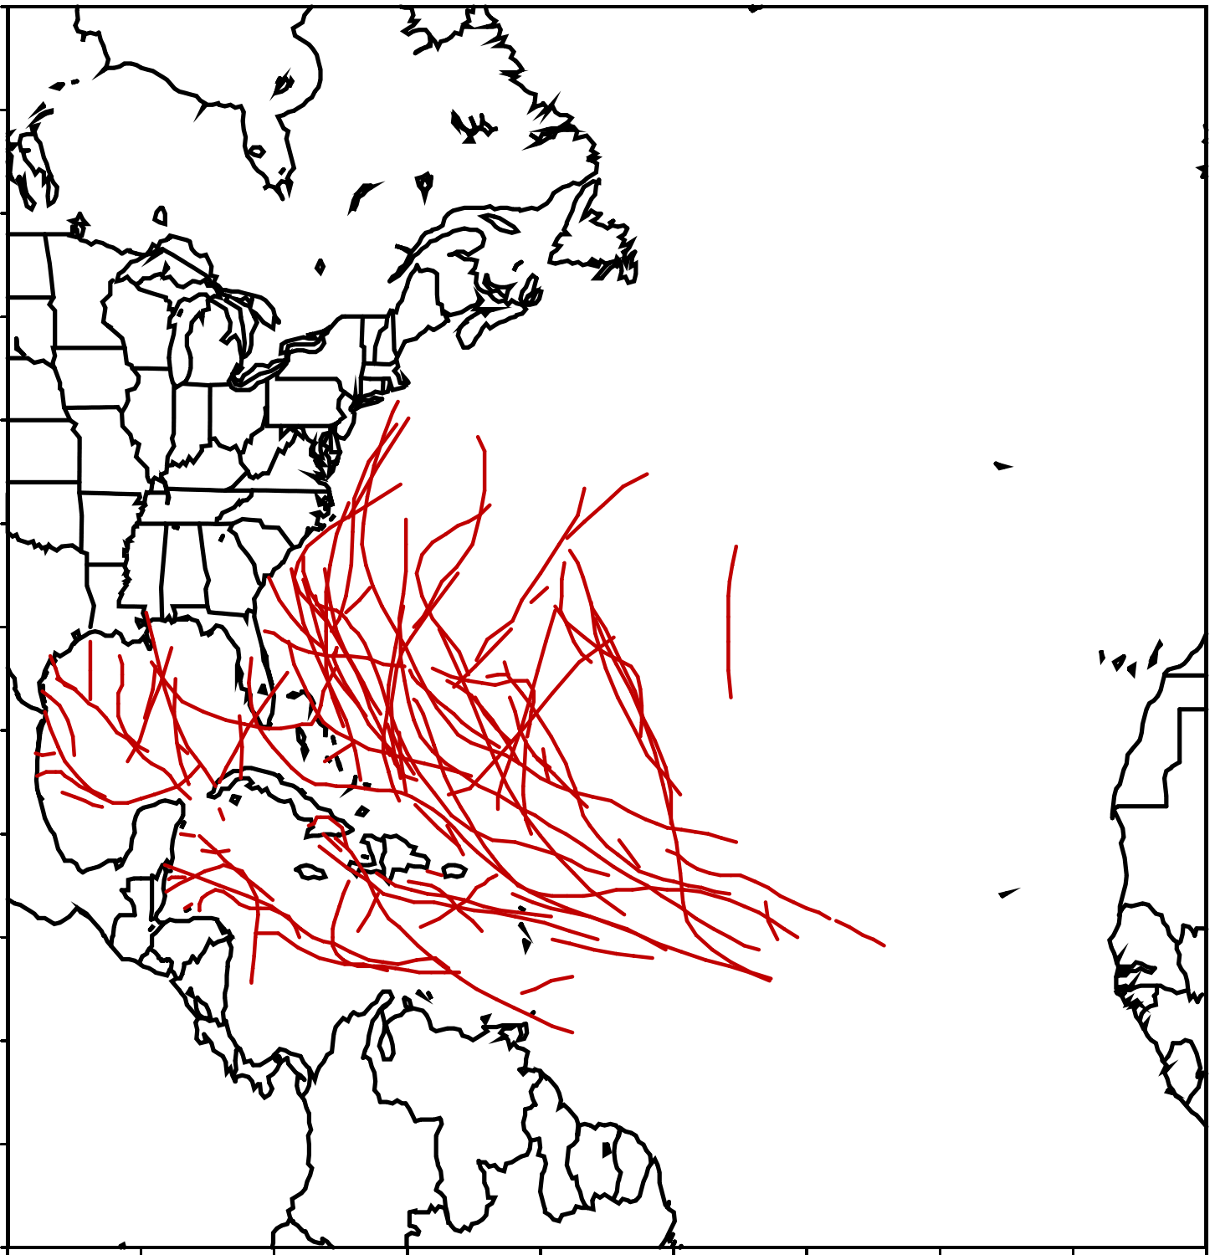
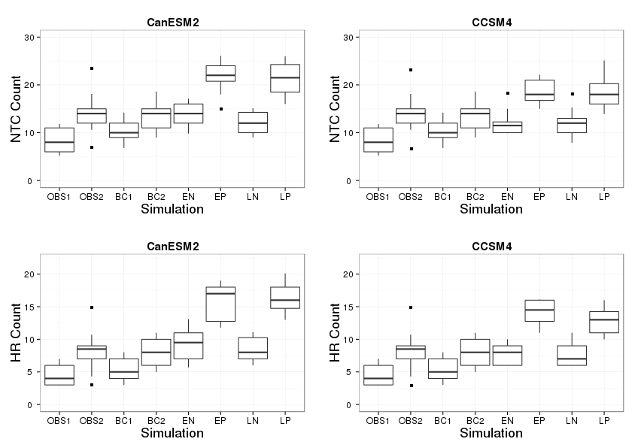
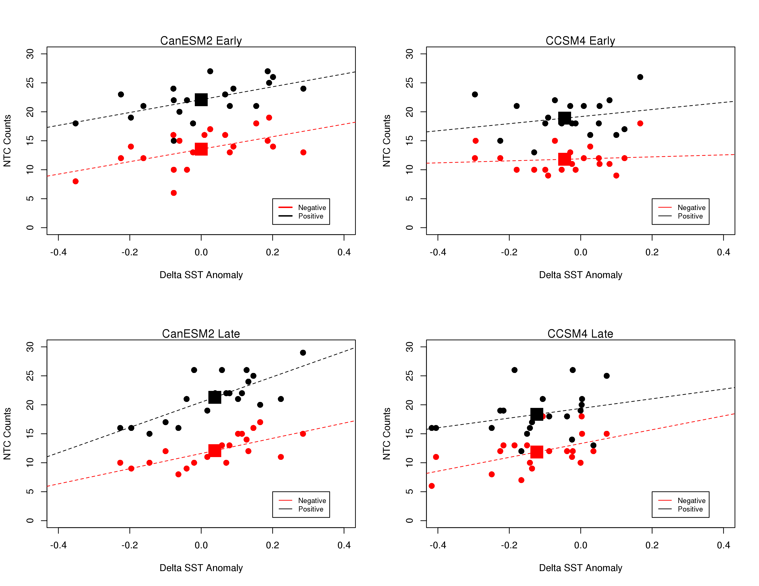
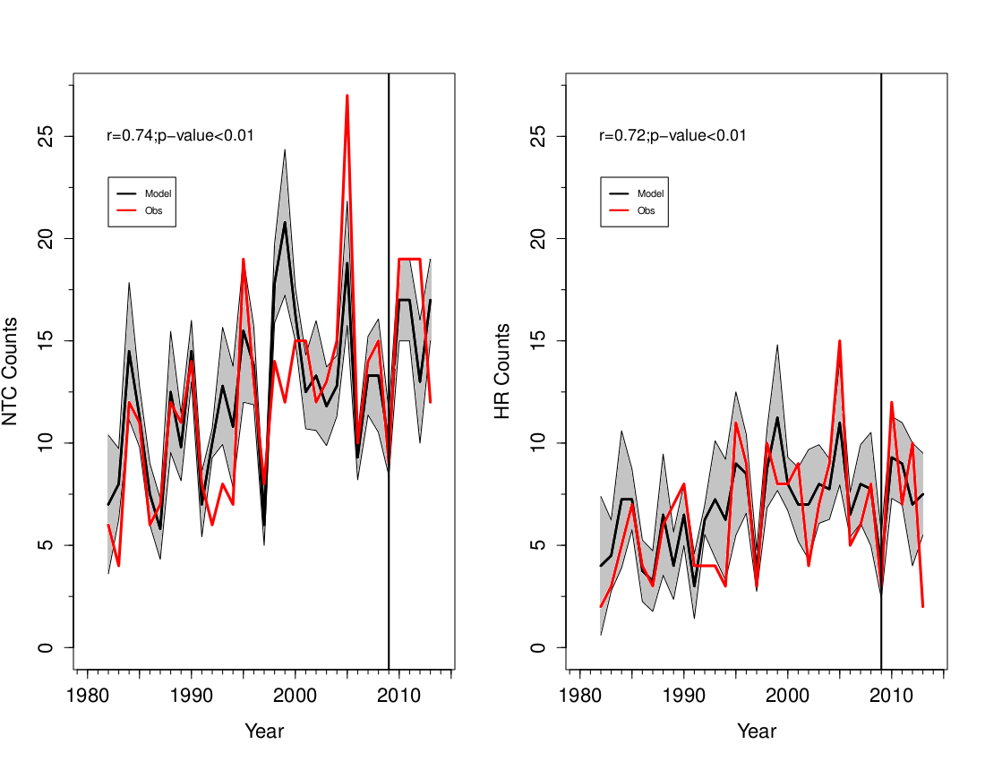
Dynamical Simulations in North Atlantic Tropical Cyclone Activity using Observed
Low-Frequency SST Oscillation Imposed on CMIP5 Model RCP4.5 SST Projections
Timothy LaRow*, Lydia Stefanova, Chana Seitz
Florida State University
(*email: tlarow@fsu.edu)
Abstract
CCSM4 and CanESM2 CMIP5 SSTs
Log₂ Track Density Differences
The effects on early and late 21st century North Atlantic tropical cyclone statistics resulting from imposing the patterns of maximum/minimum phases of the observed Atlantic Multidecadal Oscillation/Variability (AMO/AMV) onto projected sea surface temperatures (SSTs) from two Coupled Model Intercomparison Project 5 (CMIP5) climate models are examined using a 100-km resolution global atmospheric model. The AMV is thought to alter North Atlantic tropical cyclone activity through changes in the magnitude of the SST gradient. By imposing the observed maximum positive and negative phases of the AMV onto two CMIP5 SST projections from the RCP 4.5 scenario this study places bounds on future North Atlantic tropical cyclone activity. During the early (2020-2039) and late (2080-2099) twenty-first century the positive/negative AMV simulations combine to produce a statistically significant increase in the mean number of named tropical cyclones (NTCs) compared to simulations using observed SSTs from 1982-2009. The increase is approximately 35%. The positive AMV simulations produce approximately a 68% increase in mean NTC count while the negative AMV simulations are statistically indistinguishable from the mean NTC count calculated from the 1995-2009 simulations. Differences in the track densities show an increase in the number of landfalling storms along the east coast of the United States during the negative AMV phase; however, the positive AMV phase shows an increase in storms of higher intensity tracking closer to the U.S. coastline.
CCSM4
Figure 4: Mean ASO SST time series in the Niño-3.4 and main development region (MDR). Heavy black lines are the historical and RCP 4.5 simulation (not bias corrected) from CMIP5. Red lines show the SSTs for the AMV+ simulations; blue lines show the SSTs for the AMV- simulations. The orange line is the bias corrected time series. For reference, the green lines are the NOAA ERSSTv3b SSTs from 1940-2005. The vertical dashed lines bracket the two time periods of the study. Unit Kelvin.
Background - AMV and North Atlantic Tropical Cyclones
Year
CanESM2
Year
Figure 1: Positive AMV SST anomaly pattern added to the CMIP5 models for both the early and late 21st century simulations. Negative AMV SST anomaly pattern is identical to AMV positive pattern but multiplied by -1. Contour interval 0.1K.
Figure 6: Factorial changes in track densities (on 3° x 3° grid boxes) between the early and late 21st century CanESM2 and CCSM4 simulations with the current climate (BC1 and BC2) experiments. The technique used to calculate the factorial change is based on Strazzo et al. (2013). Track density is normalized using the total number of events over the domain. Plotted is the base-two logarithm of the normalized track densities divided by the normalized BC1 and BC2 track densities. CCSM4 shows more Gulf of Mexico landfalls while CanESM2 shows enhanced Southeast impacts.
Year
Year
Negative AMV
Positive AMV
Tropical Cyclone Counts
Relative SST Anomaly
r=0.57
r=0.54
r=0.24
r=0.09
r=0.74
r=0.69
r=0.28
r=0.51
Figure 2: Observed hurricane tracks (≥CAT3) from IBTrACS. Negative AMV (left). Positive AMV (right). Adapted from Goldenberg et al. 2001.
Figure 7: Scatter plots of relative ASO SST anomaly vs. NTC counts for early and late 21st century positive/negative AMV. Linear trend lines are dashed.
FSU Model and Previous Results
Conclusions
Named Tropical Cyclone Counts
Hurricane Counts
Figure 5: Boxplots of named tropical cyclone (NTC) counts and hurricane counts in the North Atlantic. (Top) NTC counts. (Bottom) Hurricane counts. In each box the thick horizontal line represents the median value, whiskers represent the 10th and 90th percentiles. OBS1(OBS2) denote the 1982-1994(1995-2009) values from the IBTrACS data. BC1(BC2) denote the 1982-1994(1995-2009) values using the OIv2 SSTs. The early 21st century negative (positive) AMV simulations are denoted as EN(EP) while the late 21st century negative (positive) AMV simulations are labeled LN (LP). Outliers (denoted by squares) are considered if they lie outside 1.5 times the inter-quartile range.
Mean NTC counts not statistically different between EN/LN and EP/LP
Approximately 68% increase in mean NTC counts during AMV+ phase compared to model’s average BC1 and BC2 simulations – occurs for both CCSM4 and CanESM2 SSTs
Approximately 72% increase in mean HR counts during AMV+ phase compared to model’s BC1 and BC2 simulations
Projected changes in mean HR counts during AMV- phase not statistically different than the model’s 1995-2009 mean
When averaged over both 20-year time periods and both AMV phases the mean HR count from the CCSM4 SST simulations yield a 24% increase compared to BC2 while the CanESM2 SST simulations yield a 43% increase
Projecting the observed max/min phase of the AMO/AMV phases onto the CCSM4 and CanESM2 CMIP5 RCP4.5 SSTs produced statistically significant changes in North Atlantic tropical cyclone activity in the FSU climate model (Figure 5).
Using the max/min AMV phases to bracket the level of hurricane activity in the 21st century, shows that in a below average season, the frequency will be similar to the high level of activity seen since 1995 (Figure 5).
CCSM4 shows more Gulf of Mexico landfalls while CanESM2 shows enhanced Southeast impacts (Figure 6).
Relative SST anomaly best predictor for NTC counts in CanESM2 simulations and Nino-3.4 SSTs best predictor in CCSM4 simulations (Figure 7).
5.4 Model
4.6 Obs
7.8 Model
7.7 Obs
10.1 Model
8.6 Obs
14.2 Model
14.7 Obs
Acknowledgements
Figure 3: Predicted North Atlantic seasonal tropical cyclone counts using the FSU global atmospheric model. Seasonal named tropical cyclone counts – includes tropical storms and hurricanes (left). Hurricane strength storms (right). Red line (observed IBTrACS), black line (ensemble mean), shaded area is the spread of the ensemble. CFSv1/v2 predicted June 1 SSTs used as boundary conditions. LaRow (2013).
Research supported by grant from the Office of Science (BER), U.S. Department of Energy and the NOAA’s Climate Program Office. We acknowledge the World Climate Research Programme’s Working Group on Climate Modelling, which is responsible for CMIP, and we thank the climate modeling groups for producing and making available their model output. For CMIP the U.S. Department of Energy’s Program for Climate Model Diagnosis and Intercomparison provides coordinating support and led development of software infrastructure in partnership with the Global Organization for Earth System Science Portals.
References
Goldenberg, S. B., C. W. Landsea, A. M. Mestas-Nunez, and W. M. Gray, 2001: The recent increase in Atlantic hurricane activity: Causes and implications. Science, 293, 474–479.
LaRow, T. E., 2013: The impact of SST bias correction on North Atlantic hurricane retrospective forecasts. Mon. Wea. Rev., 141, 490-498.
Strazzo, S., J. B. Elsner, T. LaRow, D. J. Halperin, and M. Zhao, 2013: Observed versus GCM- generated local tropical cyclone frequency: Comparisons using a spatial lattice. J. Climate, 26, 8257–8268.

