Slide 1

Diagnosing and Improving the Characteristics of Atmospheric Model Dynamical Cores via Idealized Test Cases
Christiane Jablonowski, Richard Rood, James Kent, Diana Thatcher,
Weiye Yao, Colin Zarzycki (University of Michigan)
Jared P. Whitehead (Brigham Young University)
Peter Lauritzen, Kevin Reed, Ram Nair (NCAR)
Paul A. Ullrich (University of California Davis)
Mark Taylor (Sandia National Laboratories)
DoE PI Meeting, Potomac, 5/14/2014

Slide 2
Disclaimer: Idealized Test Cases
Dry and moist idealized dynamical core test cases have the ability to mimic the complex behavior of the full atmosphere
  This makes them relevant
They give easier access to an improved understanding of the circulation and our modeling choices (numerical schemes, grids, time steps, monotonicity constraints, etc.)
This provides the scientific basis for the Dynamical Core Model Intercomparison Project (DCMIP)

Slide 3





The Ideas behind the Dynamical Core Model Intercomparison Project (DCMIP)
Launched in 2012 with a 2-week summer school (at NCAR)
DCMIP-2012 highlighted the newest test cases and modeling techniques for the dynamical cores of atmospheric GCMs
DCMIP-2012 paid special attention to emerging non-hydrostatic dynamical cores
Hosted 18 participating dynamical cores (3 remote groups)
Introduced gateway for the (virtual) global community:
Sponsors:
http://earthsystemcog.org/projects/dcmip-2012/

Slide 4
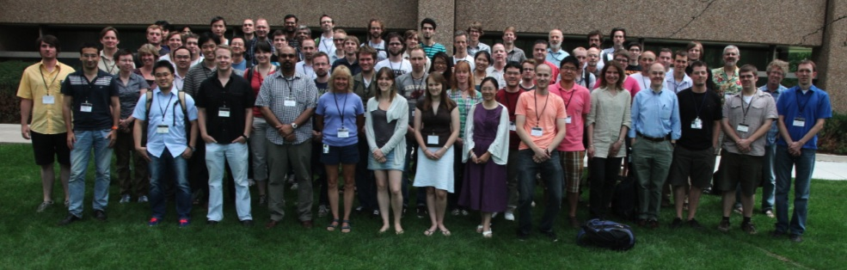
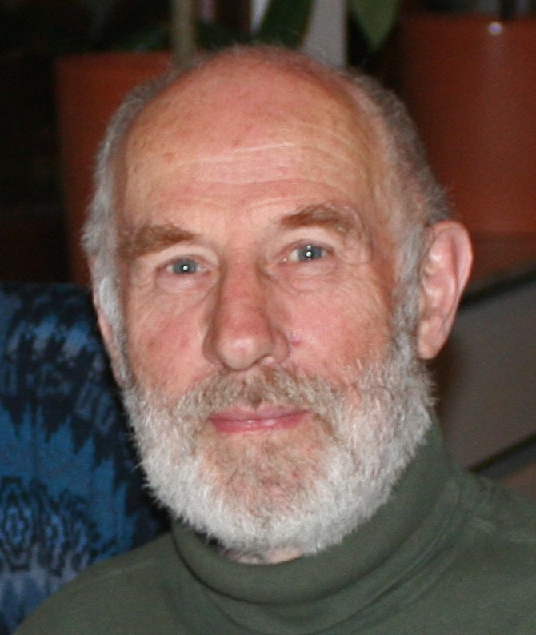
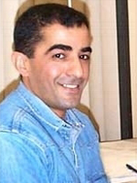
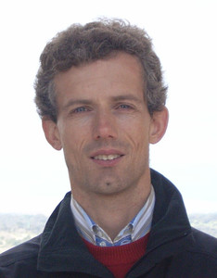









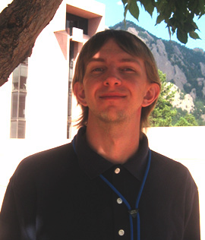
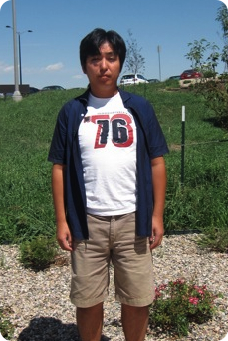
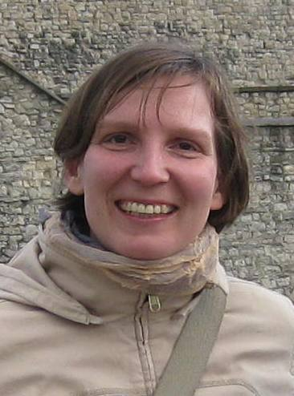





DCMIP-2012 Participants & Mentors

Slide 5
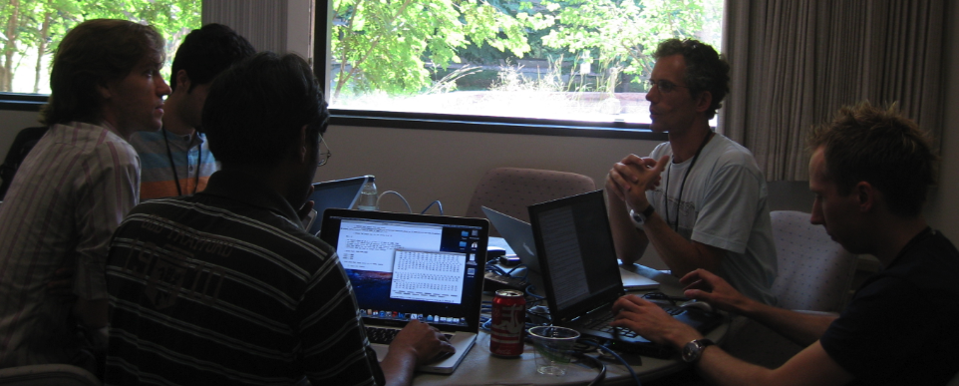
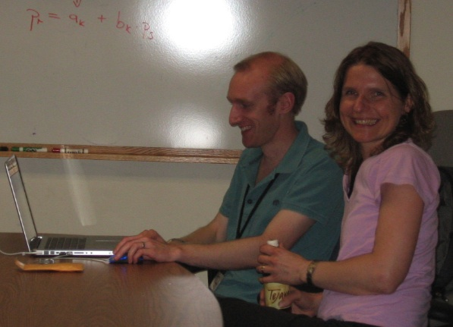
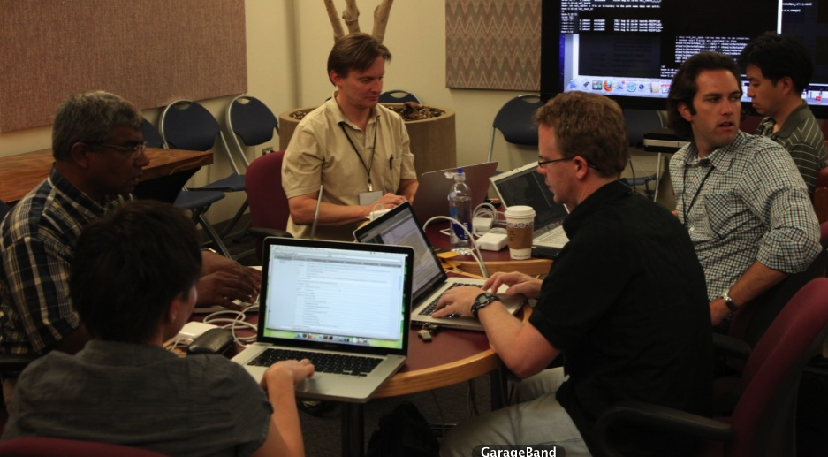
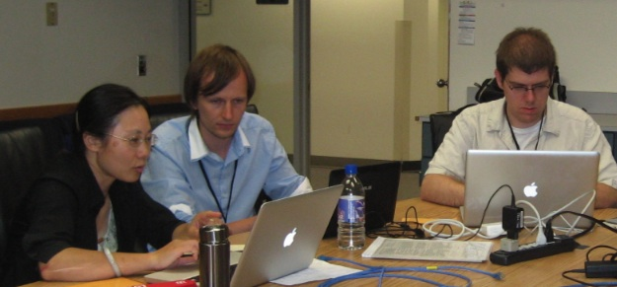
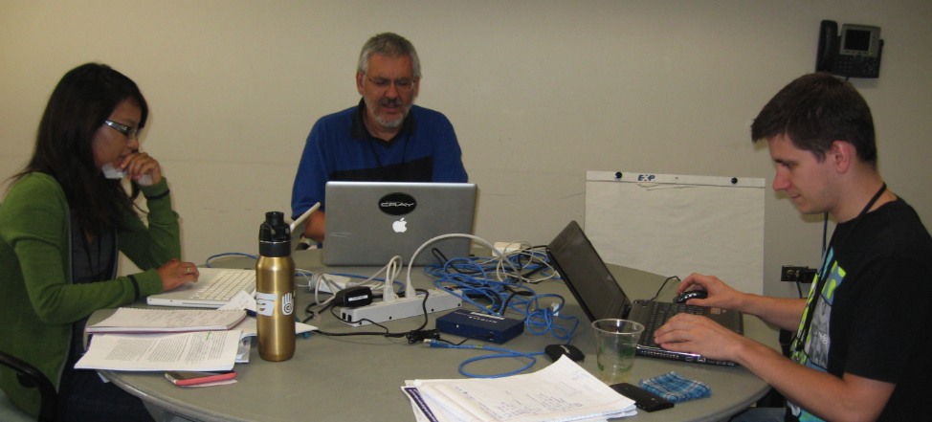
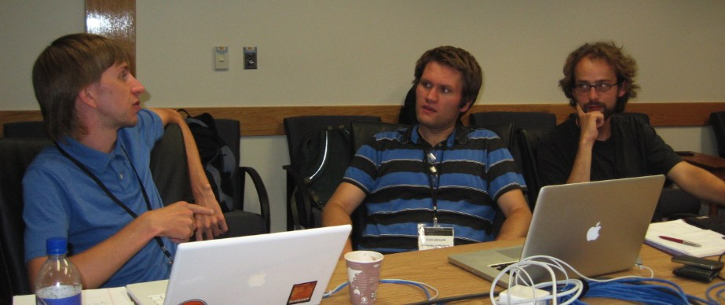
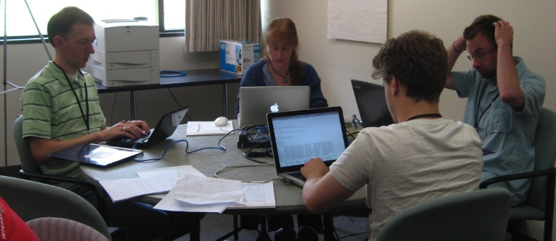
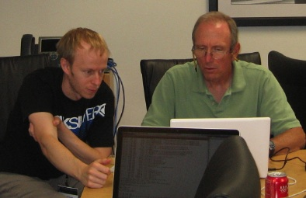
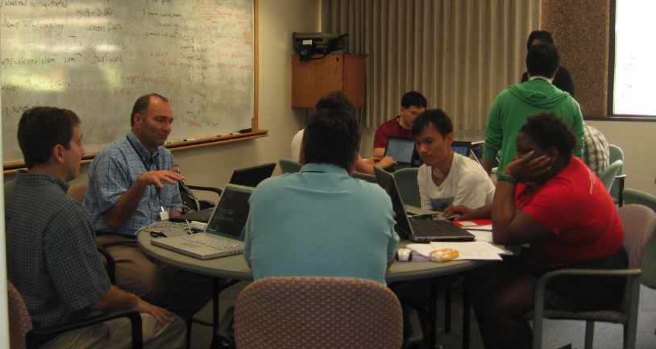
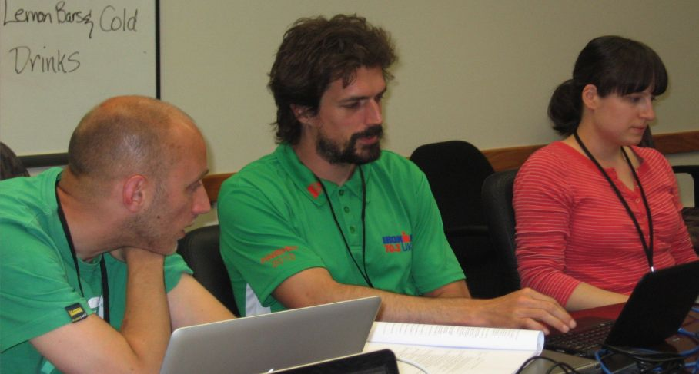
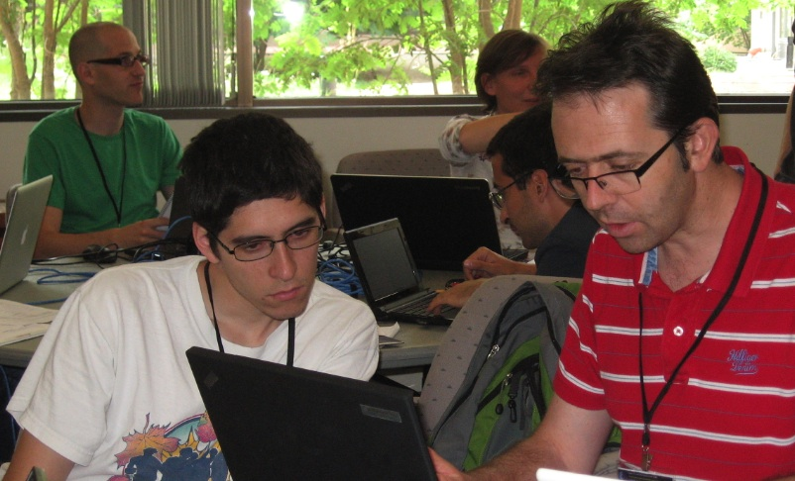
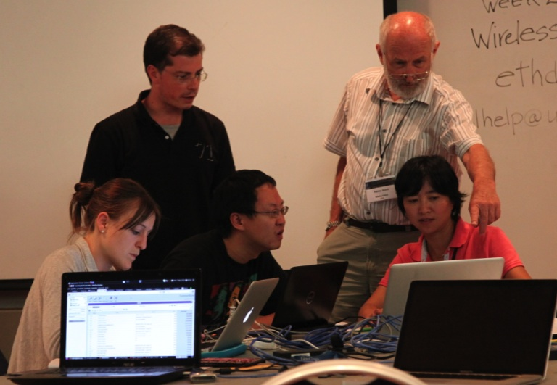


DCMIP-2012
ICON-MPI-DWD
CAM-FV
MCORE
CAM-SE
MCORE
UZIM
MPAS
IFS
FV3-GFDL
OLAM
OLAM
ICON-IAP
DYNAMICO
ENDGame
FIM
FIM
NICAM
NIM

Slide 6
Idealized Test Cases: Goals and Wish-List
Test cases should
be designed for hydrostatic and non-hydrostatic dynamical cores on the sphere,
ideally: for both shallow and deep atmosphere models
be easy to apply: analytic initial data (if possible)
suitable for all grids
formulated for different vertical coordinates
be as easy as possible, but as complex as necessary
be cheap and easy to evaluate: small Earth, standard diagnostics
be relevant to atmospheric phenomena
reveal important characteristics of the numerical scheme
have an analytic solution or converged reference solutions
deal with moisture in a simple way
find broad acceptance in the modeling community

Slide 7
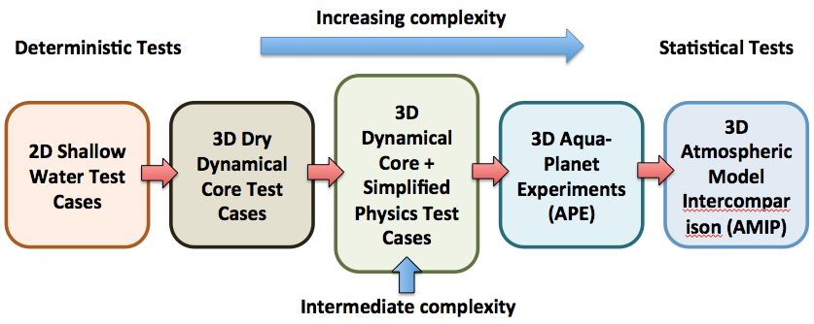
DCMIP: Test Case Hierarchy with Increasing Complexity
DCMIP

Slide 8
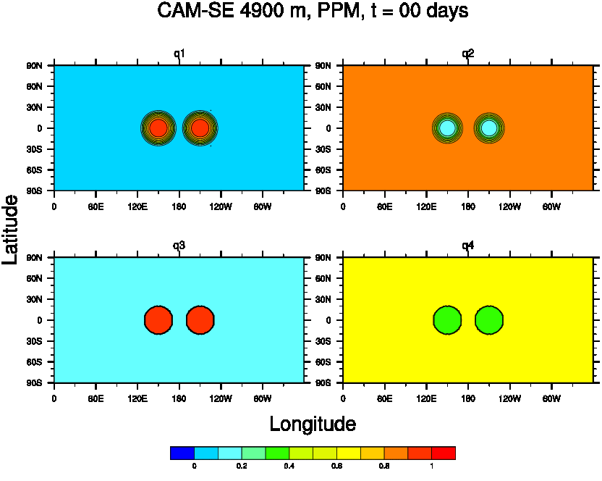

DCMIP-2012: 3D Advection Tests

Slide 9
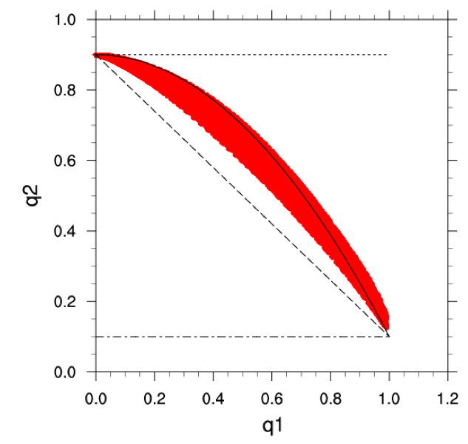
3D Advection: Deformational Flow
Correlated tracers q1 & q2: Mixing diagnostics at day 6
CAM-FV
FV3-GFDL
Functional
relationship
between q1
and q2
CAM-SE
ENDGame
IFS
CAM-SE
dx= 110 km, dz = 200 m

Slide 10
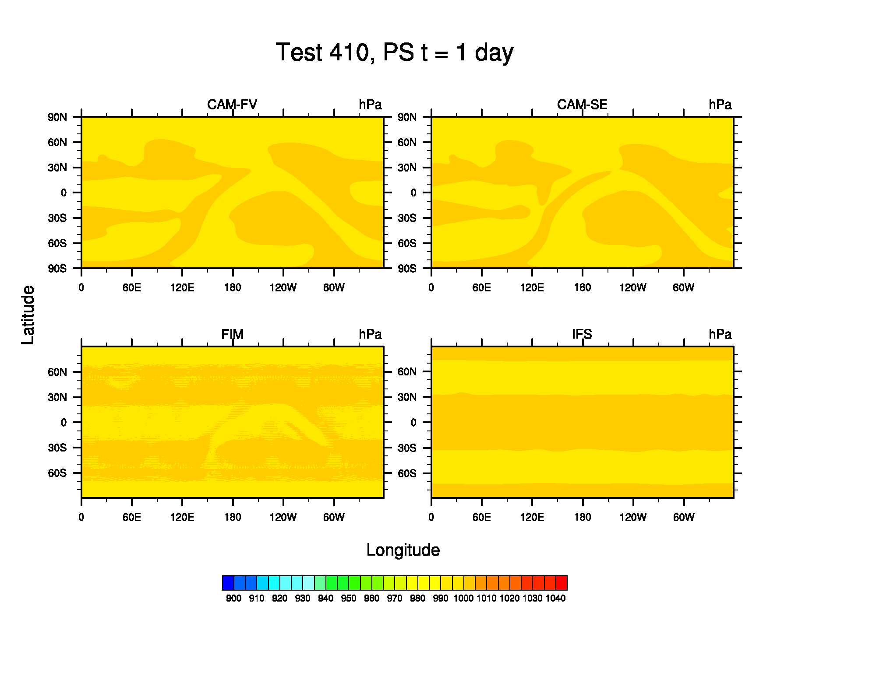
Baroclinic Wave: Surface pressure
Baroclinic wave, evolution of the surface pressure
(30-day animation)
strong grid
imprinting,
interferes
with baroclinic
wave
Jablonowski and
Williamson (QJ, 2006)
dx=110 km
1°x1°L30
p_{s} (hPa)

Slide 11
Baroclinic Wave: Diffusive Properties
Kinetic energy spectra in dry baroclinic wave simulations with
different dynamical cores reveal the diffusive properties of complex
CAM5 aqua-planet experiments: Relevant & Inexpensive

Slide 12
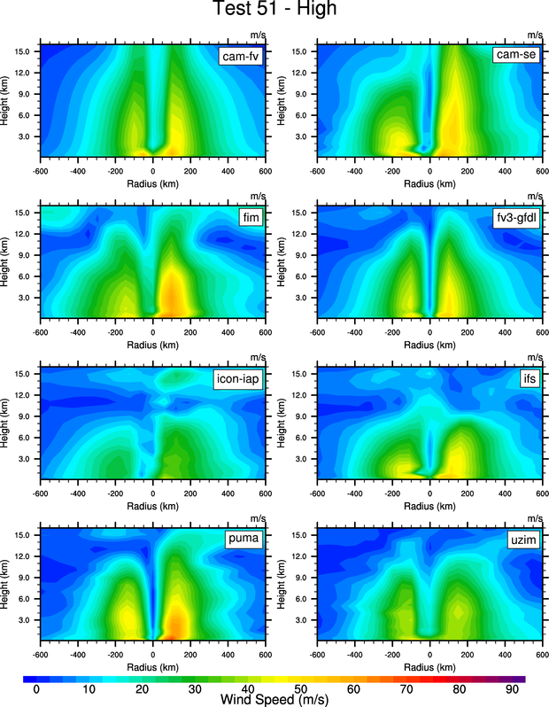
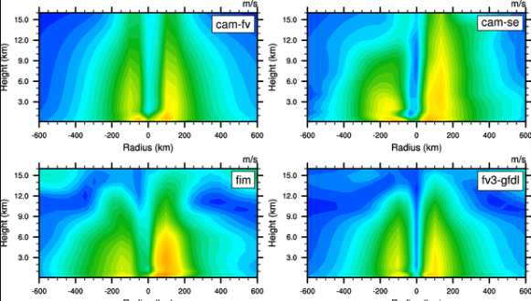
Idealized TC on an aqua-planet: Simulations with Simple-Physics
Extreme Storms: Tropical Cyclones (TC)
Adding simple moisture processes is a ‘game changer’
CAM-FV
CAM-SE
FIM
FV3
Height (km)
Height-longitude cross
section of the wind
speed (m/s) at day 10:
wide spread in results
PUMA
UZIM
Reed and Jablonowski (MWR, 2011)
Reed and Jablonowski (James, 2012)
0.5° x 0.5° L30, dx = 55 km

Slide 13
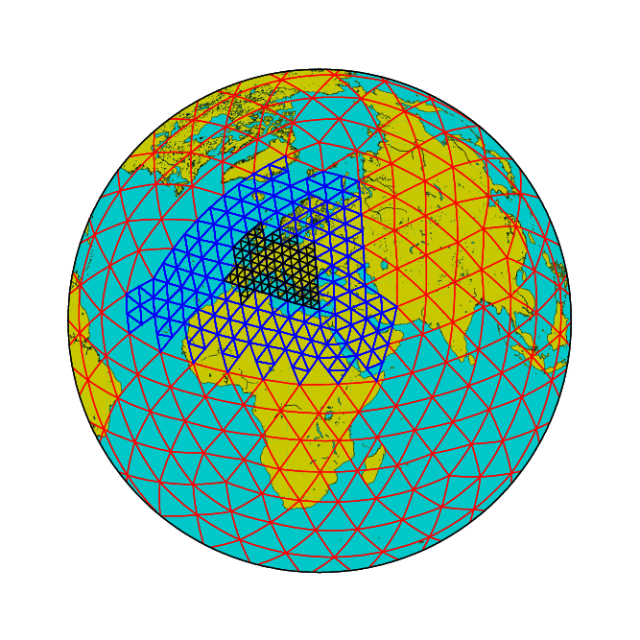
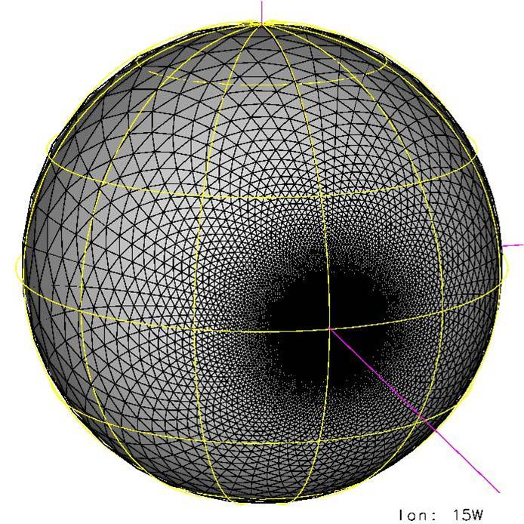
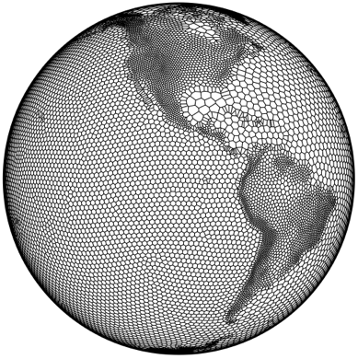
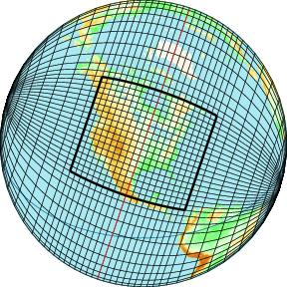
DCMIP-2016?
Test new modeling designs: Nonhydrostatic models with optional variable-resolution static grids or Adaptive Mesh Refinements (AMR)

Slide 14
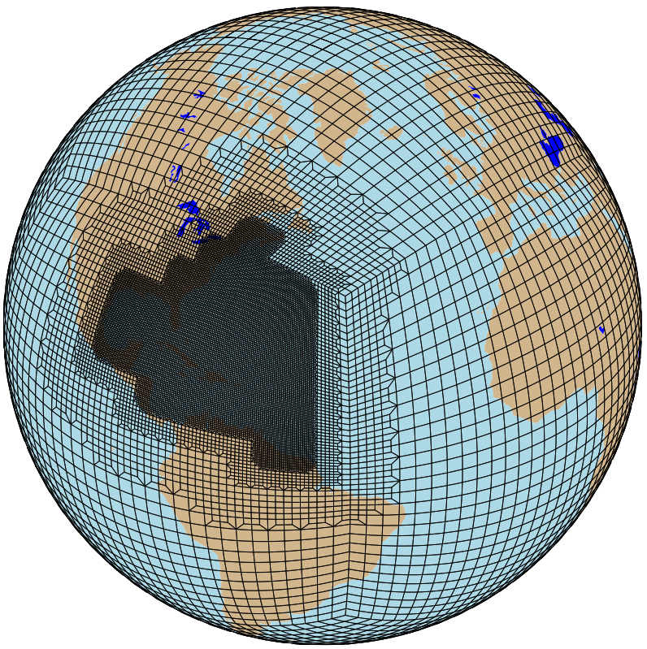
DCMIP: Some Emerging Frontiers
Testing of variable-resolution GCMs
In-depth look at the vertical direction:
  Impact of vertical grid spacing
  High model tops (impact of a resolved stratosphere)
  Consistency between horizontal and vertical resolutions, especially for small Δx, Δy grid spacings
Pressure-gradient force (PGF) errors
Behavior near (steep) topography, spurious mixing
(Simple) moist interactions
(Simple) long-term “climate-like” evaluations

Slide 15
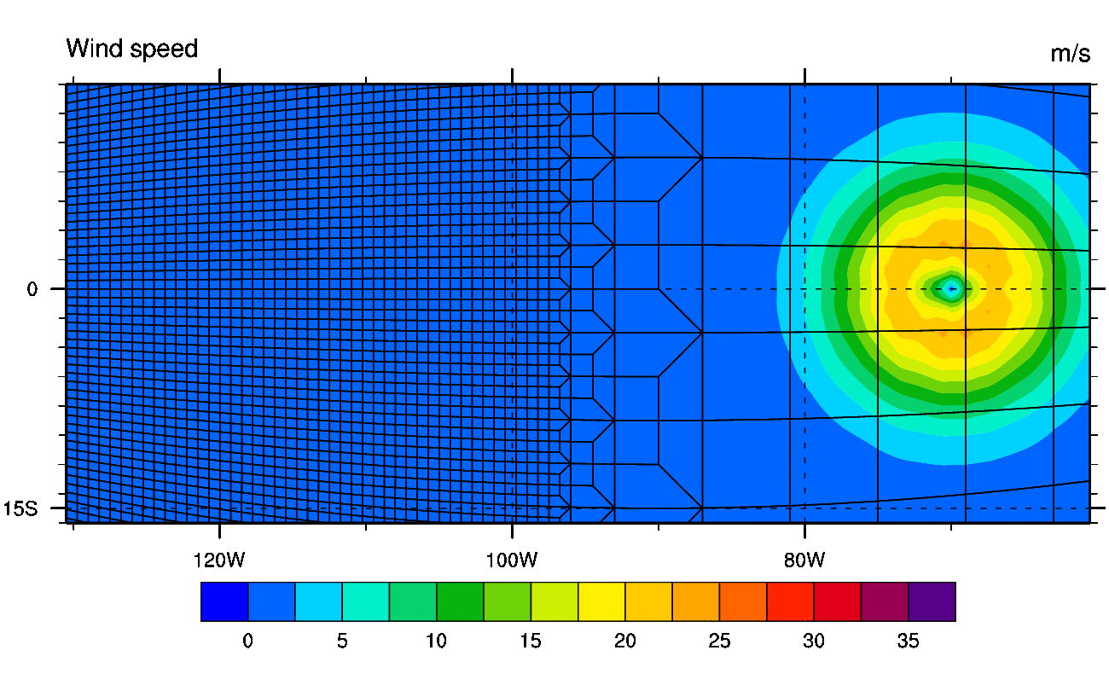
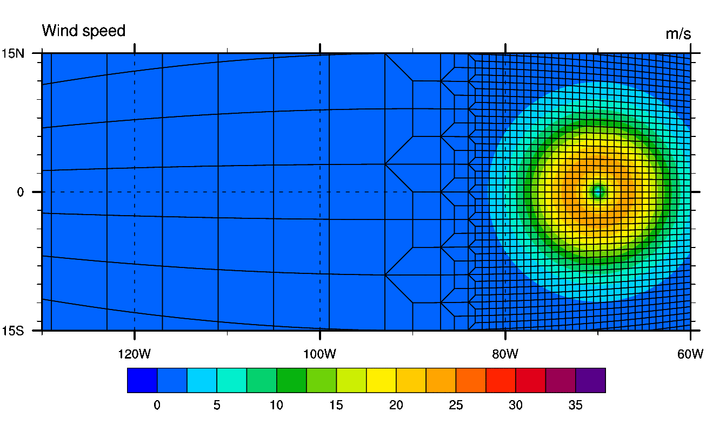
Variable-Resolution: Grid Transition Tests
850 hPa
wind speed
  Low to high transition
  Are there effects/reflections in the
  grid transition area? Translation of a dry tropical cyclone like
  vortex on a
  non-rotating Earth
  High to low transition
Zarzycki et al. (MWR, 2014)
Zarzycki et al. (J. Climate, 2014)
at 850 hPa

Slide 16
Accuracy of the Pressure Gradient Force (PGF) in CAM-SE
Steady-state with stratified thermal structure (constant lapse rate):
Spurious vertical pressure velocity in the presence of topography
Finite-difference
with 30 levels
Floating Lagrangian
with 30 levels
Floating Lagrangian
with 30 levels
Floating Lagrangian
with 60 levels
Big errors
Better numerics:
Errors reduced
Higher and steeper mountain:
Error almost insensitive to increased
vertical resolution

Slide 17
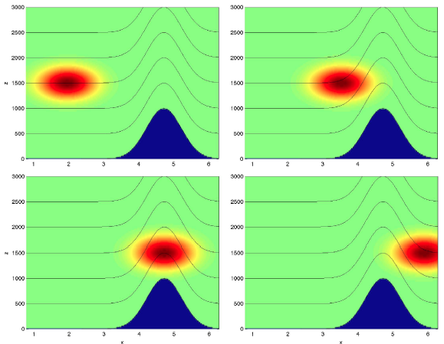
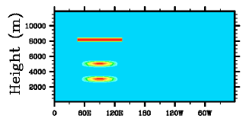
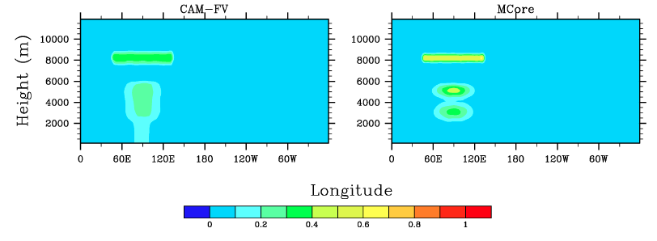
Horizontal Advection over Topography
Initial state: 3 idealized tracers
Wind blows them in the zonal direction
Example results: Expose spurious mixing
Initial state is analytic solution
Strong
numerical
mixing
Reduced
numerical
mixing

Slide 18
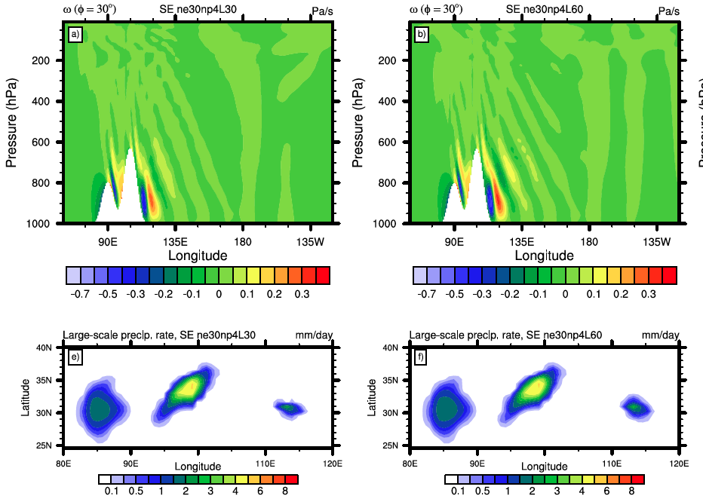
Vertical velocity and Topographic Precipitation: Impact of Vertical Resolution
Vertical
pressure
velocity
at day 5
CAM-SE (110kmL30)
CAM-SE (110kmL60)
30 levels
60 levels
Stronger
gravity waves
Large-scale
condensation

Slide 19
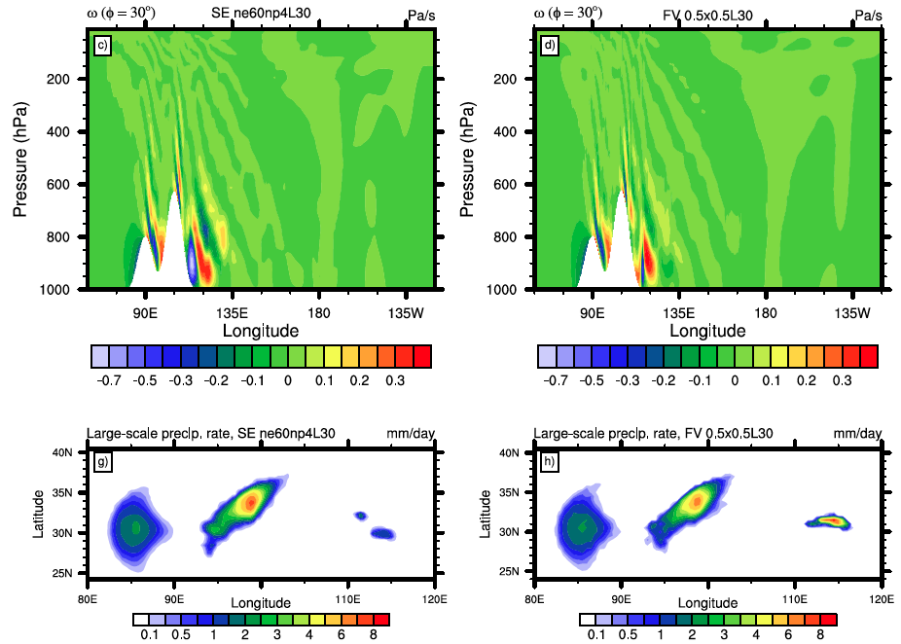
Vertical velocity and Topographic Precipitation: Impact of the Dynamical Core
Vertical
pressure
velocity
at day 5
CAM-SE (55 km L30)
CAM-FV (55 km L30)
Big differences
Large-scale
condensation
at day 5

Slide 20
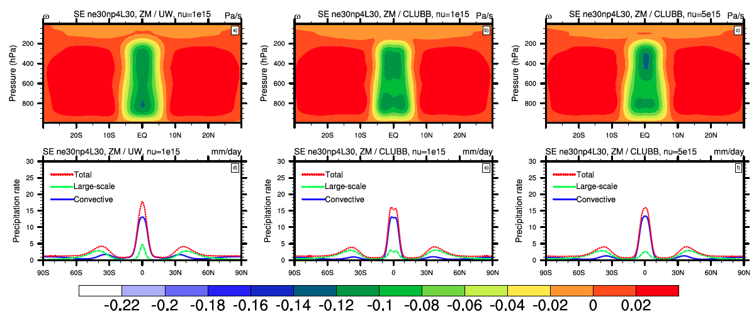
Single/Double ITCZ: Aqua-planet tests
Impact of physical parameterizations and explicit (K₄) diffusion on tropical precipitation, CAM-SE (110kmL30)
Default: ZM/UW
ZM/CLUBB, standard diffusion
ZM/CLUBB, increased diffusion
ω
1 x K₄
ω
1 x K₄
ω
5 x K₄
Double ITCZ
Single ITCZ
Precip.
Precip.
Precip.
See also poster 220, room 21 (Zarzycki et al.)

Slide 21
Thoughts & Conclusions
Dry and moist idealized dynamical core test cases mimic the complex behavior of the full atmosphere
  This makes them relevant
They give easier access to an improved understanding of the circulation and our modeling choices (numerical schemes, grids, time steps, monotonicity constraints, subgrid-scale mixing, …)
This provides a hierarchical test bed for rapid (inexpensive) model component tests and improvements

Slide 22
References
Reed, K. A., and C. Jablonowski (2011a), An analytic vortex initialization technique for idealized tropical cyclone studies in AGCMs, Mon. Wea. Rev., 139, 689–710
Reed, K. A., and C. Jablonowski (2011b), Impact of physical parameterizations on idealized tropical cyclones in the Community Atmosphere Model, Geophys. Res. Lett., 38, L04 805
Reed, K. A., and C. Jablonowski (2011c), Assessing the Uncertainty of Tropical Cyclone Simulations in NCAR’s Community Atmosphere Model, J. Adv. Model. Earth Syst., 3, M08002, 16, doi:10.1029/2011MS000076.
Reed, K. A., and C. Jablonowski (2012), Idealized tropical cyclone simulations of intermediate complexity: a test case for AGCMs, J. Adv. Model. Earth Syst., Vol. 4, M04001, doi:10.1029/2011MS000099
Kent, J., P. A. Ullrich and C. Jablonowski (2014), Dynamical Core Model Intercomparison Project: Tracer Transport Test Cases, Quart. J. Roy. Meteorol. Soc., in press
Zarzycki, C. M., C. Jablonowski and M. A. Taylor (2014), Using Variable Resolution Meshes to Model Tropical Cyclones in the Community Atmosphere Model, Mon. Wea. Rev., Vol. 142, 1221-1239
Yao, W. and C. Jablonowski (2013), Spontaneous QBO-like Oscillations in an Atmospheric Model Dynamical Core, Geophys. Res. Lett., Vol. 40, 3772-3776, doi:10.1002/grl.50723

Slide 23
References
Jablonowski, C., P. H. Lauritzen, R. D. Nair and M. Taylor (2008), Idealized test cases for the dynamical cores of Atmospheric General Circulation Models: A proposal for the NCAR ASP 2008 summer colloquium, Technical Report May/29/2008 (download at http://esse.engin.umich.edu/groups/admg/publications.php)
Jablonowski, C., and D. L. Williamson (2006), A Baroclinic Instability Test Case for Atmospheric Model Dynamical Cores, Quart. J. Roy. Met. Soc., Vol. 132, 2943-2975
DCMIP shared workspace and DCMIP test case document:
http://earthsystemcog.org/projects/dcmip-2012/
Whitehead, J., C. Jablonowski, J. Kent and R. B. Rood (2014), Potential vorticity: Measuring consistency between GCM dynamical cores and tracer advection schemes, Quart. J. Roy. Meteorol. Soc., in review
Lauritzen. P. H. and J. Thuburn (2012): Evaluating advection/transport schemes using interrelated tracers, scatter plots and numerical mixing diagnostics. Quart. J. Roy. Meteor. Soc., Vol. 138, 906–918, DOI:10.1002/qj.986
Ullrich, P. A., T. Melvin, C. Jablonowski and A. Staniforth (2014), A baroclinic wave test case for deep- and shallow-atmosphere dynamical cores, Quart. J. Roy. Meteorol. Soc., in press

