Slide 1
Perspectives on Climate Change Impacts, Adaptations, and Vulnerabilities (IAV)
Tom Wilbanks
Oak Ridge National Laboratory
2014 Climate Modeling PI Meeting,
U.S. Department of Energy, Office of Science
12 May 2014

Slide 2
In 2007, the Integrated Assessment Research Program of the DOE Office of Science Began Expanding its Scope to Include Energy Sector Impacts and Adaptations (IAV):
Because it was becoming clear that climate change impacts would shape future energy pathways and trajectories of technology choices
To be linked with and contribute to Integrated Assessment Modeling (IAM)

Slide 3
Major Emphases in IAV Science and Tool Development In Recent Years Have Included (I):
Particular attention to energy infrastructures related to both supply and demand
Growing attention to interconnections between energy infrastructures and other infrastructures, especially water
Growing attention to climate-related extreme weather events as well as longer-term climate change

Slide 4
Major Emphases in IAV Science and Tool Development In Recent Years Have Included (II):
Adding capacities for IAV modeling and analysis to simulate changes in future driving forces: e.g., socioeconomic scenarios, changes in population distribution, technological change
Increasing attention to integrated assessment research at regional and more local scales as well as the national scale

Slide 5
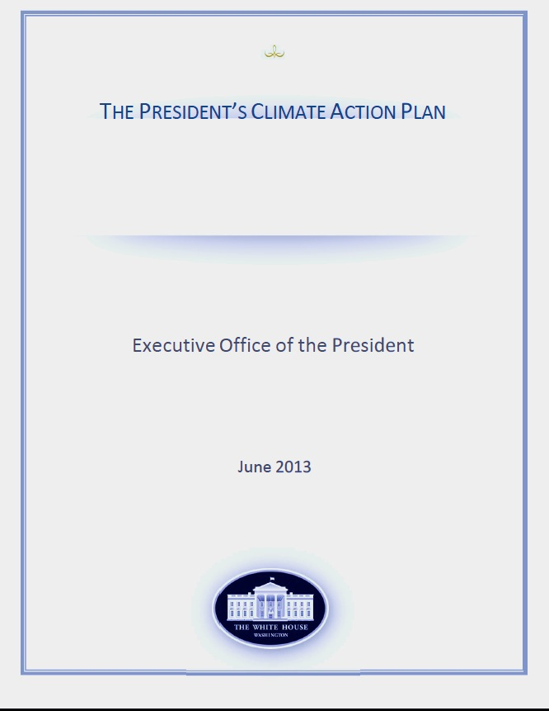
This Science and Tool Development Is Directly Relevant to a Number of Current DOE Priorities:
Concerns about vulnerable energy supply and use infrastructures since Superstorm Sandy
Particular concerns about energy-water linkages: e.g., WETT
The Quadrennial Energy Review (QER):
  Climate preparedness and resilience objectives
  A very specific focus on America’s infrastructure for transmission, storage, and delivering energy
A variety of cross-government interests in issues where DOE is a recognized leader: e.g., DOE co-chairing the Infrastructure Resilience Working Group of the White House Council on Resilience and Preparedness

Slide 6
In Expanding the Capacity of Integrated Assessment Modeling (IAM) Frameworks to Analyze Climate Change Vulnerability, Impact, and Adaptation Issues:
Particular challenges have included:
    Modeling and analyzing cross-sectoral linkages, such as among energy, water, and land use as a part of IAM
    Modeling and analyzing IAV issues related to built infrastructures (as contrasted with ecological and other “natural” systems)
Critical infrastructure modeling approaches that were developed for DHS through NISAC (CIP) were designed specifically to meet these kinds of needs
The CIP models and data bases have been expanded significantly for energy system-related issues and their interconnections with other infrastructures: Connected Infrastructure Dynamics Models (CIDM)

Slide 7
The Major Addition to DOE IAV Modeling and Analysis Since 2011 Has Been CIDM (I):

Slide 8
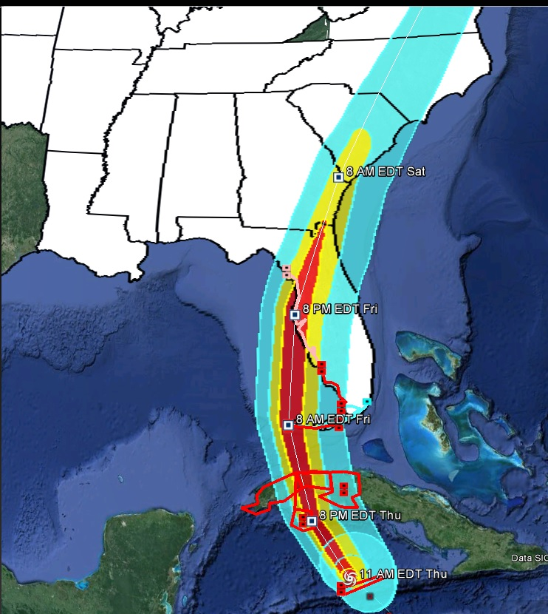
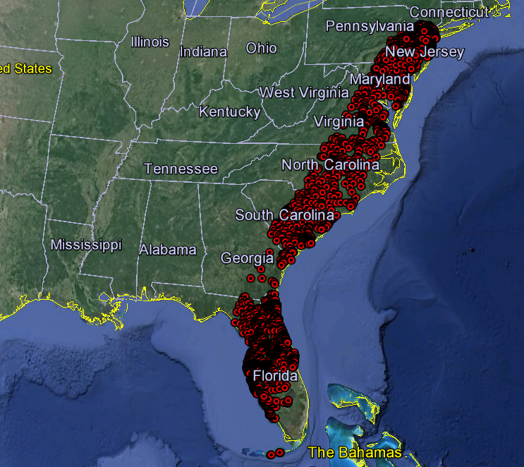
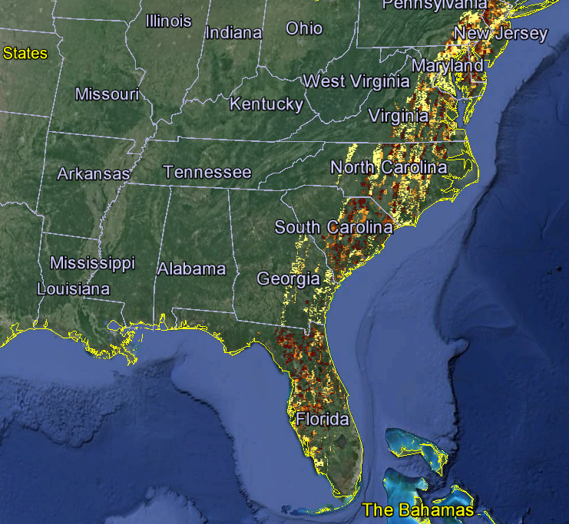
Energy Infrastructure Impact Simulation Capacities are Impressive, e.g., Hypothetical Hurricane Charley Impacts on the Electric Grid
Charley-Category 4 Advisory 13
Sub Stations Affected
Service Area Recovery Estimates

Slide 9
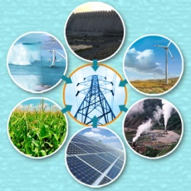
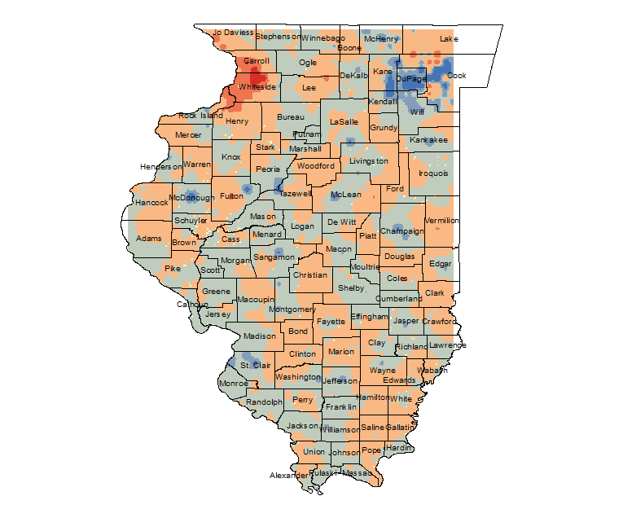
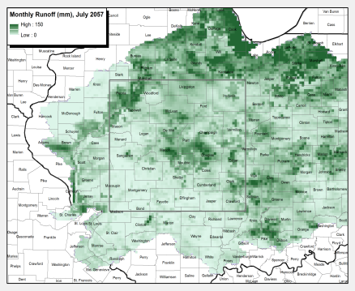
A Three-Lab CIDM Collaboration Is Currently Investigating Climate Impacts on Vulnerabilities of Connected Infrastructures:
Objective: Assessment of the vulnerability of new configurations of infrastructures and their interdependencies in response to Climate Drivers, Population Movements, Expansion and Abandonment Of Infrastructure Networks, Water Forecasts, Technology Insertion
Participants:
ORNL: Steven J. Fernandez, Olufemi A. Omitaomu, Melissa R. Allen, Shieh-Chieh Kao, Thomas J. Wilbanks
LANL: Loren Toole; Judith Cohn; Jared Dreicer
Sandia National Laboratory: Vincent Tidwell
LANL: Technology Insertion changes demand profile and water extractions
ORNL: Difference in Electricity Demand Per Cell Due to Temperature Rise and Population Shift, July 2057-July 2004
SNL /ORNL : Energy –Water interdependencies impacts on Generation/Demand Balance

Slide 10
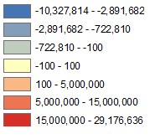
Climate Impacts on New Connected Infrastructure Vulnerabilities
Preliminary Findings
Results demonstrate the feasibility of generating high resolution energy demand maps under different climate scenarios, the ability to couple power systems to changes in the water availability and hydrology changes, and the ability to perform “what if” analyses based on technology policies.
Difference in Electricity Demand Per Cell Due to Temperature Rise and Population Shift,
July 2057-July 2004

Slide 11
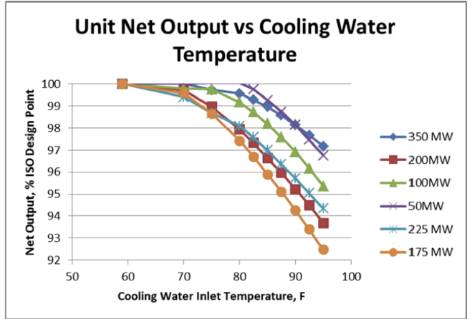
Another Project Has Used CIDM’s Rich Database on Energy Facilities at an Asset Scale to Investigate Sensitivities of Electricity Generation Capacity in the SE to Climate Change (I):
Stimulated initially by the DOE IARP RIAM project, about which you will hear more….
In order to assess capacity reductions due to projected changes in regional temperature and precipitation in the US SE:
  Combines a downscaled climate change scenario for this region with
  The CIDM asset-specific geocoded data base on electric power plants and
  Sensitivity curves describing relationships between thermal power plant capacity and air and water temperatures
Has required adding considerable detail to the CIDM power plant data base

Slide 12
Another Project Has Used CIDM’s Rich Database on Energy Facilities at an Asset Scale to Investigate Sensitivities of Electricity Generation Capacity in the SE to Climate Change (II):
In the scenario used for the initial experiment (GFDC A2), average temperature changes in the SE over the period 2050 are less than 2°C -- not a radical change
Reductions in thermal power generation capacity, based on the current capital stock, would be relatively significant compared with design capacity (~5-10% in the summer, equivalent to a 3000-6000 MWe outage for the 10-state region), but mixed compared with current capacities in the same season
The threat is from effects of serious seasonal droughts and heat waves on the temperature of the EPA-regulated “mixing zone,” where higher ambient water temperatures could lead to extensive power plant deratings over periods of weeks or longer

Slide 13
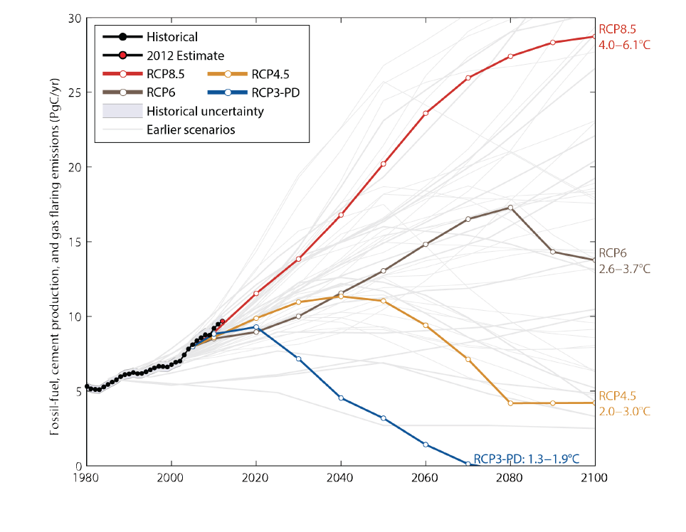
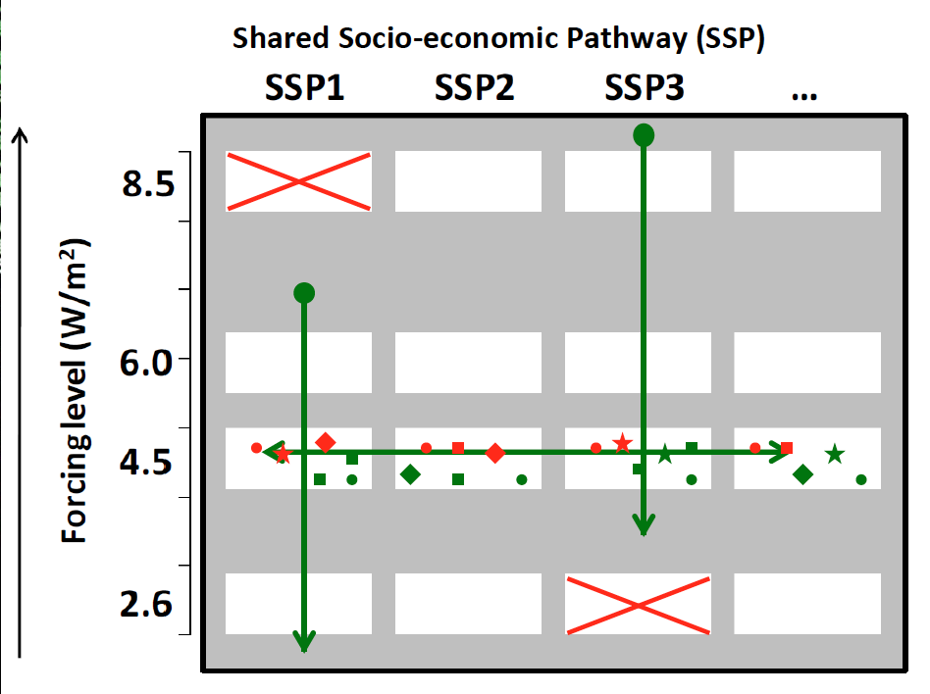
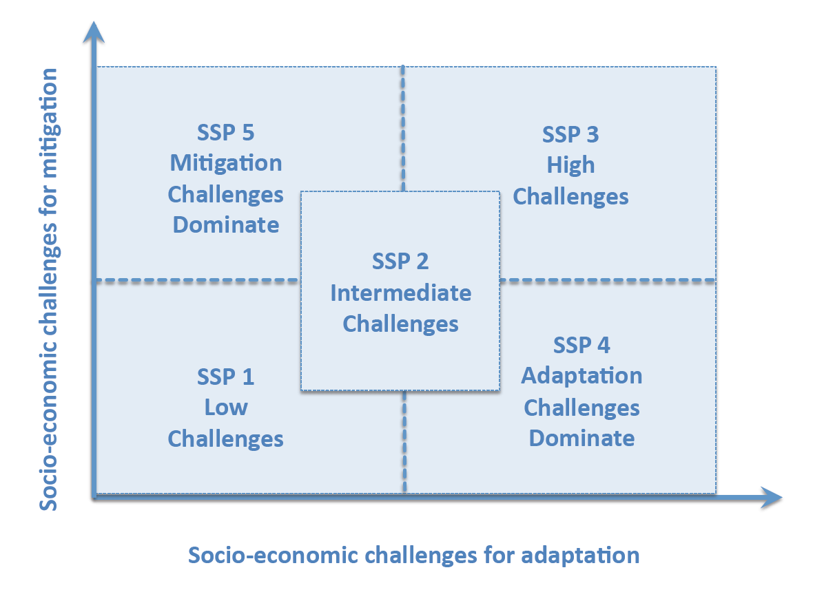
Progress with Linking IAV Modeling and Analysis with IAM (Integrated Assessment Modeling):
Collaboration in developing:
  The Representative Concentration Pathways (RCPs)
  The Shared Socioeconomic Pathways (SSPs)
Continuing bonding through the annual EMF/IAV Snowmass meeting, organized by John Weyant
The Regional Integrated Assessment Modeling (RIAM) project: pursuing linkages by combining top-down and bottom-up approaches at an intermediate scale

Slide 14
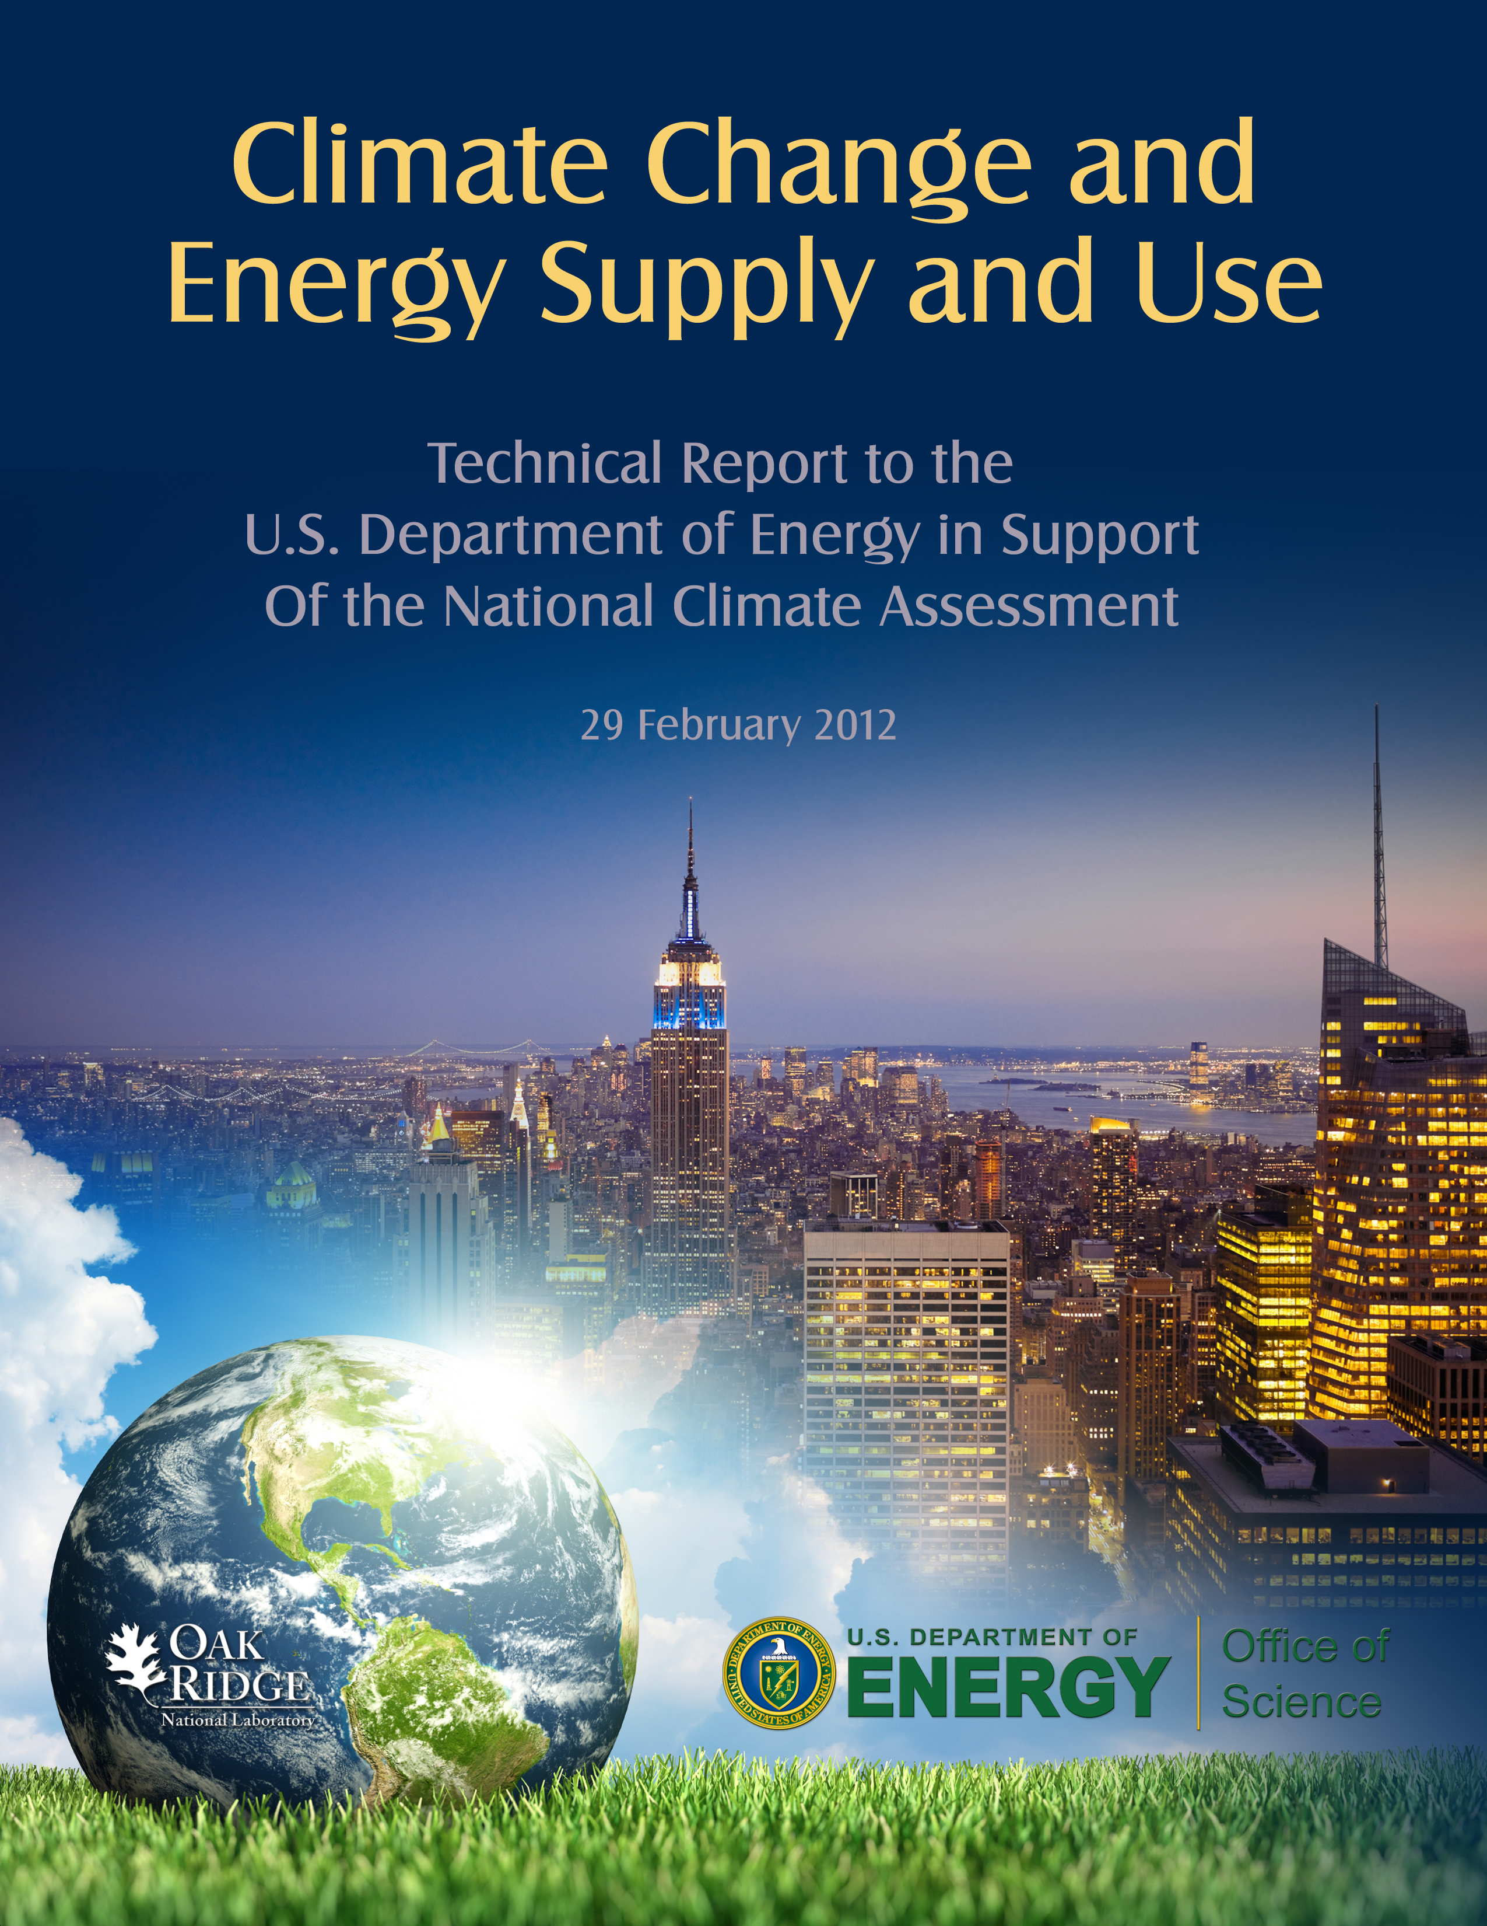
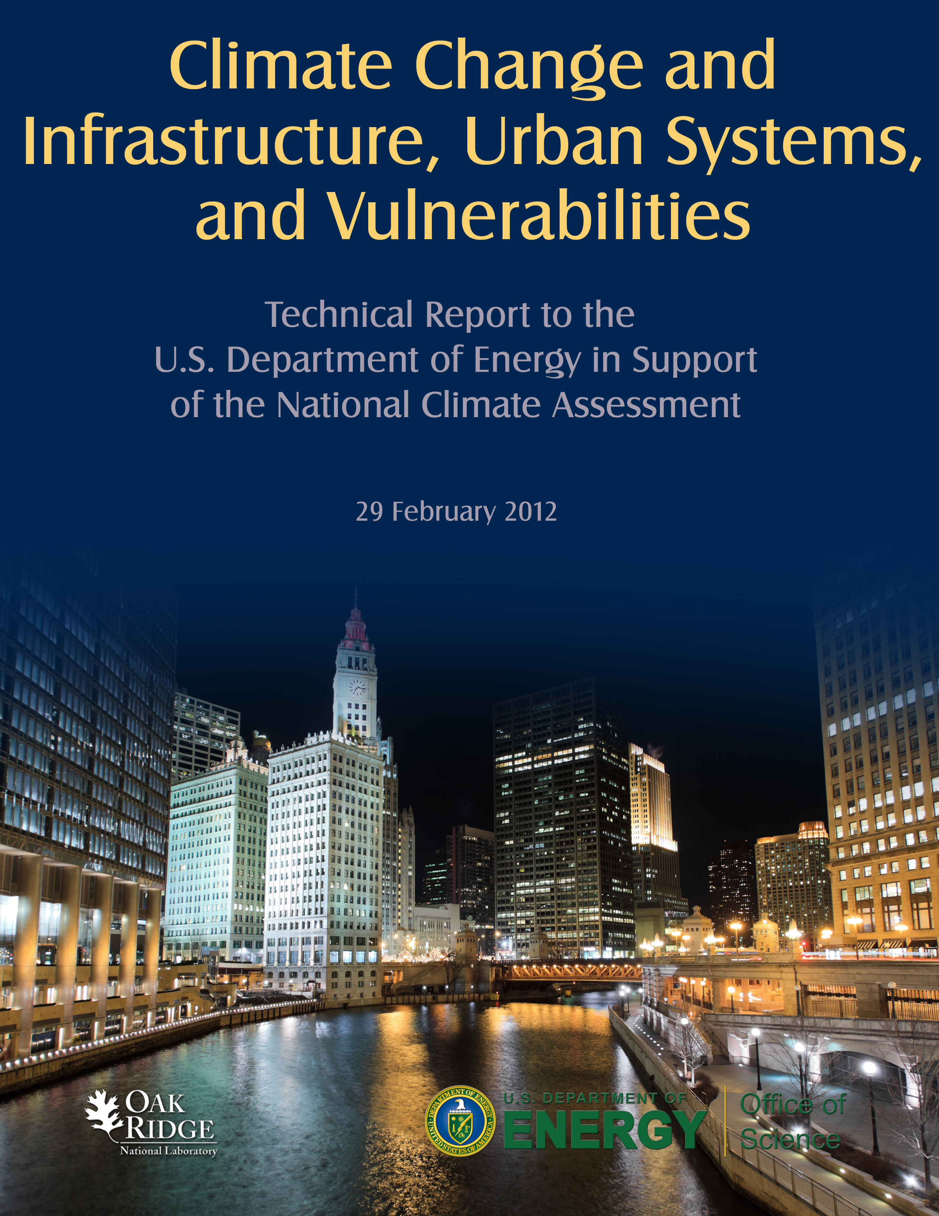
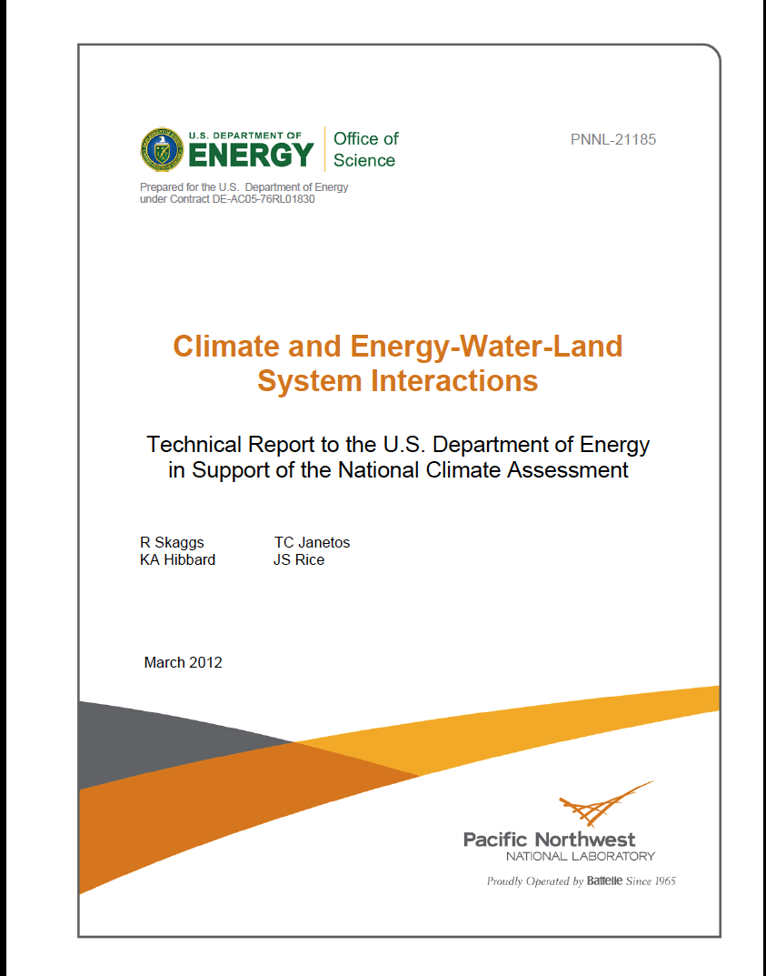
Other Program Accomplishments Have Included (I):
Contributing integrated assessment research perspectives to major national and international assessment activities
  IPCC Working Groups II and III
  NCA third assessment report: mitigation, energy supply and use, infrastructures and urban systems, energy-water-land interactions
  NCA continuing assessment process, e.g.,
      Indicators: energy and infrastructure
      Scenarios: energy, socioeconomic, user perspectives

Slide 15
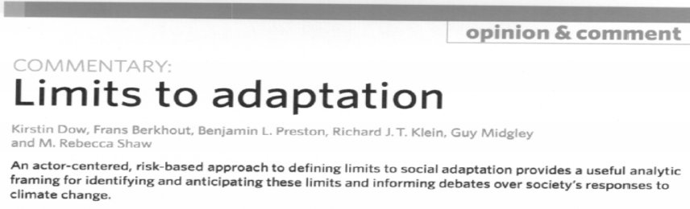
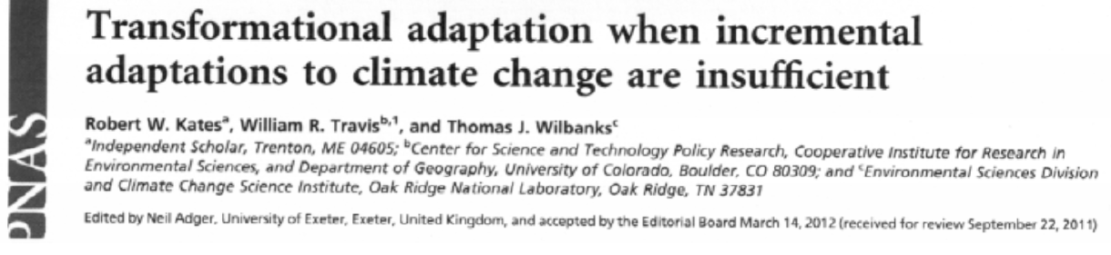
Other Program Accomplishments Have Included (II):
Significant contributions to climate change adaptation science, e.g.,
  Limits to adaptation
  Transformational adaptation
DCAS (DOE Climate Analysis System):
  Adaptation of the NWS Local Climate Analysis Tool (LCAT) to facilitate access by DOE PI’s to CMIP-5 scenarios
  Supported by IARP and RGCM
  Demo tomorrow afternoon

Slide 16
For a Small Office of Science Research Program, the IAV Science and Tool Development Advances
of IARP Have Had an Enormous Impact:
Have significantly contributed to strengthening the science base for analyzing potentials for (and limitations of) climate change adaptation
Have been instrumental in transforming contextual scenarios for climate change drivers, impacts, and responses
Have significantly enriched the science base for analyzing energy-water sector interconnections
Have transformed science and tools for examining implications of climate-related extreme events for energy infrastructures and their interdependencies with other built infrastructures

Slide 17
Thomas J. Wilbanks
Phone: (865) 574-5515
E-mail: wilbankstj@ornl.gov
THANK YOU !

