Slide 1
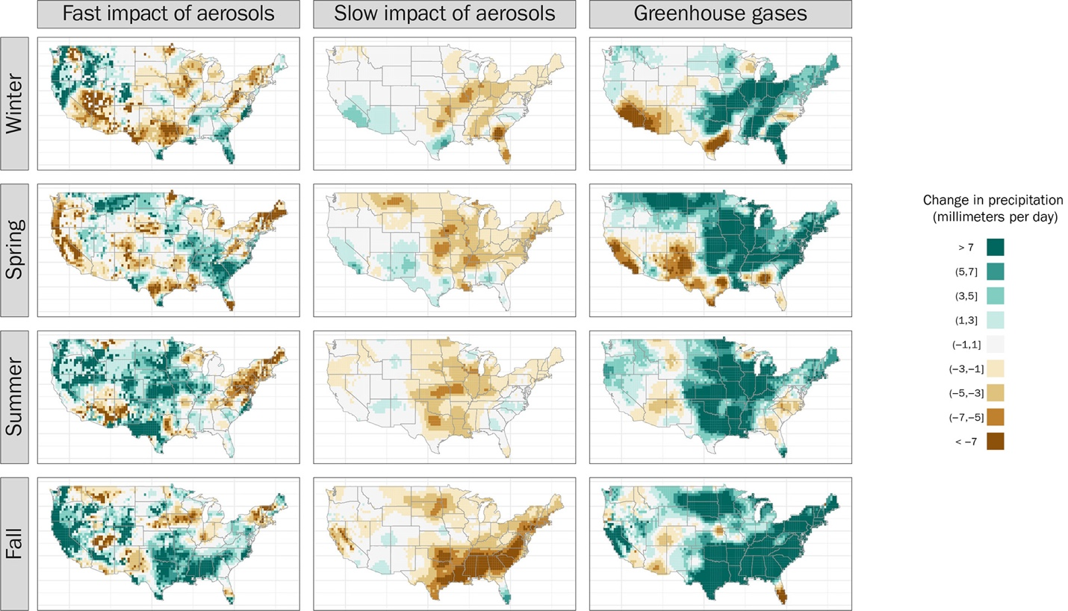
Anthropogenic Aerosols Mask Increases in US Rainfall by Greenhouse Gases
Scientific Challenges
A comprehensive understanding of human-induced changes to rainfall is essential for water resource management and infrastructure design. However, at regional scales, existing detection and attribution studies are rarely able to conclusively identify human influence on precipitation.
Approach and Results
The authors use rain gauge measurements to derive data-driven estimates of how climate change impacts extreme rain in the US. They find the expected rainfall increases driven by burning fossil fuels are offset with drying caused by manmade aerosols.
Significance
We have now provided conclusive evidence for higher rainfall and helped explain why past studies assessed by the Intergovernmental Panel on Climate Change reached conflicting conclusions.
The fast precipitation response to aerosols has an important seasonal component: local emissions cause drying in the winter and spring and more rain in the summer and fall.
Our results provide guidance for improving future projections of rainfall in the United States, particularly in the summer season.
These maps show how aerosol and greenhouse gas emissions influence local extreme rainfall across the seasons. Green indicates an increase in rain, while brown means a decrease.
Risser, M.D., Collins, W.D., Wehner, M.F. et al. (2024). Anthropogenic aerosols mask increases in US rainfall by greenhouse gases. Nature Communications 15, 1318. [DOI: https://doi.org/10.1038/s41467-024-45504-8]

