Slide 1
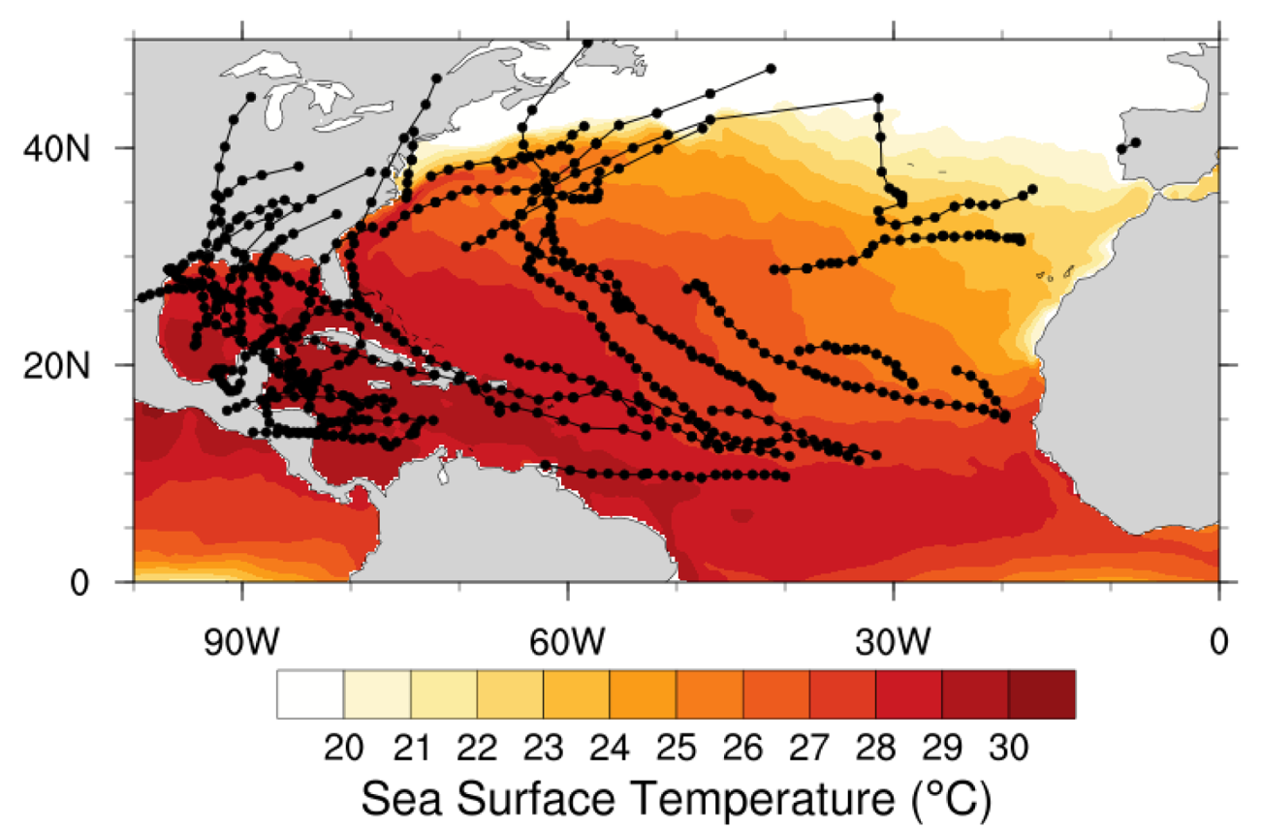
Attribution of 2020 hurricane season extreme rainfall to human-induced climate change
The 2020 North Atlantic hurricane season was one of the most active on record, causing heavy rains, strong storm surges, and high winds throughout the basin. Human activities continue to increase the atmospheric concentrations of greenhouse gases, resulting in an increase of more than 1 °C in the global average surface temperature in 2020 compared to 1850. Using the hindcast attribution methodology, this work demonstrates that human-induced climate change increased the extreme 3-hourly storm rainfall rates and extreme 3-day accumulated rainfall amounts during the full 2020 hurricane season for observed storms that are at least tropical storm strength (> 18 m/s) by 10 and 5%, respectively. When focusing on hurricane strength storms (> 33 m/s), extreme 3-hourly rainfall rates and extreme 3-day accumulated rainfall amounts increase by 11 and 8%, respectively.
Observed sea surface temperatures (color contours) and hurricane tracks for the 2020 North Atlantic hurricane season (June 1 – November 30).
This work represents the first time that an attribution statement about the impact of climate change on rainfall throughout a full hurricane season has been made. As the hurricanes of 2020 spanned the full range of intensity on the Saffir-Simpson scale, the attribution statements are less prone to the selection bias of our previous work focused on high impact storms. Consequently, the attribution statements can be more generally applied to storms that have not been analyzed for their anthropogenic components.
The best estimates of the anthropogenic increase in individual hurricane total rainfall are consistent with Clausius-Clapeyron (C-C) scaling (~6-7%/C) of the North Atlantic anthropogenic sea surface temperature increase. However, extreme 3-hourly hurricane rainfall increases at a rate best estimated at nearly twice C-C scaling, particularly for hurricane strength storms.
Kevin A. Reed, Michael F. Wehner, Colin M. Zarzycki (2022) Attribution of 2020 Hurricane Season Extreme Rainfall. Nature Communications 13, 1905. https://www.nature.com/articles/s41467-022-29379-1

