Slide 1
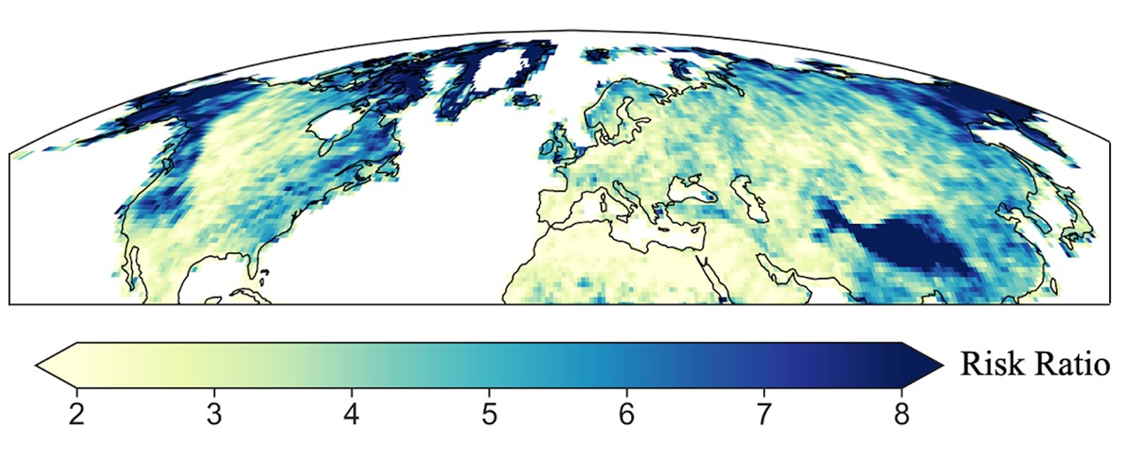
A warming-induced reduction in snow fraction amplifies rainfall extremes
Scientific Challenges
Global warming is widely recognized to intensify precipitation extremes. Of particular importance are rainfall (liquid phase) extremes due to their devastating impacts of flooding, landslides and soil erosion. However, to this date, it remains largely unknown how the intensity of rainfall extremes will change as a result of global warming. Additionally, it is not known whether high elevation regions would be at more risk due to the shift of snow to rain.
Approach and Results
Our approach relied on utilizing historical observations in addition to climate model simulations to examine global warming impact on rainfall extremes. Our results indicate that high elevation regions exhibit a 15% increase in the intensity of rainfall per 1 degree C of warming, which pinpoint those regions as hotspots vulnerable to risk of rainfall extremes.
Caption: The Risk Ratio (RR) of extreme rainfall. An RR value of 2 means that an event is 2 times more likely to occur in a future climate. Regions in dark blue color (e.g., Pacific Mountain ranges, Rockies, Himalayas) have high risk of rainfall extremes in a future climate.
Significance
Identifying mountainous regions and their foothills as hotspots of rainfall extremes. This underlines the importance of developing sound adaptation and mitigation strategies to protect the built environment and the communities residing in those regions.
Our results single out certain components of climate models requiring improvement to reduce uncertainty in projections of rainfall extremes.
Ombadi M., Risser M., Rhoades A., & Varadharajan C., A warming-induced reduction in snow fraction amplifies rainfall extremes. Nature (2023). https://doi.org/10.1038/s41586-023-06092-7

