Slide 1
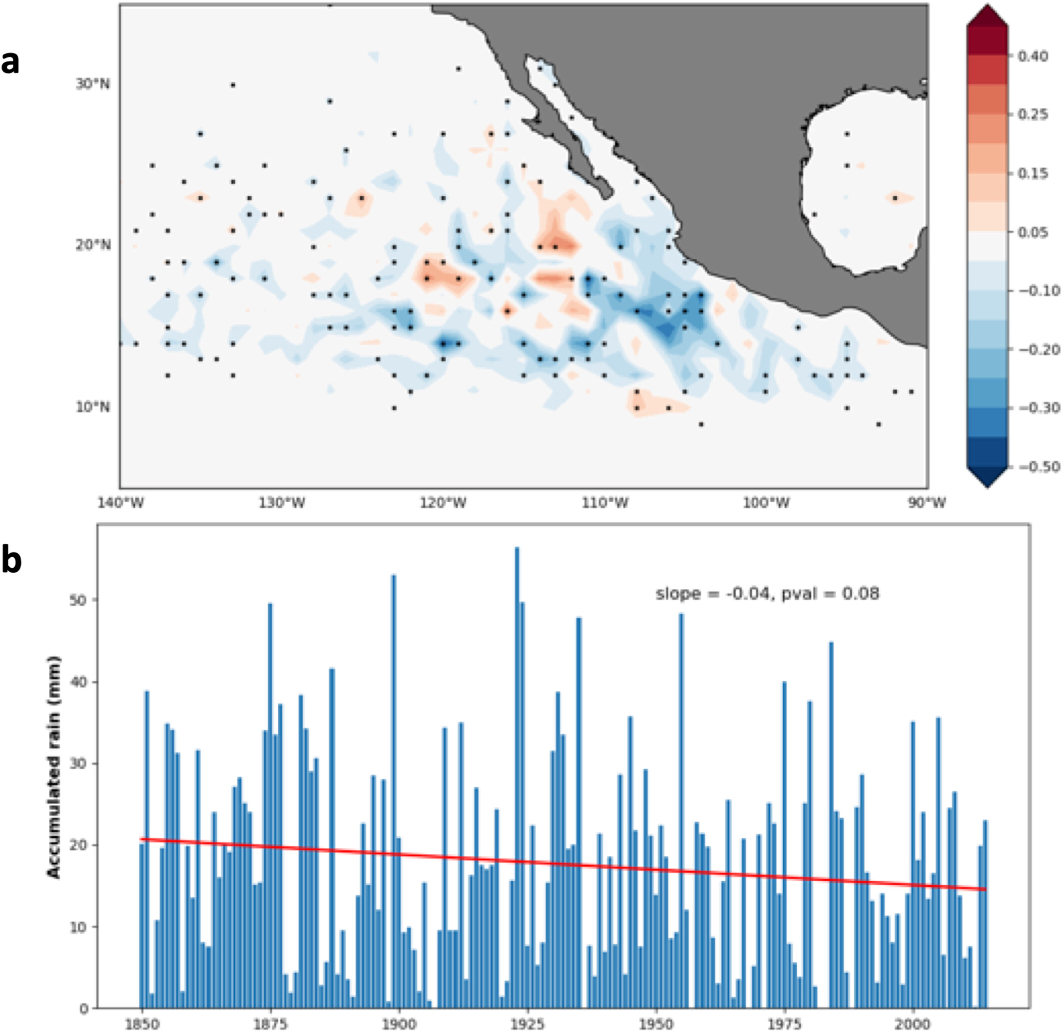
Influence of Eastern Pacific Hurricanes on the Southwest US Wildfire Environment
Objective
Determine if recurving Eastern Pacific (EP) hurricanes can influence wildfires in the Southwest US.
Approach
Using observations, generate composite mean time evolution of precipitation, soil moisture and vapor pressure deficit in the Southwest US during recurving EP hurricanes.
Perform similar analysis using historical simulations based on the North American Regionally Refined Model (NARRM) configuration of E3SM, which explicitly resolves EP hurricanes.
Examine wildfire observations to discern their response to recurving EP hurricanes.
Impact
Recurving EP hurricanes increase precipitation and soil moisture, and reduce vapor pressure deficit in the Southwest US, making the environment less conducive for September-October wildfires.
Consequently, during years with recurving EP hurricanes, the prevalence of wildfires in the Southwest US is reduced.
Long-term historical trends indicate a decline in EP hurricane activity, and their contribution to Southwest US precipitation, with substantial implications for autumn wildfires in that region.
Long-term Eastern Pacific (EP) hurricane changes simulated by E3SM. (a) Ensemble mean change in hurricane track density, computed over the period 1850-2014. b) Ensemble mean trend in annual total precipitation over the Southwest US from EP hurricanes. The results are based on 3 historical simulations using E3SM NARRM. In panel (b), the long-term trend is indicated by the red line. Also shown are the trend and p-value.
Balaguru K, et al. “Influence of Eastern Pacific Hurricanes on the Southwest US Wildfire Environment.” Geophys. Res. Lett., 51, (2024). [DOI: 10.1029/2023GL106774]

