Slide 1
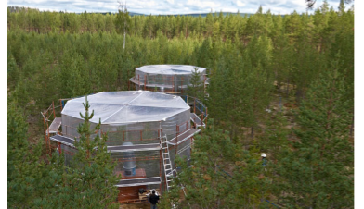
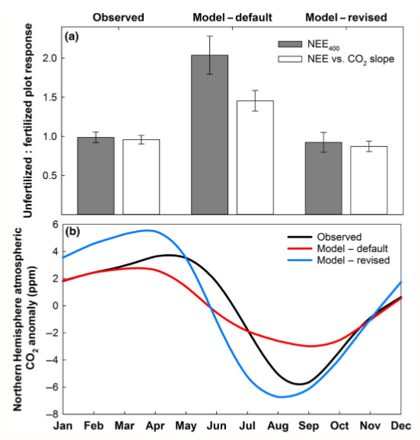
Global model improved by incorporating new hypothesis for vegetation nutrient limitation, supported by field experiment
Contact: Peter Thornton, 865-241-3742, thorntonpe@ornl.gov
Funding: DOE Office of Science, BER: ESM and TES
Objective
Use new data from low-cost field experiment to test a new hypothesis for how plants respond to chronic nutrient limitation. If correct, this hypothesis could explain and reduce a longstanding bias in global climate-carbon cycle model results.
New Science
Innovative field experiment provided new results regarding the fundamental process of photosynthetic carbon uptake in the face of varying levels of nutrient limitation.
Empirical data refute current modeling approach for instantaneous downregulation of carbon uptake, support new hypothesis for long-term storage and release of excess carbon.
Above: experimental chambers in use. Below: modeling results compared to local and global-scale observations
Significance
This new hypothesis has significant impact on seasonal cycle of atmospheric CO2, an important performance metric for global carbon cycle models. The fate of excess carbon can have significant impact on other ecosystem processes.
Citation:
Metcalfe, D. B., D. Ricciuto, S. Palmroth, C. Campbell, V. Hurry, J. Mao, S. G. Keel, S. Linder, X. Shi, T. Näsholm, K. E. A. Ohlsson, M. Blackburn, P. E. Thornton and R. Oren 2016. Informing climate models with rapid chamber measurements of forest carbon uptake. Global Change Biology DOI: 10.1111/gcb.13451.

