Slide 1
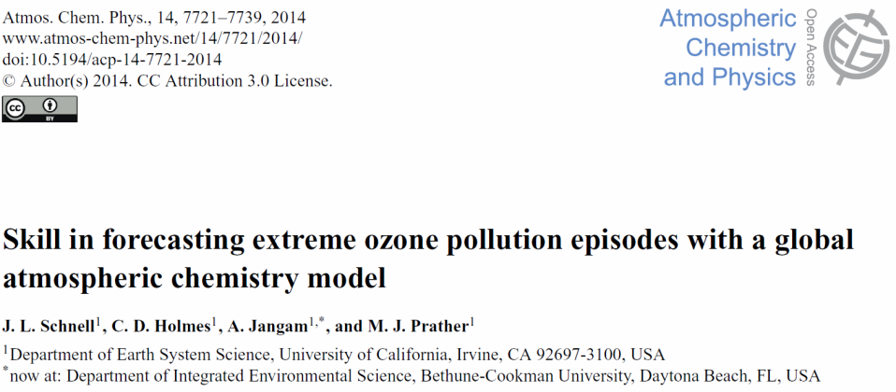
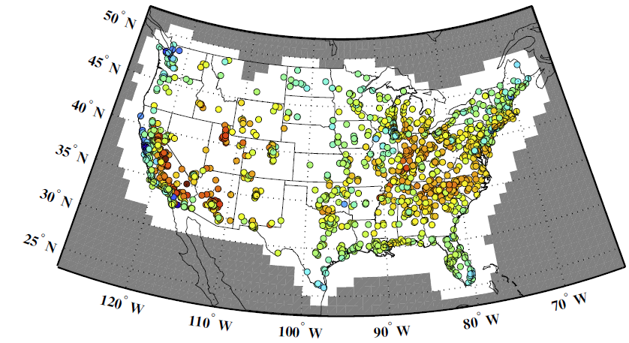
A fresh look at air quality extremes - from a climate perspective.
Using old numerical techniques with a new climate-science approach, a paper from UC Irvine has created a solid, quantitative link between measurements at the thousands of surface air-pollution stations and the global chemistry-climate models that we use to project future air quality. This innovative technique provides air-pollution data on the same scales as the global models, including the full statistics of clean-air versus extreme pollution episodes.
A surprising result is that surface ozone extremes tend to occur as multi-day, 1000-km mega-pollution episodes over the USA and Europe, and moreover, the UCI chemistry model was able to predict their occurrence with skill.
from the published ACPD reviews:
“Simulating surface ozone in polluted regions has long been a challenge in global chemistry models. This paper provides a clever and rigorous method for doing so, … a technique for producing gridded ozone fields and statistics of pollution episodes from air quality networks in the U.S. and Europe that seems quite sound. … [T]he procedure will be an excellent tool for evaluation of air quality in other models for hindcast and future.” Anonymous Referee #1
“Schnell et al. … show a method for evaluating the ability of models to simulate the widespread, multi-day episodes of ozone pollution which make a large contribution to real-world air quality threshold exceedance events. By examining the frequency of extreme events based on a fixed return time, rather than basing their analysis on air quality thresholds, they avoid the problem of bias in the current generation models. They show that a modern chemical transport model is able to hindcast observed widespread ozone pollution events with a good degree of skill, The limitations of the methodologies are also well discussed. The paper is very well written.” Anonymous Referee #2
from EPA station data
to
climate model grid
surface ozone (ppb)

Slide 2
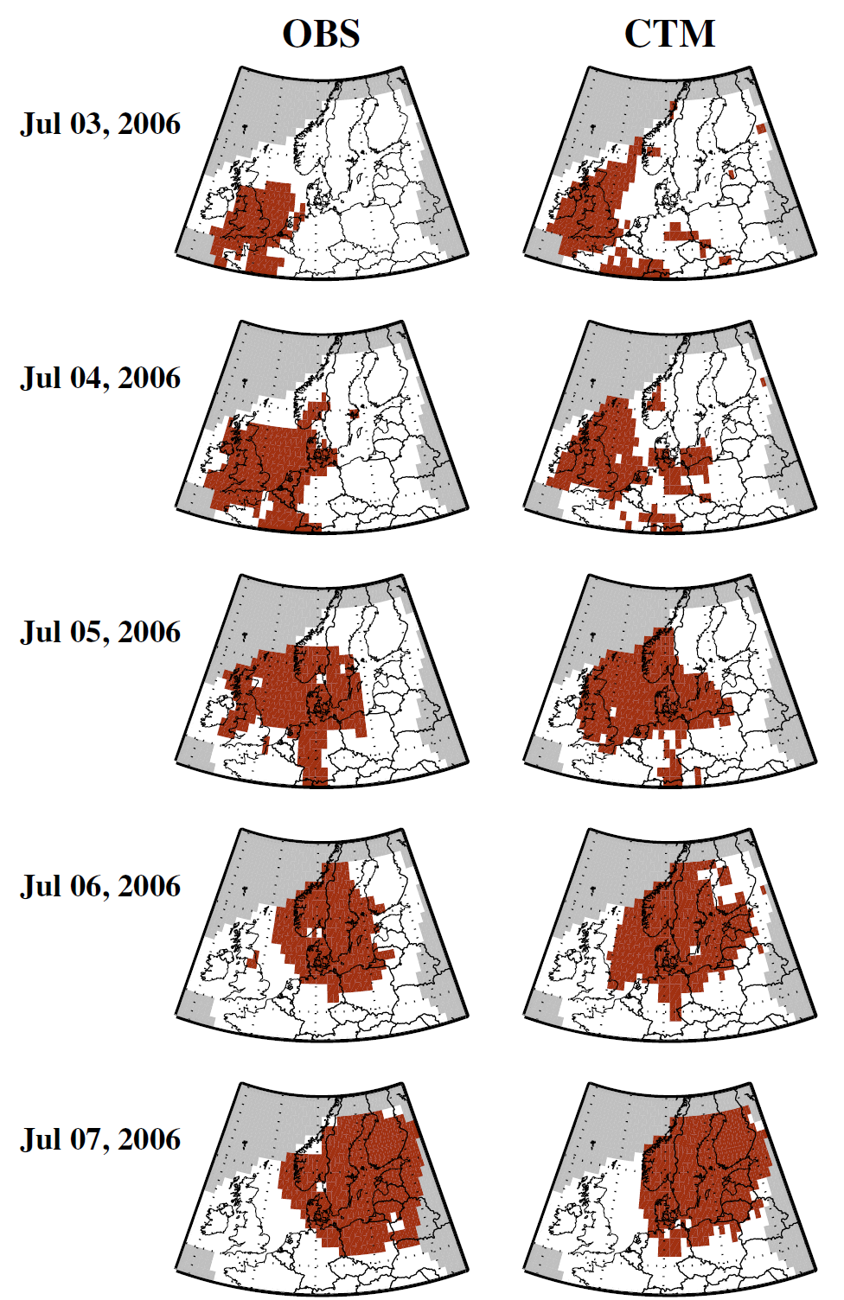
Schnell et al. (2014) look at Air Quality Extremes (AQX) in terms of climate rather than absolute exceedances.
Every grid cell defines its own extremes, and an AQX event (red cells to right) is defined as one of the 100 worst days per decade. This is similar to climate extremes, which are defined in terms of local return times.
AQX events are discovered to cluster into episodes, spanning 1000+ km and lasting several days. (new)
The 3-7 July 2006 European AQX episode was observed (OBS) by the surface air quality monitoring stations. This extreme episode was also skillfully predicted by the global UC Irvine chemistry-transport model (CTM), even though the CTM was biased high (+60%) in terms of absolute O₃ levels. (new)
Will future climate create more, bigger AQX episodes that hit us like the giant heat waves? (next, in progress)
Jordan Schnell, Chris Holmes, Ayush Jangam, Michael Prather (2014) “Skill in forecasting extreme ozone pollution episodes with a global atmospheric chemistry model,” Atmos. Chem. Phys., 14, 7721-7739

Slide 3
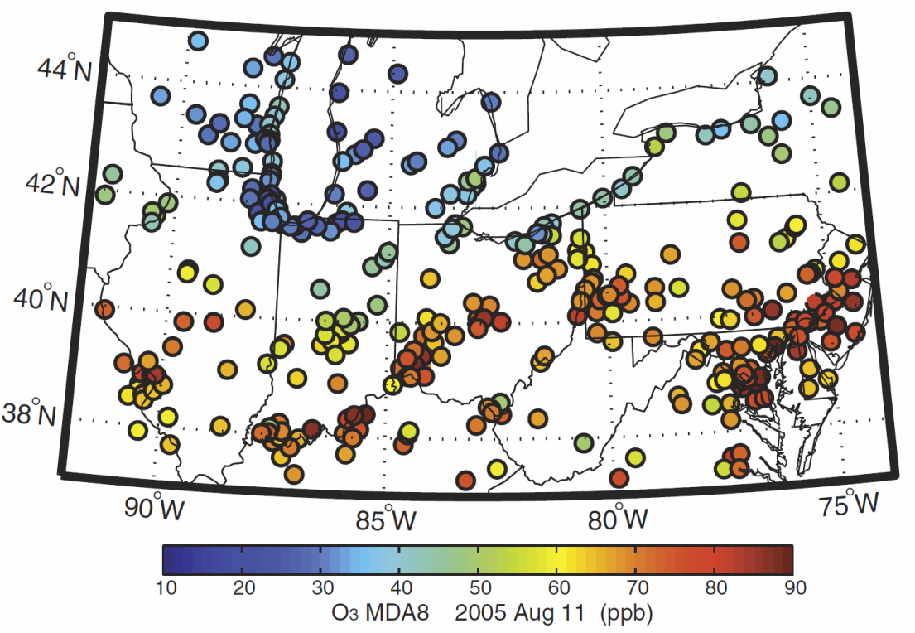
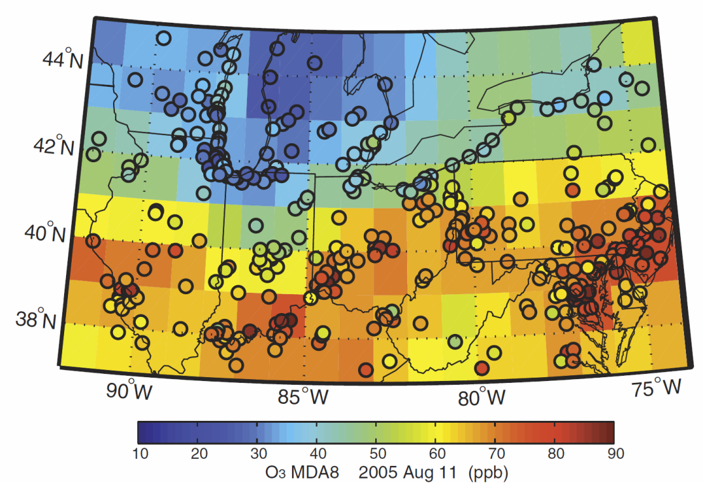
extra slide
1608 stations (EPA’s AQ System)
hourly O₃ max daily 8-hr (MDA8)
Resulting grid-cell averaged O₃
Jordan Schnell, Chris Holmes, Ayush Jangam, Michael Prather (2014) “Skill in forecasting extreme ozone pollution episodes with a global atmospheric chemistry model,” Atmos. Chem. Phys., 14, 7721-7739

Slide 4
extra slide
Jordan Schnell, Chris Holmes, Ayush Jangam, Michael Prather (2014) “Skill in forecasting extreme ozone pollution episodes with a global atmospheric chemistry model,” Atmos. Chem. Phys., 14, 7721-7739, see http://SchnellPrather-AQpaper)
Skill in forecasting extreme ozone pollution episodes with a global atmospheric chemistry model
J. L. Schnell, C. D. Holmes, A. Jangam, and M. J. Prather
Abstract. From the ensemble of stations that monitor surface air quality over the United States and Europe, we identify extreme ozone pollution events and find that they occur predominantly in clustered, multiday episodes with spatial extents of more than 1000 km. Such scales are amenable to forecasting with current global atmospheric chemistry models. We develop an objective mapping algorithm that uses the heterogeneous observations of the individual surface sites to calculate surface ozone averaged over 1° by 1° grid cells, matching the resolution of a global model. Air quality extreme (AQX) events are identified locally as statistical extremes of the ozone climatology and not as air quality exceedances. With the University of California, Irvine chemistry-transport model (UCI CTM) we find there is skill in hindcasting these extreme episodes, and thus identify a new diagnostic using global chemistry–climate models (CCMs) to identify changes in the characteristics of extreme pollution episodes in a warming climate.
Acknowledgements. This research was supported by an NSF Graduate Fellowship to J. L. Schnell; the NSF REU (1005042) support of A. Jangam; the NASA Modelling, Analysis, and Prediction Program (NNX13AL12G); the Office of Science (BER) of the US Department of Energy (DE-SC0007021); and the Kavli Chair in Earth System Science.

