Slide 1
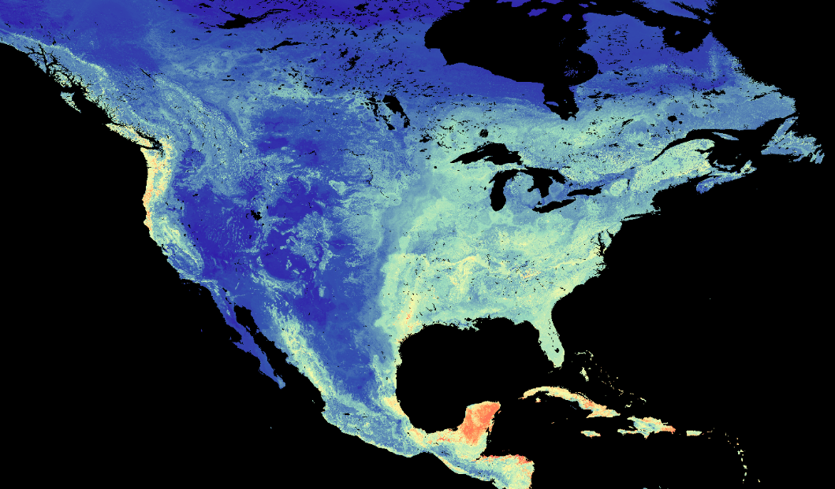
Machine Learning Produces an Unprecedented Global Map of 1 km² Soil Respiration
Objective
Use machine learning to investigate global scale patterns of annual soil respiration and provide new insight into the sources of its prediction uncertainty.
Approach
Use a comprehensive and customized database on soil-to-atmosphere CO₂ flux (soil respiration) measured over 50 years.
Identify most important predictors using Random Forest and a quantile regression forest model.
Conduct spatial predictions of fluxes and associated uncertainties produced at very high spatial resolution (1 km²) globally.
Impact
Produced valuable benchmark maps.
Found prediction uncertainty to be highest in high latitudes and data scarce regions, which should be targets for future measurements.
A new global map of soil respiration and its uncertainties provides modelers and experimentalists with a “gold standard” benchmark dataset.
Warner, Bond-Lamberty, Jian, and Vargas (2019). Spatial patterns of global soil respiration at 1 km resolution, Global Biogeochemical Cycles. (In press.)
DOI: 10.1029/2019GB006264
Notes:
http://www.pnnl.gov/science/highlights/highlights.asp?division=749

