Slide 1
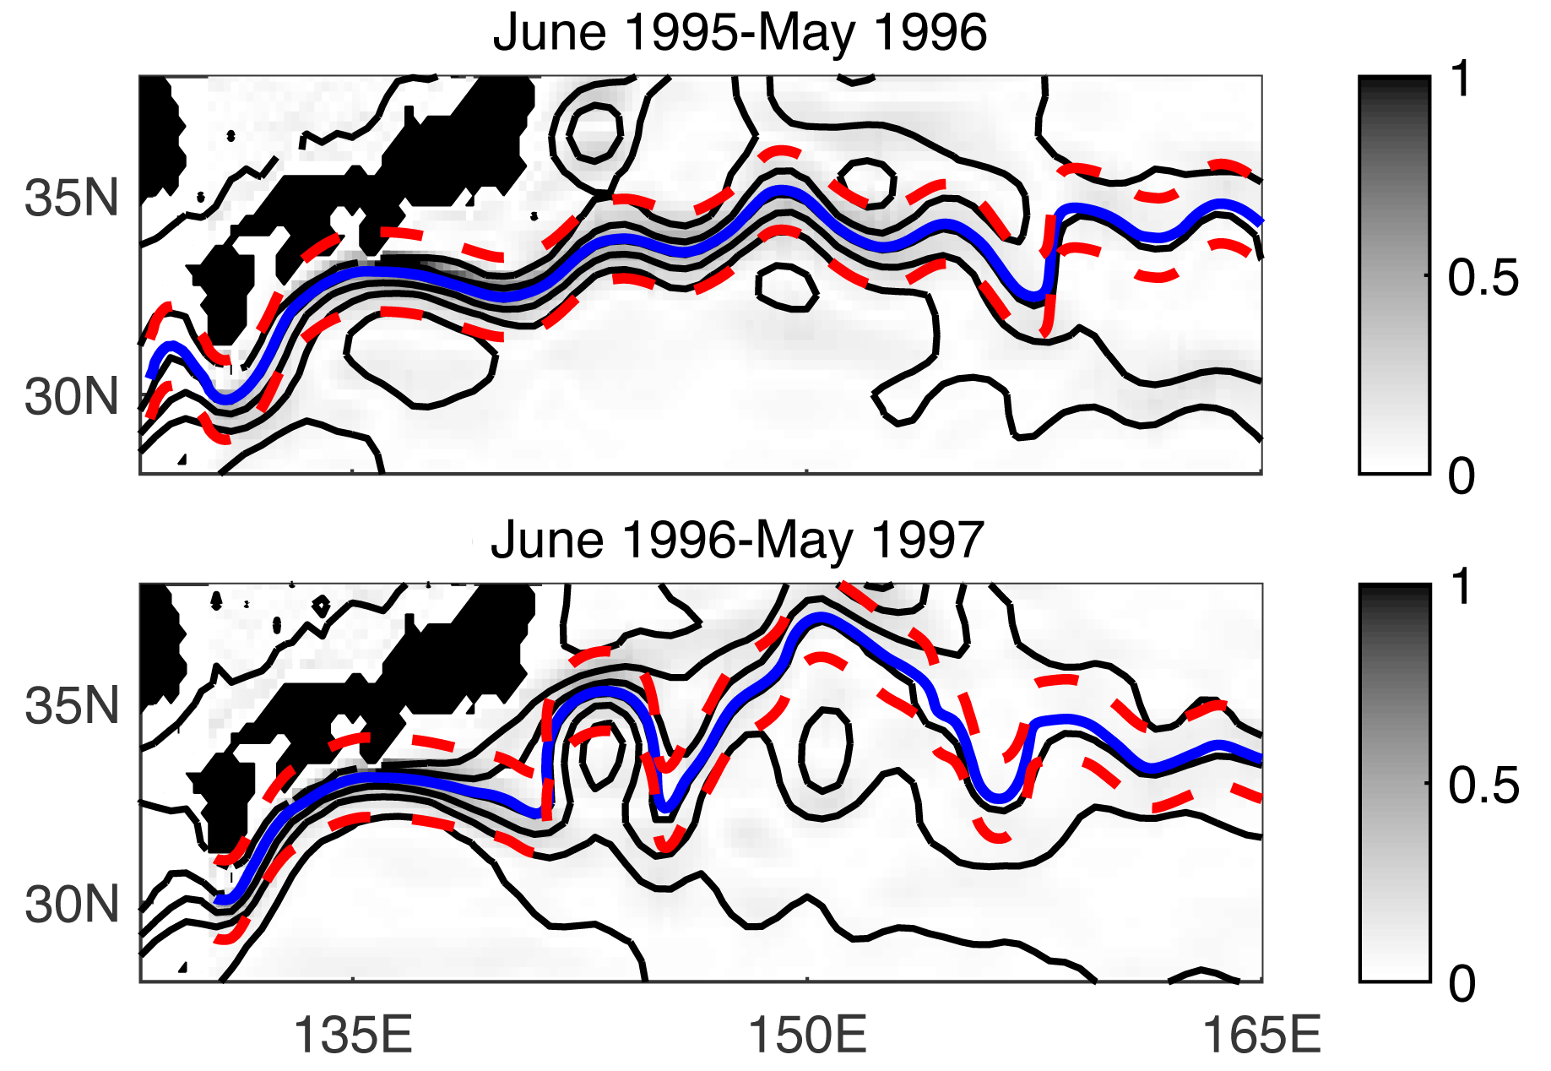
Isopycnal eddy mixing across the Kuroshio Extension: stable versus unstable states in an eddying model.
Objective
Contrast estimates of eddy cross-stream mixing on constant density surfaces in the North Pacific Kuroshio Extension (KE) during its strong elongated (stable) and weak contracted (unstable) states from a global strongly eddying ocean general circulation model.
Approach
Obtain metrics of model veracity: length and position of KE paths and eddy kinetic energy.
Calculate cross-jet diffusivities from online numerical particles deployed in global 0.1° Parallel Ocean Program (POP) forced with atmospheric reanalysis fluxes.
Contrast mixing structures in the upper and deep ocean over a complete cycle of KE jet energetics.
Core of the Kuroshio Extension (KE) jet (blue curve) and the KE jet boundaries (red lines) for stable (06/1995-05/1996) and unstable (06/1996-05/1997) states from an eddy-active ocean model simulation (Figure modified from Chen et al., 2017; Fig. 10).
Impact
The location of elevated cross-jet eddy mixing varies in the KE jet during the two states and likely plays a role in the variability of the amounts of central and subtropical mode water that form to the south of the KE front. These mode waters are responsible for the uptake of heat and salt by the ocean during winter and re-emerge in subsequent winters to impact North Pacific climate.
Chen, R., S. T. Gille, and J. L. McClean (2017), Isopycnal eddy mixing across the Kuroshio Extension: Stable versus unstable states in an eddying model, J. Geophys. Res. Oceans, 122, doi:10.1002/2016JC012164.

