Slide 1
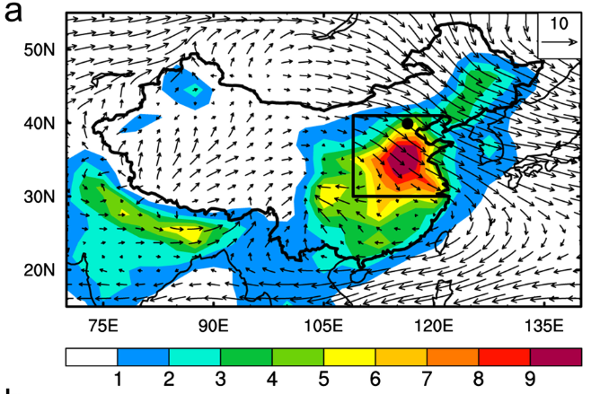
Black Carbon Amplifies Haze Over the North China Plain
Objective
Examine influences of Arctic and midlatitude black carbon (BC) on the East Asian winter monsoon and haze in China
Approach
Perform simulations with BC emissions in the Arctic and midlatitudes scaled up by large factors in the Community Earth System Model
Analyze meteorological responses in East Asia to the strong BC emission perturbations
Impact
BC weakens East Asian winter monsoon wind by changing cloud structure and land-sea thermal contrast
The impact on monsoon wind per unit change in Arctic BC emissions is similar to that of midlatitude BC emissions but has a larger uncertainty
Reducing BC emissions could have significant indirect benefits for air quality and human health in the North China Plain
Top: The map shows modeled wintertime BC concentrations (μg/m⁻³) and winds (m/s) over China, with the North China Plain outlined.
Bottom: A time series shows a negative correlation between modeled BC concentrations and wind speeds in the North China Plain. The correlation coefficient is in the top right.
BC near-surface concentration (μg/m⁻³)
Years
Lou S, Y Yang, H Wang, SJ Smith, Y Qian, and PJ Rasch. 2018. “Black Carbon Amplifies Haze Over the North China Plain by Weakening the East Asian Winter Monsoon.” Geophysical Research Letters 46(1):452−460, https://doi.org/10.1029/2018GL080941.
Notes:
http://www.pnnl.gov/science/highlights/highlights.asp?division=749

