Slide 1
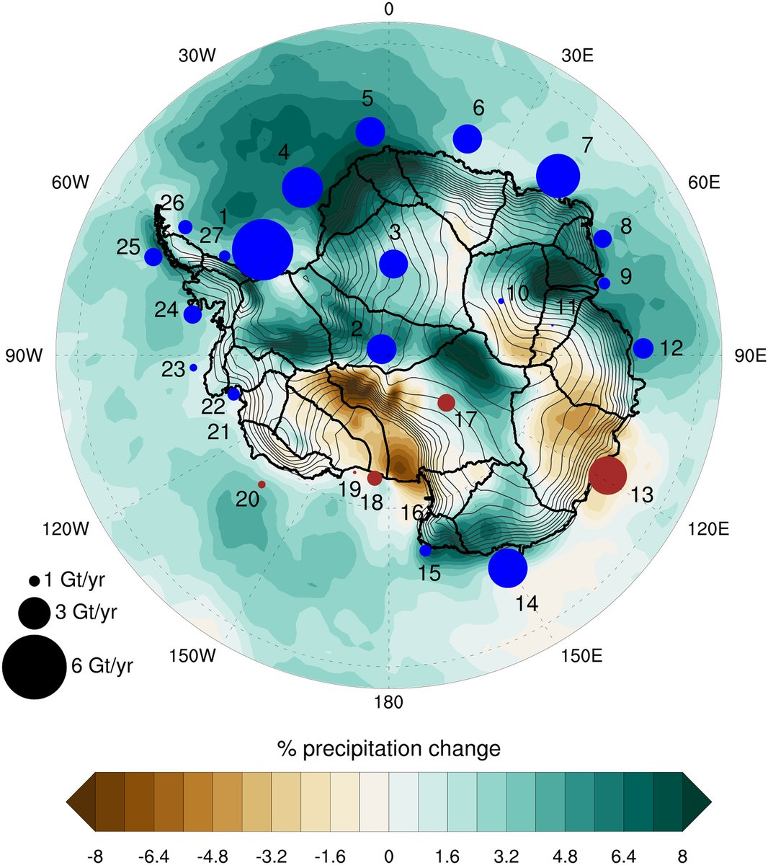
The signature of ozone depletion in recent Antarctic precipitation change: A Study with the Community Earth System Model
Scientific Achievement
Large ensembles used to isolate ozone impact on Antarctic snowfall
We show a significant increase in Antarctic snowfall and a strong spatial pattern of change, in response to historical depletion
Significance and Impact
Ozone depletion has partly mitigated (but not completely cancelled) ongoing Antarctic contributions to global sea level rise
Ozone recovery will remove this mitigating effect and accelerate future sea level rise
Research Details
Figure. Impact of stratospheric ozone depletion on Antarctic snowfall, segregated by Antarctic ice drainage basin.
We used paired large ensembles of Community Earth System Model simulations
We used spatial differencing of ensemble averages to identify ozone signal in the presence of large internal variability in Antarctic snowfall
Lenaerts, J.T.M.; Fyke, J.G. and Medley, B., 2018: The signature of ozone depletion in recent Antarctic precipitation change: a study with the Community Earth System Model. doi: 10.1029/2018GL078608.

