Slide 1
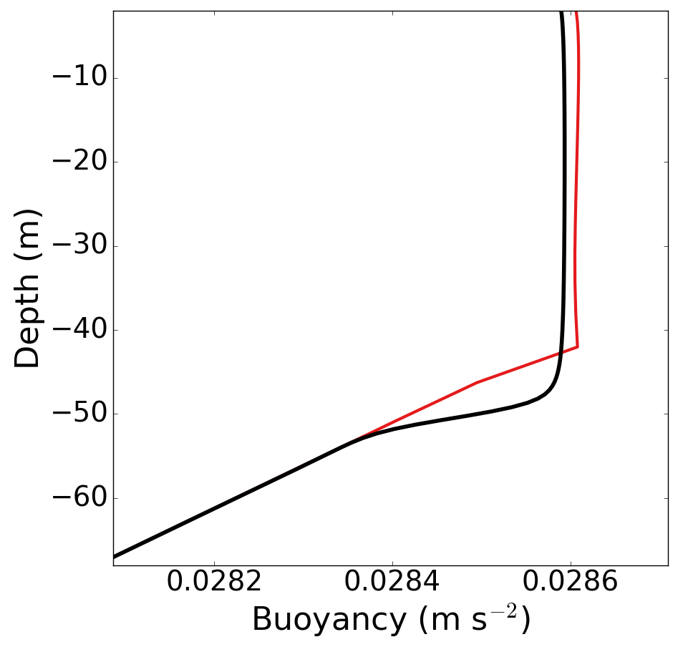
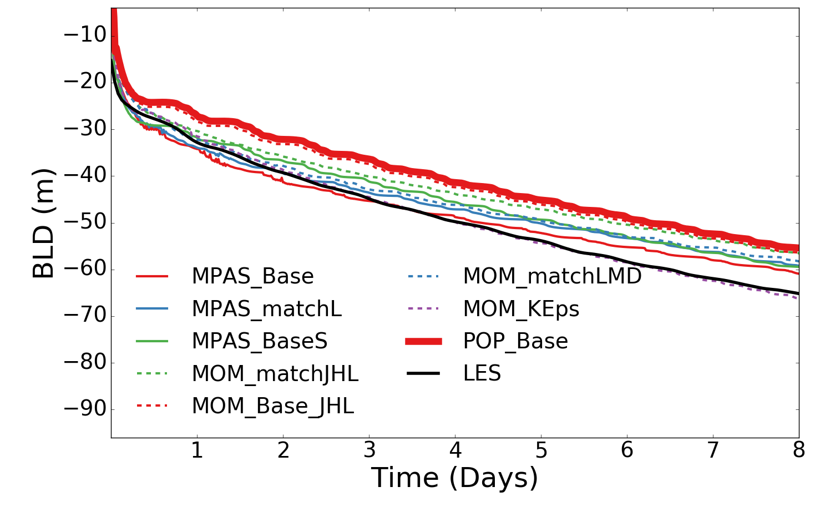
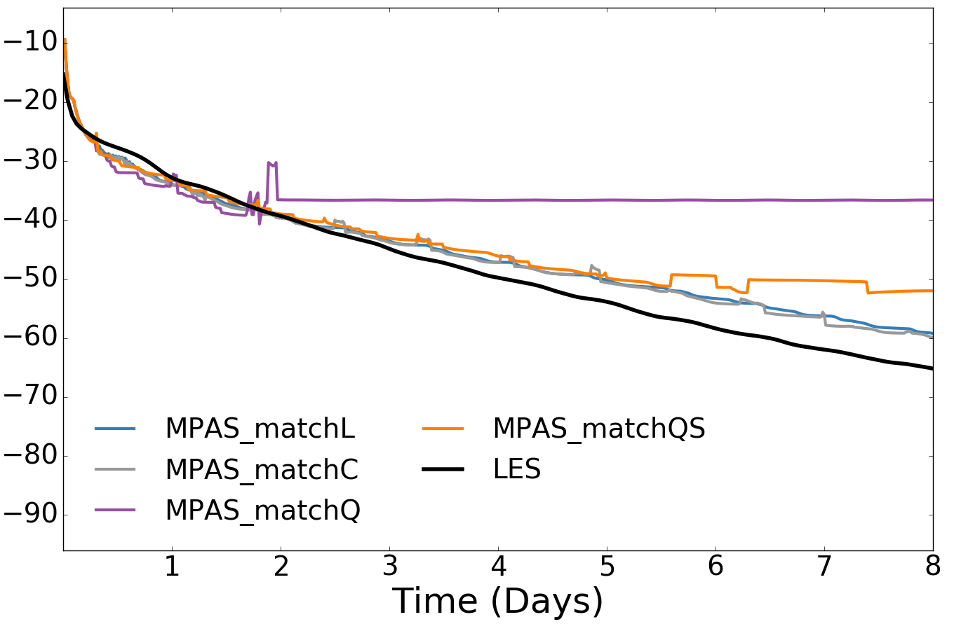
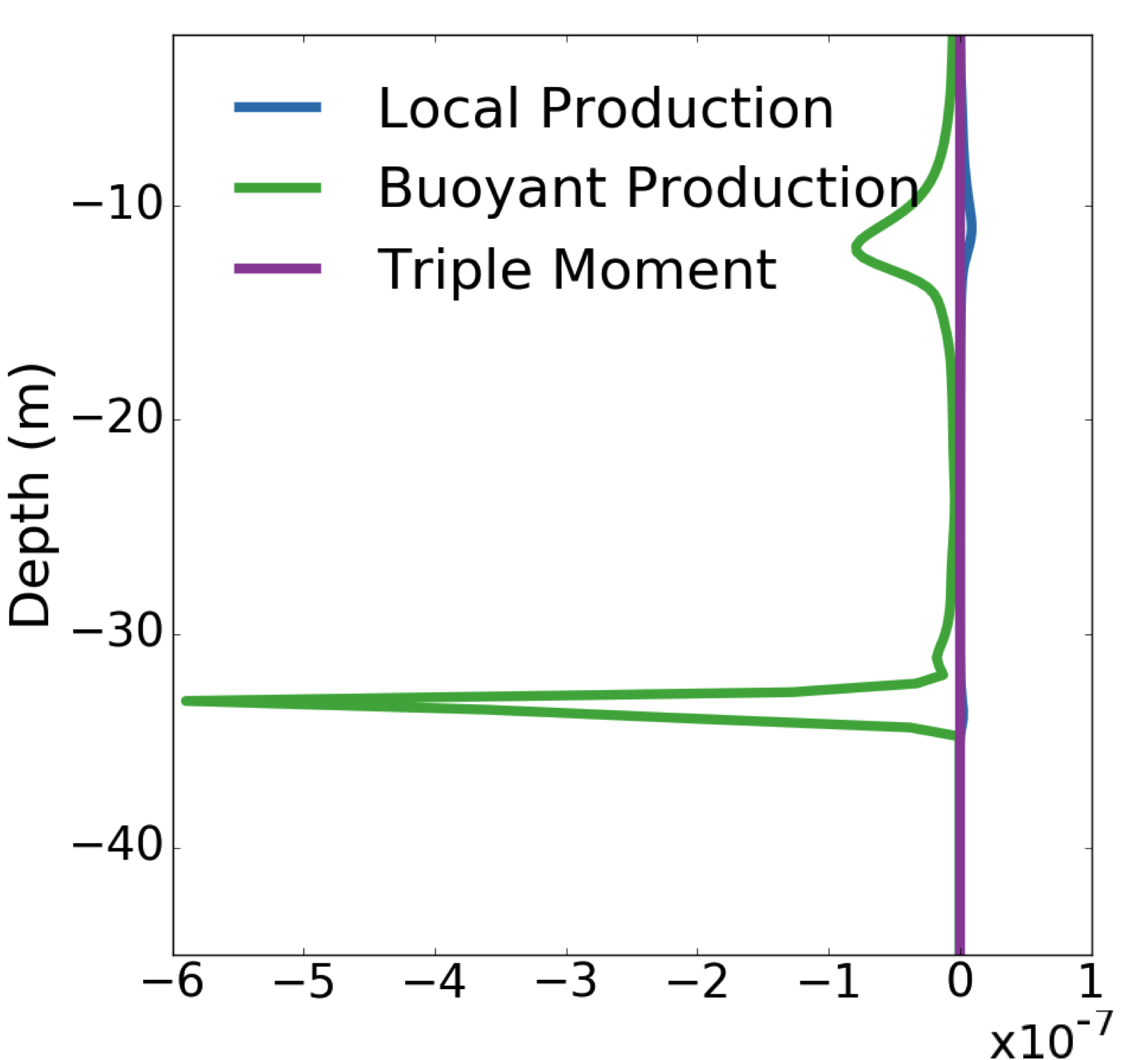
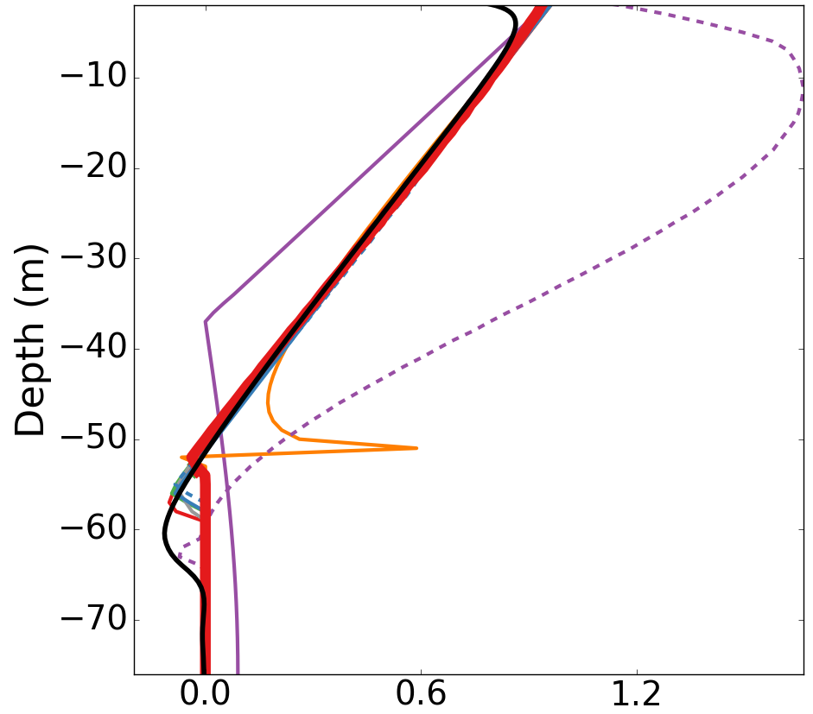
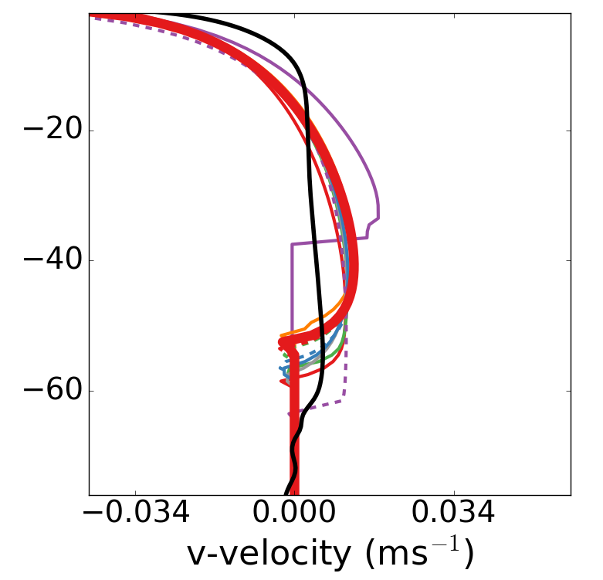
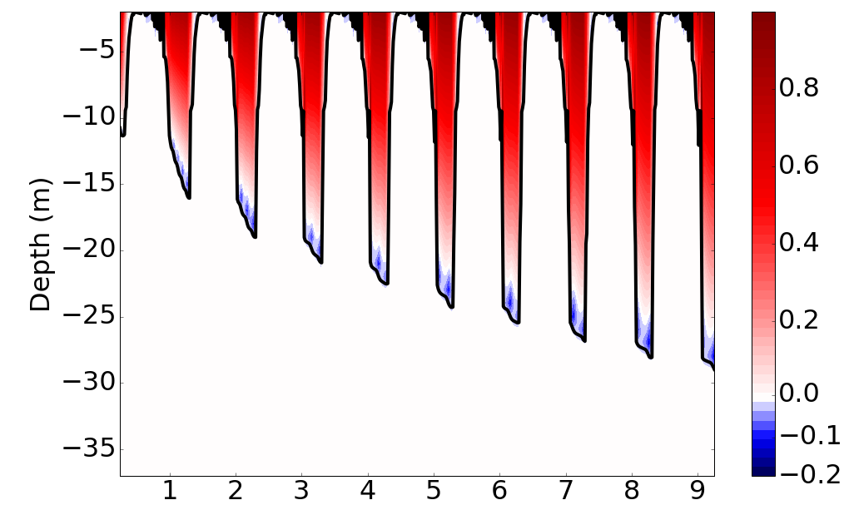
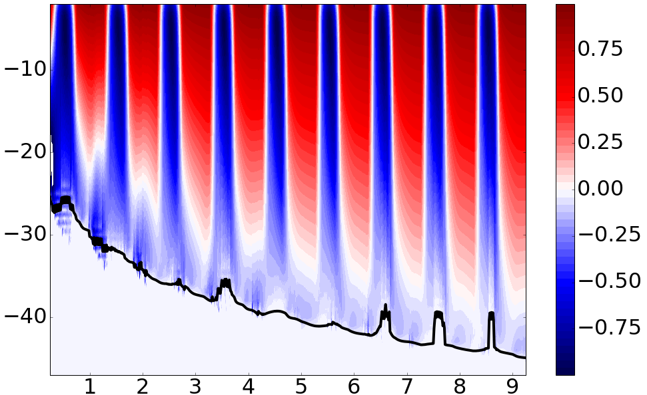
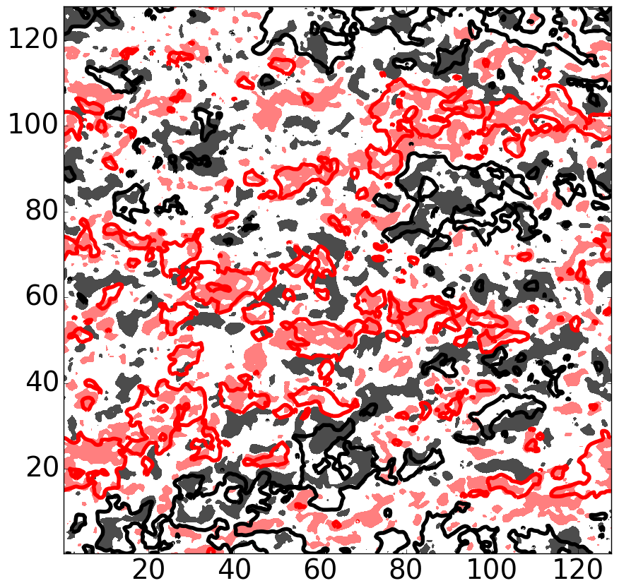
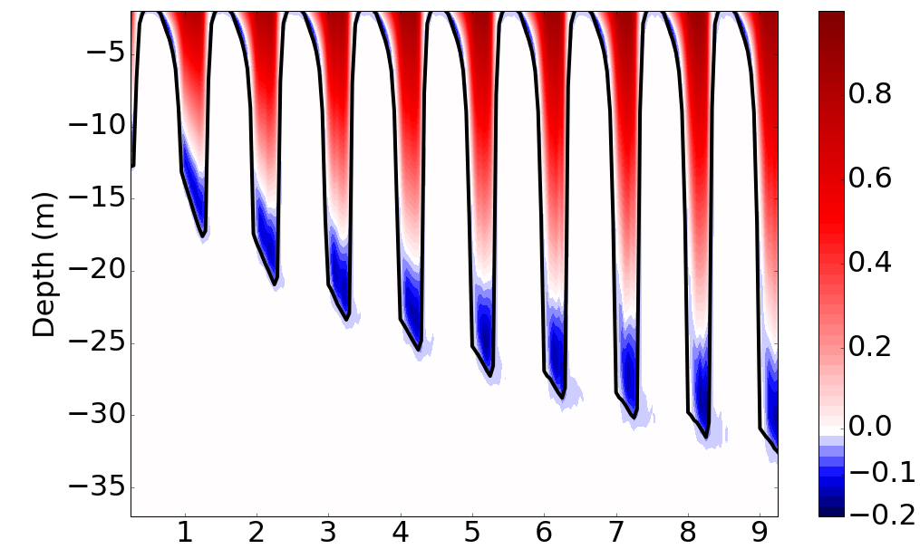
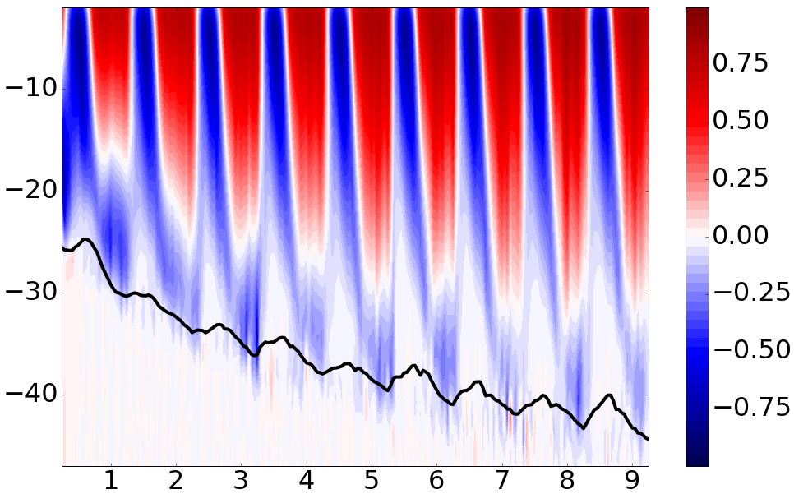
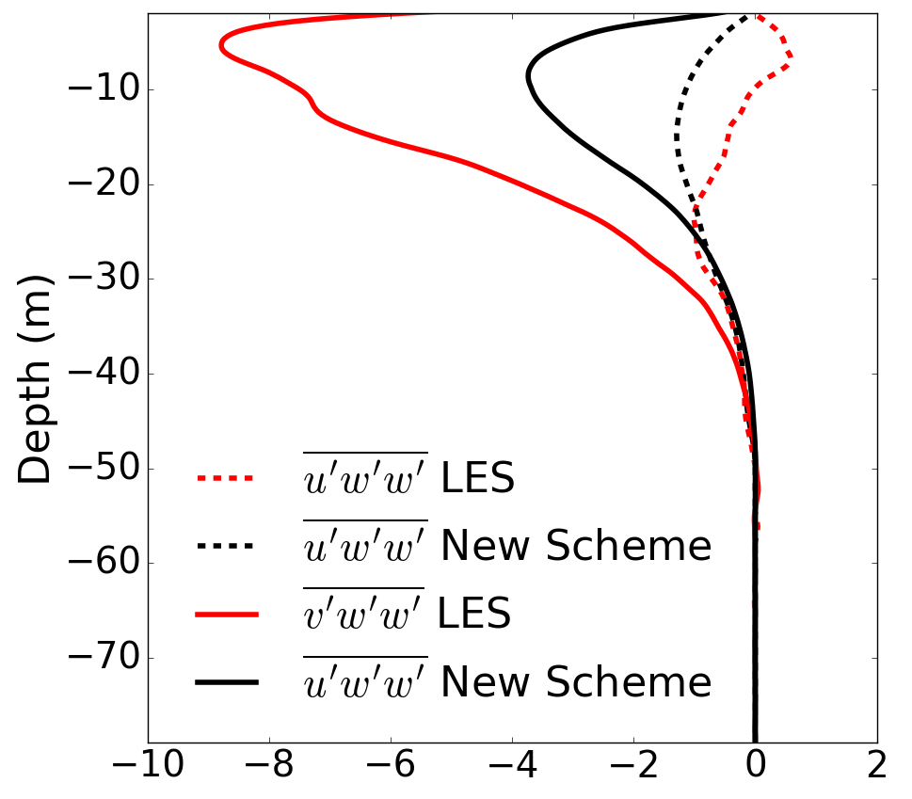
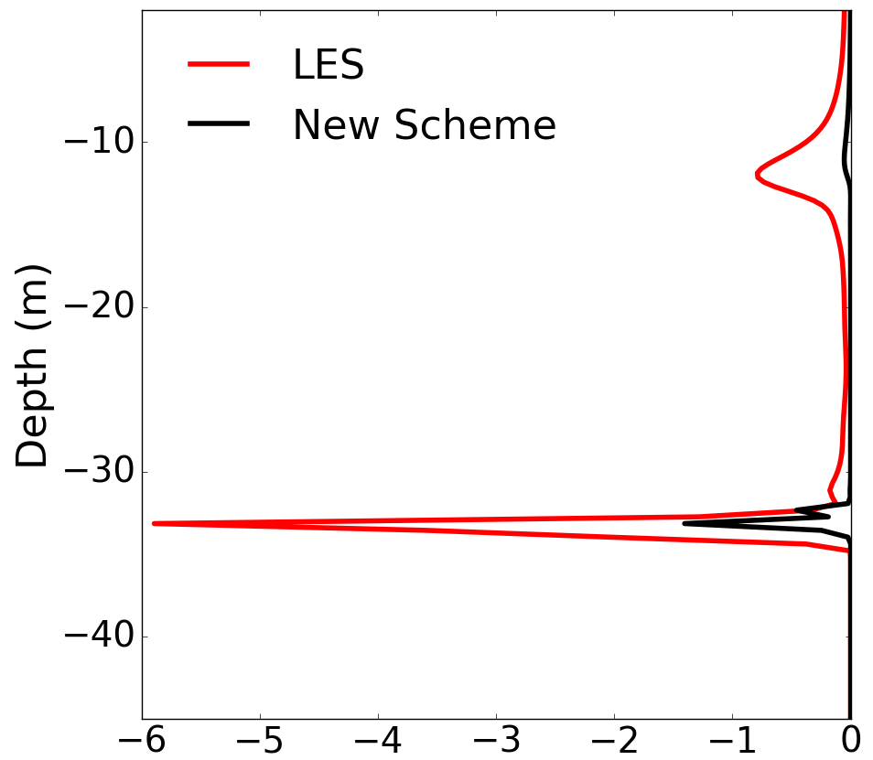
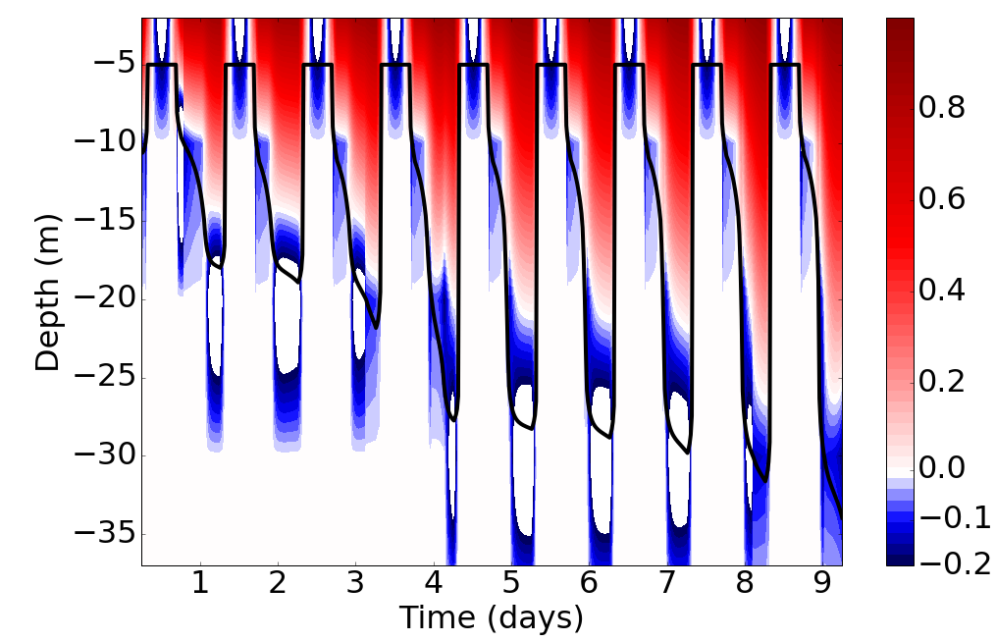
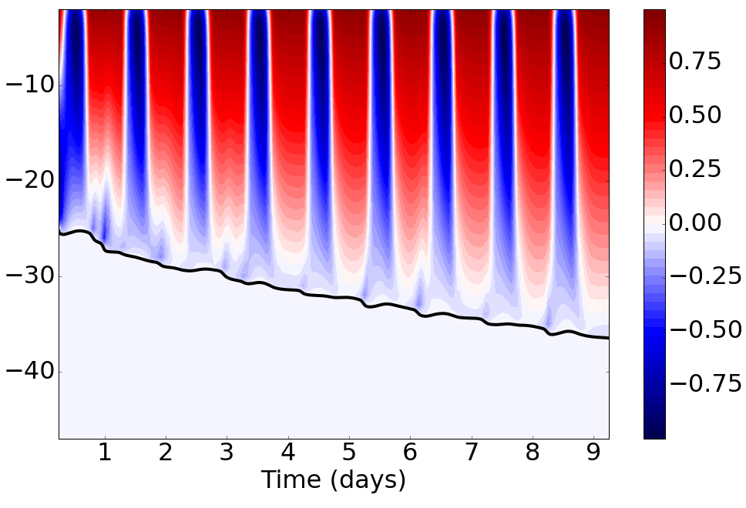
Vertical Mixing in MPAS-O
L.P. Van Roekel¹, A.J. Adcroft², G. Danabasoglu³, S.M. Griffies²,
B.Kauffman³, W. Large³, M. Levy³, B. Reichl², T. Ringler¹, M. Schmidt⁴
M. Veneziani¹
¹LANL ²GFDL, Princeton, NJ. ³NCAR, Boulder, CO. ⁴Leibniz-Institute of Baltic Sea Research, Rostock, Germany
Background
KPP vs. LES: Transient Simulations
Vertical mixing parameterization:
K-Profile Parameterization (KPP):
Quasi-River runoff test:
Convection and Wind:
Current models determine vertical turbulent fluxes by assuming
Predictive equation is assumed steady.
Resulting equation can be written as
In KPP, the diffusivity is parameterized as
A surface cooling is imposed, no surface salinity forcing.
A surface cooling, wind stress, and salinity fluxes are imposed. All are destabilizing.
KPP internal matching should not be used (orange and purple lines top right and bottom left). Large gradients in internal mixing create negative diffusivities.
V-momentum profiles not mixed enough, need non-local momentum flux. (bottom right)
KPP tracks LES well for a short time (solid lines). Dramatic divergence in T and S after a few days (dashed lines).
(1)
Mixing in the boundary layer is assumed to be dominated by surface processes (right)
LES
KPP
Small Eddies
Large Eddies
The shape function (lower right) coefficients are determined by
Matching to internal mixing
Forcing G=0 at σ = 1
NL flux of a scalar quantity is assumed to be
KPP predicts no salinity flux, while LES predicts a vigorous flux (right).
LES turbulent salinity flux budget shows assuming a dependence on surface flux is poor (left)
Most assume the non-local term (NLT) is zero (magenta above)
KPP assumes NLT is proportional to the surface flux
KPP vs. LES: Diurnal Tests
New Ideas
Left column – Diurnal cycle only. Top is 1m resolution, middle is LES, and 10m resolution is bottom.
Flux at the base of the boundary layer is very dependent on resolution in KPP (compare top left to bottom left).
Right Column – same test as left column with a moderate wind stress added. Top is 1m resolution, middle is LES, bottom is 1m resolution with a Richardson number smoothing.
Richardson number mixing can be susceptible to grid scale noise, but smoothing diminishes OBL entrainment (bottom right)
During the day, KPP is too efficient at mixing heat to the boundary layer.
Creates artificial stratification
A new scheme is proposed following Van Roekel (2010) that assumes upward and downward moving water parcels carry specific anomalies of temperature, salinity, and momentum. Testing shows this assumption is reasonable (right).
The downward moving water is assumed to occupy an area a. If
are predicted, then a can be determined.
Using the same formulation an explicit entrainment rate can be predicted.
Black - upward motion (fill) and positive T anomalies (contour). Red - downward and negative T anomalies
The inversion thickness ( ) is a function of local and OBL integrated properties
Initial Testing
Method provides a way forward for non-local momentum transport. (Left)
New scheme also predicts a non-local salinity flux in transient case (above) where KPP predicts none (Right).
For additional information, contact:
Luke Van Roekel
Post-Doc
LA-UR-16-28486
Los Alamos National Laboratory
(505) 667-1402
lvanroekel@lanl.gov
climatemodeling.science.energy.gov/acme

