Slide 1
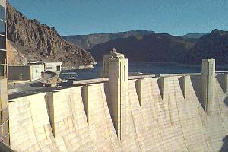
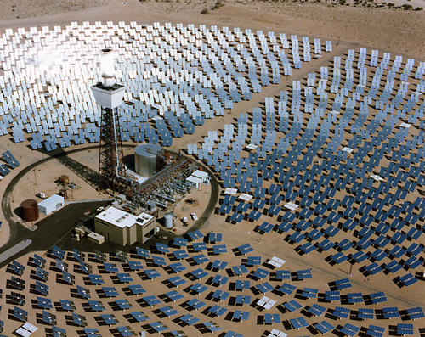
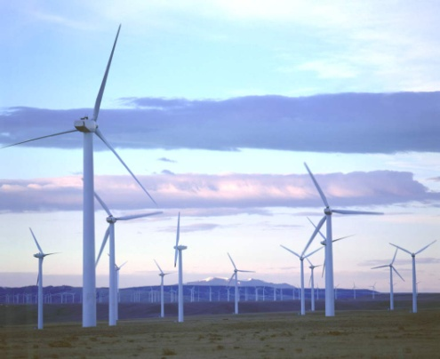
Climate Vulnerability of Water Sector Infrastructure
Vincent Tidwell, Eugene Yan, Carey King,
Ruby Leung, Steve Fernandez, and Loren Toole
DOE Climate Modeling Principal Investigator Meeting
Washington, DC , May 12, 2014

Slide 2
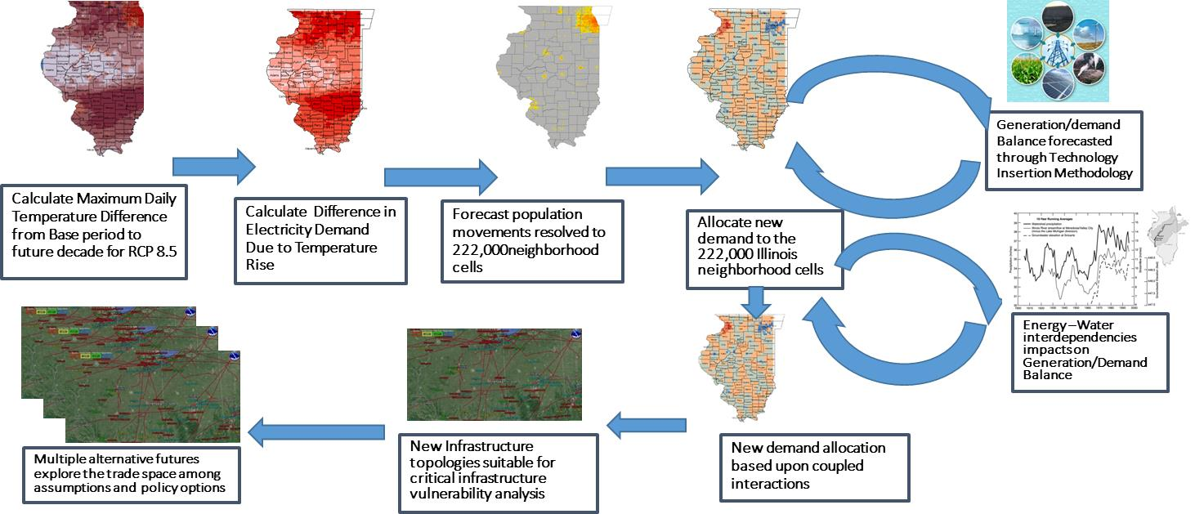
Climate Impacts on New Connected Infrastructure Vulnerabilities
Oak Ridge, Los Alamos and Sandia National Laboratories
Objective: Assessment of the vulnerability of new configurations of infrastructures and their interdependencies in response to Climate Drivers, Population Movements, Expansion and abandonment of infrastructure networks, water forecasts, technology insertion

Slide 3
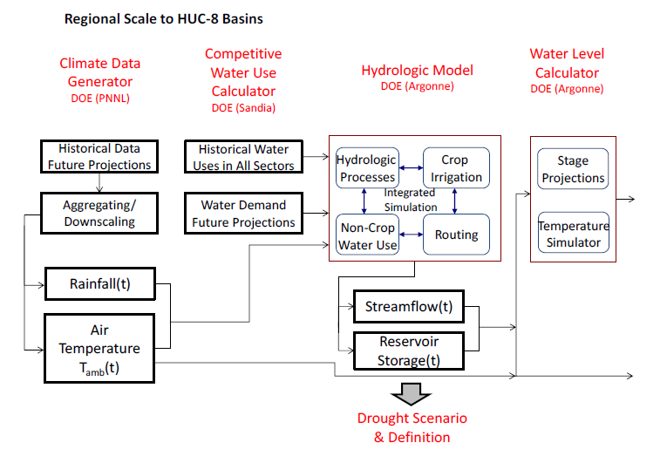
Methods of Analysis (1)
Notes:
Composite figure: circles are average of 11 drought year; color are less than 5 percentile, color line is 2007, shaded area is drought year, water year start from oct..
Characteristics:
1. Deficit: precip-winter, snowmelt-spring, soil moisture, runoff – summer
2. temp.
Annual: 0.3-0.8 C elevated from normal year
Summer and fall: 0.5-1 elevated from normal
Increased trend in recent year: 2007 drought -- ~2 C elevated from normal
2. Chance or global warming trend
Recent drought in 2001-2008 in Colorado basin: it is 60% probability for 100 year based historical measurements.

Slide 4
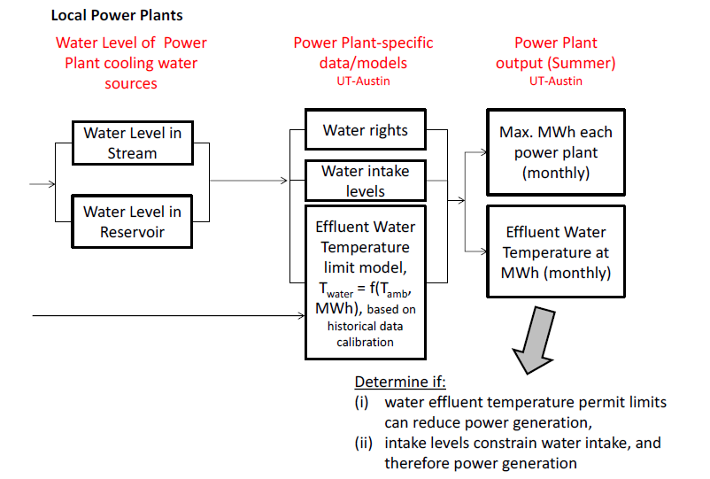
Methods of Analysis (2)

Slide 5
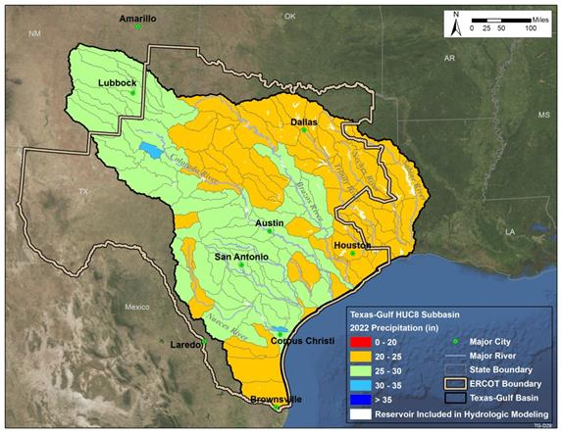
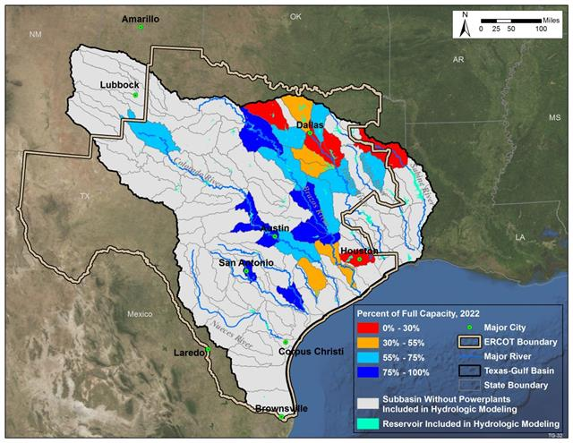
Water Supply Vulnerability
Climate Impact on Precipitation
Climate Impact on Reservoir Storage
Projected capacity in drought conditions for those reservoirs supplying water for thermoelectric generation

Slide 6
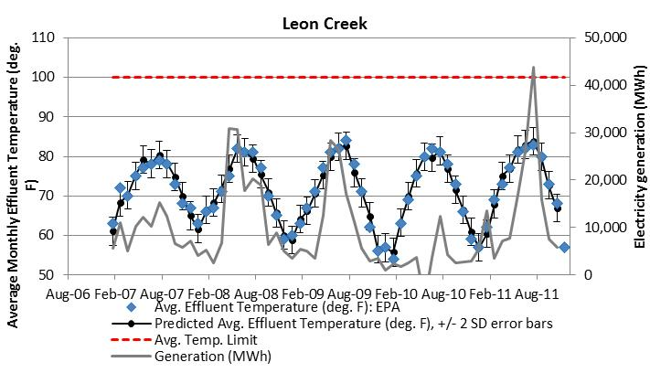
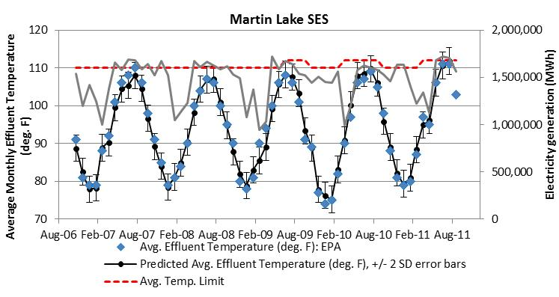
Vulnerability to Discharge Limits
Measured and modeled power plant effluent temperatures plotted against permitted limit for two different facilities in Texas

Slide 7
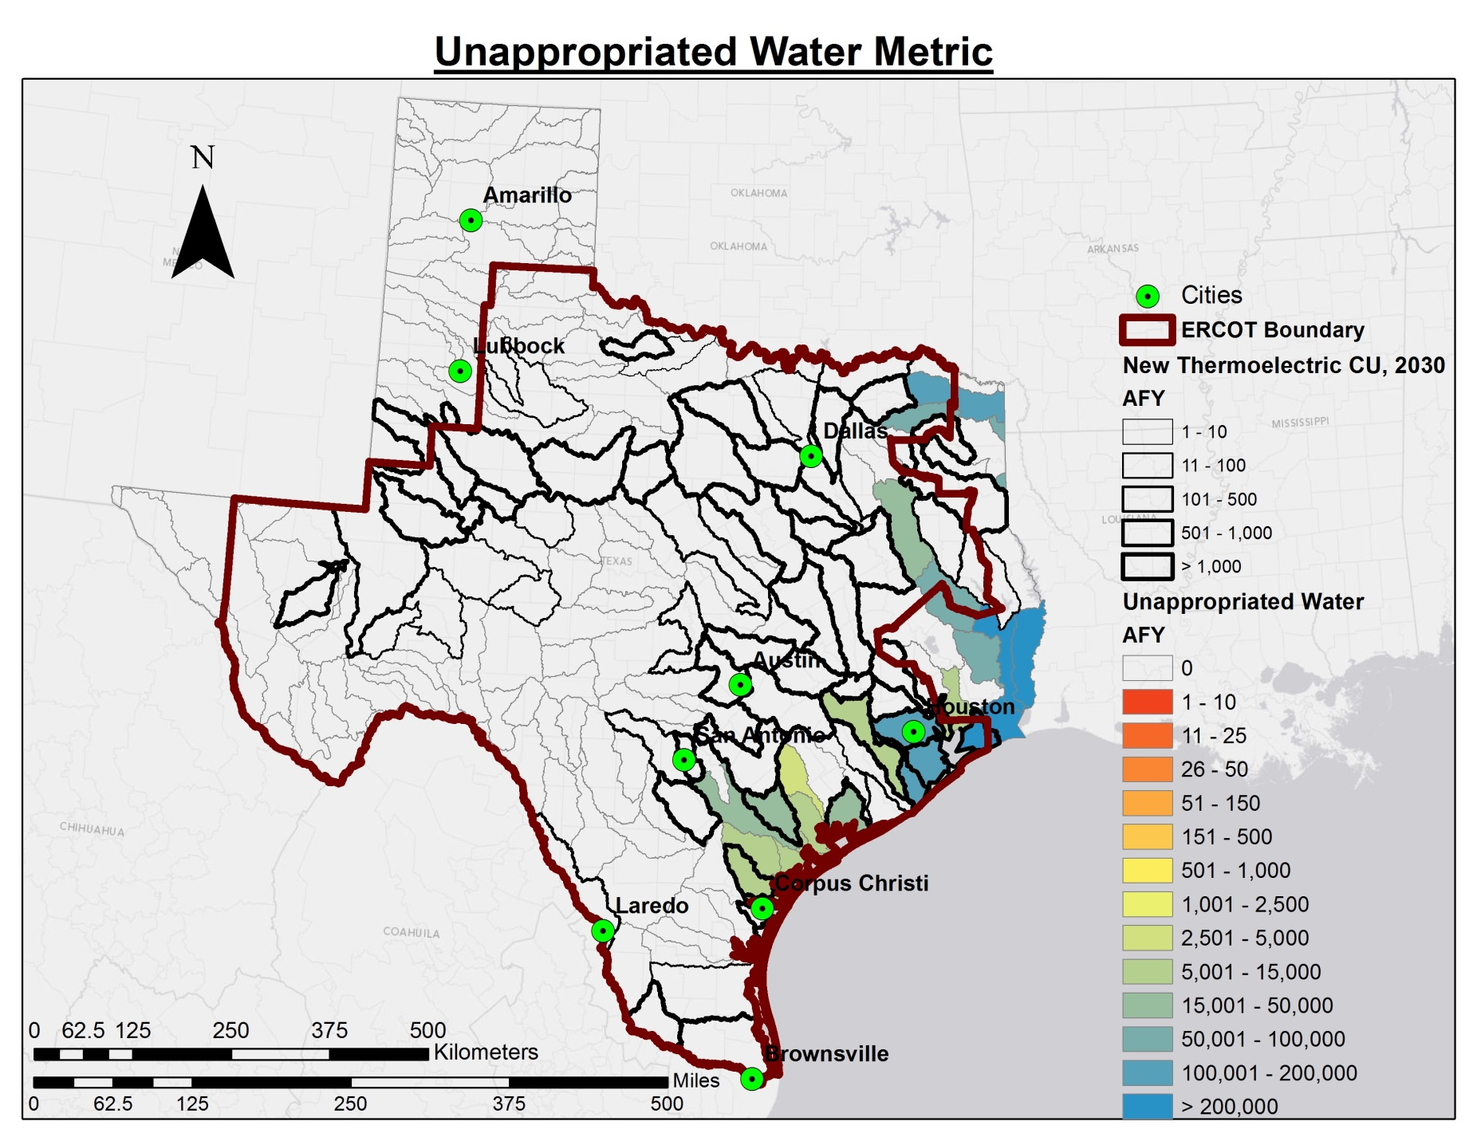
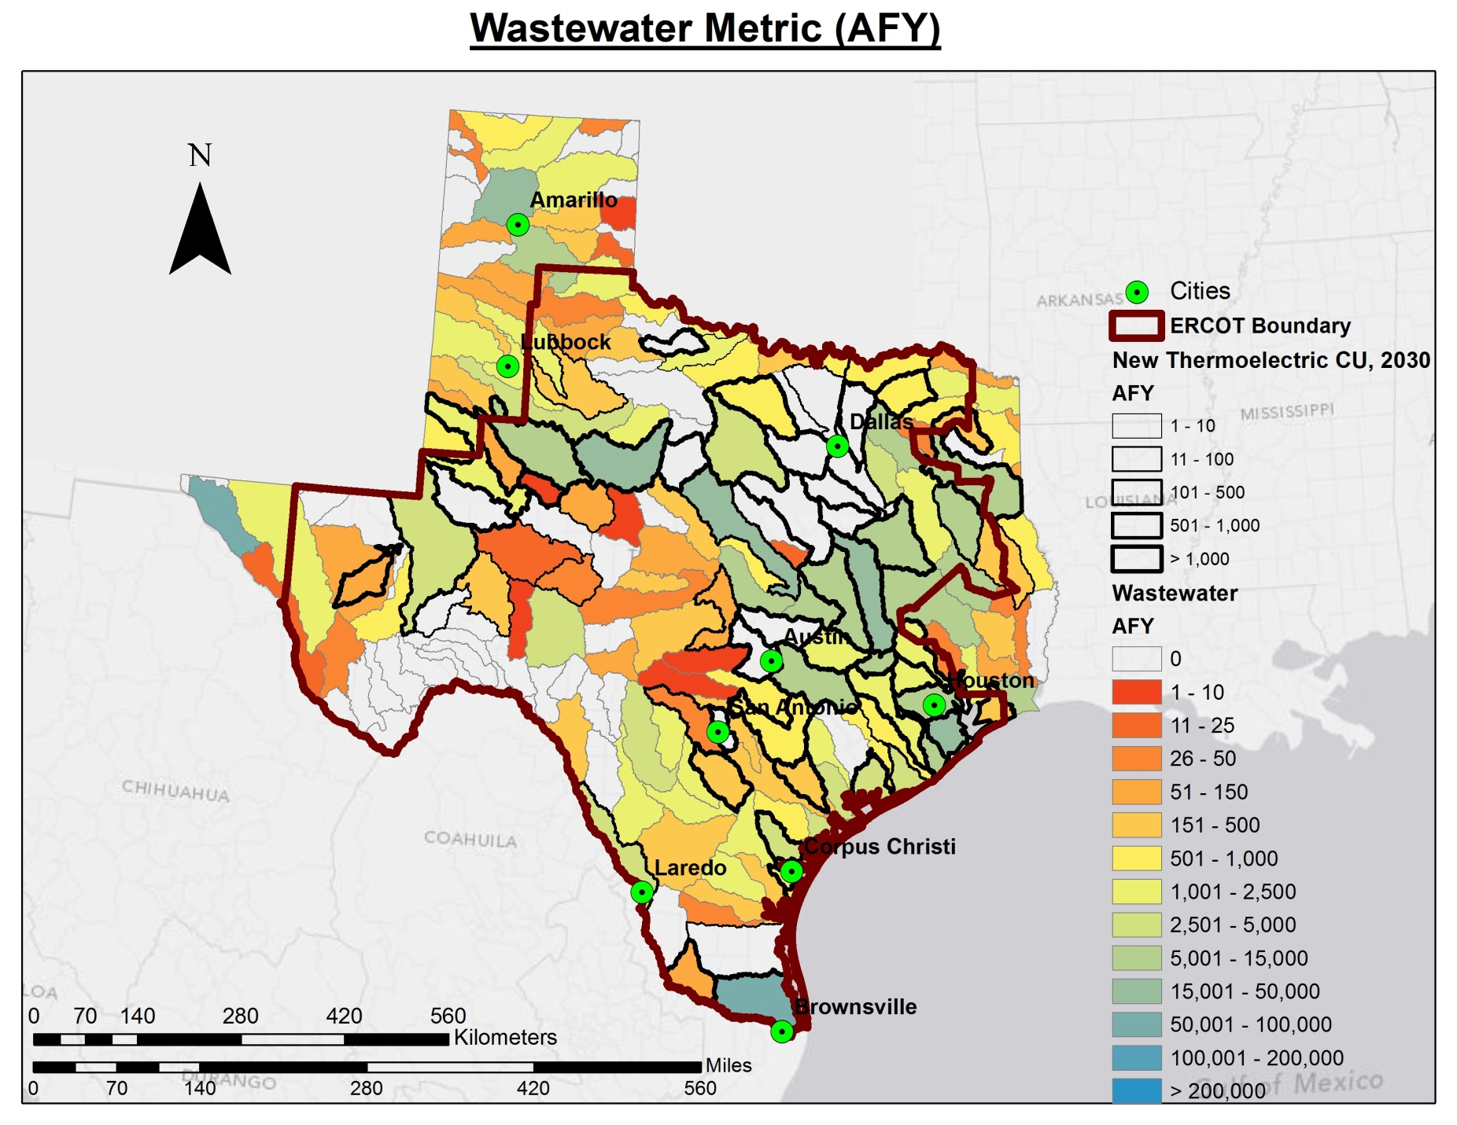
Water Supply for Development
Availability of two different supplies of water for future development. Unappropriated surface water is based on drought of record. Outlined basins indicated locations of projected future thermoelectric water demands.

