Slide 1
Developing a Predictive Model to Identify Potential Electric Grid Stress Events due to Climate and Weather Factors
Jennie Rice, Lisa Bramer, James Dirks, John Hathaway, Ruby leung, ying liu, Trenton Pulsipher, daniel skorski
Pacific Northwest National Laboratory
Integrated Climate Modeling Principal Investigator Meeting
May 12, 2014

Slide 2
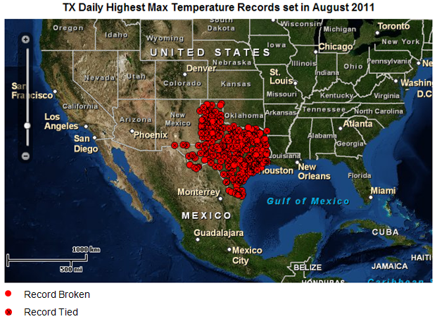
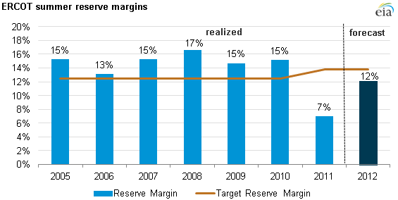
Electricity Grid Stress
Grid stress is when the electricity grid is compromised in its ability to reliably meet the demand for electricity.
The standard industry measure of grid stress is the reserve margin --the percent by which the system’s available capacity (supply) exceeds the peak load (demand).
Climate and weather directly influence grid stress.
Sources: U.S. Energy Information Administration, based on the Electricity Reliability Council of Texas Annual Capacity, Demand, and Resource Reports and 2012 Long-Term Demand and Energy Forecast.
Source: U.S. Energy Information Administration, based on the National Oceanic and Atmospheric Administration

Slide 3
Predicting Electricity Grid Stress Events
Science questions:
  Are standard definitions of extreme climate/weather events (e.g., WMO heat wave definition*) sufficient for predicting grid stress events?
  Can we develop a better predictive model of grid stress?
  Will climate change contribute to an increase in the frequency or severity of grid stress events?
Research approach:
  Identify grid stress events from the historical record, using the Texas electricity grid (ERCOT)
  Identify commensurate weather data and derive potential predictive variables
  Test alternative predictive models, including WMO heat wave definition
This research is supported by the Integrated Assessment Research Program, Regional Integrated Assessment Modeling (RIAM) project
* When the daily maximum temperature of at least five consecutive days exceeds the climatological norm maximum temperature by 5 °C

Slide 4
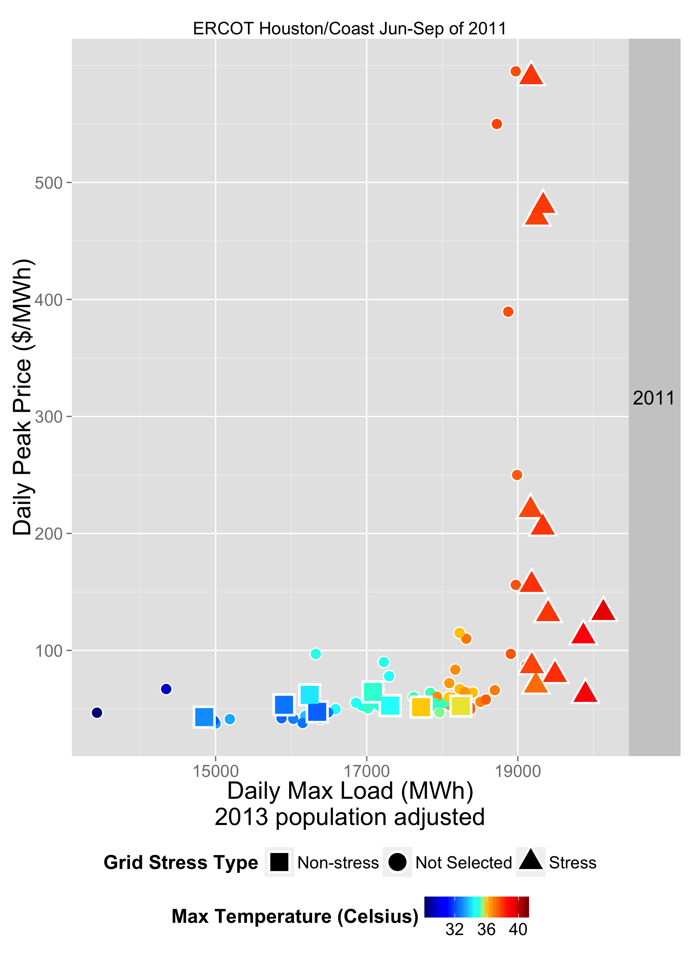
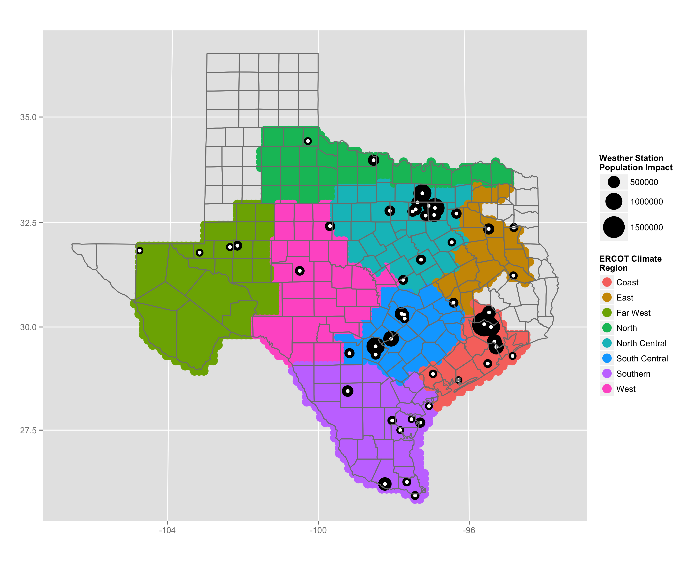




Data Challenges
Publicly available reserve margin data incomplete for the period studied (2003-2013)
Decision made to use daily peak demand (load) to identify grid stress days
Day ahead on-peak prices (also not available for the entire period) used to check grid stress days
Notes:
The current research explores the first two questions, focusing on identifying the weather conditions leading to electricity demand-side stress. (Subsequent phases will address predictive models for supply-side stresses and then utilize the combined results to address the third question.)
Also explain that we are using ERCOT data for 8 unique climate regions over the years 2003-2013.

Slide 5
Approach: Classification Model
Define Training Dataset
  Selected 90 grid stress and 90 non-stress days for each climate zone
  Set aside 10% each of grid stress and non-stress days
Develop Weather Variables
  Capture persistence, changes, and magnitude (>100 variables)
Naïve Bayes classification
  5,000 random samples of training dataset
  Stepwise variable selection for each sampled training set
  Choose variables that are selected with the highest frequency
 | Temporal Aggregation
 | Daily (Hourly) | 1,3, & 5 days | 2 & 8 hour window
Temperature | Maximum, Minimum, Mean | Period mean for days prior to observed day Percent difference in variable from observed day and aggregated day level | Period mean for hours from peak temperature
Relative Humidity | Maximum, Minimum, Mean
Absolute Humidity | Maximum, Minimum, Mean
Pressure | Maximum, Minimum
Wind Speed | Mean
Coast Region – Stepwise Variable Selection Results
Variable | Proportion of Times Selected
MaxTemp.pctdiff.5days | 0.7254
MeanTemp | 0.5894
MaxTemp.mean.8hr | 0.3936
MaxPressure.pctdiff.3days | 0.1562
MeanTemp.pctdiff.5days | 0.1464
MaxPressure.pctdiff.5days | 0.1330
MinAbsHum.pctdiff.1day | 0.0962
Notes:
We have ERCOT demand data that was used to classify stress and non-stress days and verify using limited price data
Selected 90 grid stressing days for each climate zone and a sample of 90 non-stress days
Climate/Weather data for several variables and computed statistical summaries over different time windows to capture weather changes or persistent behavior
Use Naïve Bayes model and perform variable selection for each climate zone

Slide 6
Predictive Model Results
Optimal Weather Variables
Cross Validated Prediction Results
Climate Region | Naïve Bayes Bootstrap Mean Accuracy |  | WMO Bootstrap Accuracy
 | Region Specific | Global
Coast | 84.30% | 80.71% | 50.00%
North | 72.37% | 70.97% | 47.77%
North Central | 90.38% | 89.06% | 50.53%
South Central | 89.48% | 86.60% | 51.67%
Southern | 83.02% | 79.73% | 51.12%
East | 76.89% | 72.19% | 50.55%
West | 82.14% | 78.22% | 49.43%
Far West | 74.69% | 70.78% | 52.74%
Variable | Type | Window | Statistic | Climate Region
Pressure | Maximum | 5 day | Percent | S, NC
Pressure | Minimum | 3 day | Percent | FW
Relative Humidity | Maximum |  |  | FW
Relative Humidity | Mean | 3 day | Percent | N, E
Temperature | Maximum | 2 hr | Mean | SC
Temperature | Maximum | 5 day | Percent | C
Temperature | Mean |  |  | E,C, FW
Temperature | Minimum | 1 day | Mean | W
Temperature | Minimum |  |  | W
Temperaure | Maximum | 8 hr | Mean | S, C, NC
Wind Speed | Mean | 1 day | Mean | E
Wind Speed | Mean | 2 hr | Mean | SC
Wind Speed | Mean | 5 day | Mean | N,W
Wind Speed | Mean | 8 hr | Mean | SC
Notes:
We built regional models and then aggregated across the regional models to build a global model which accounts for regional climate differences
Table on the left shows variables selected for each climate zone, these were variables selected the highest percentage of times over the 5,000 bootstrap iterations
Prediction results are based on a prediction for a subset of data not used in model fitting, for each of the 5,000 iterations
Table on right: for Naïve Bayes the left column gives the accuracy assuming we use only variables selected for respective region
the right column gives the accuracy when we use a general model with all variables used for each climate zone prediction
WMO definition is used for each bootstrap iteration and averaged, so results are comparable to Naïve Bayes

Slide 7
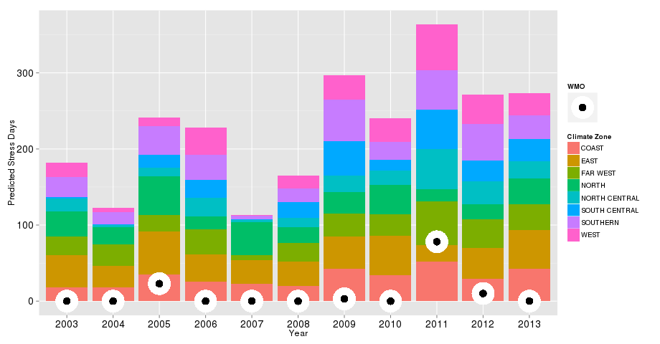
Conclusions & Path Forward
  Weather-driven multivariate models improve prediction of grid stress days over WMO heat wave definition
  Interdisciplinary team critical for integrated modeling
  Energy sector data availability challenges likely to persist for integrated modeling
Next steps:
  Further refinement/optimization of final variable set
  Investigation of prevalence and duration of future grid stressing events by applying model to RESM RCP4.5 and RCP8.5 output
Application of Predictive Model to Historical Weather Data Compared to WMO Heat Wave
Notes:
Graph show the total number of grid stress days by year and colored by region, the large black and white dot represents the number of WMO classified days totaled over all regions in a year
Specific WMO non-zero counts: 2005 – 23, 2009 – 3, 2011 – 78, 2012 - 10

Slide 8
Backup Slides

Slide 9
Naïve Bayes Classification Model
  Use weather variables to predict/classify a day as grid stress or non-stress event
  Statistical model based on Bayes theorem:
    Y = 1: grid stressing event and X₁=k, X₂=j, …: weather variable values
Classify a day as grid stress/non-stress based according to which density is highest
Non-Stress
Grid Stress
Example of Naïve Bayes model for the Coast region using only Maximum Temperature to classify grid stress events
Notes:
Pr(Y|X) reads probability of Y given X, so for us we are trying to find the probability of it being a stress event given the weather variables equal certain values
Graph gives an example of what a model using maximum temperature would result in a day with a temperature greater than ~34.1 degrees being classified as grid stressing and anything below being a non-stress

