Slide 1
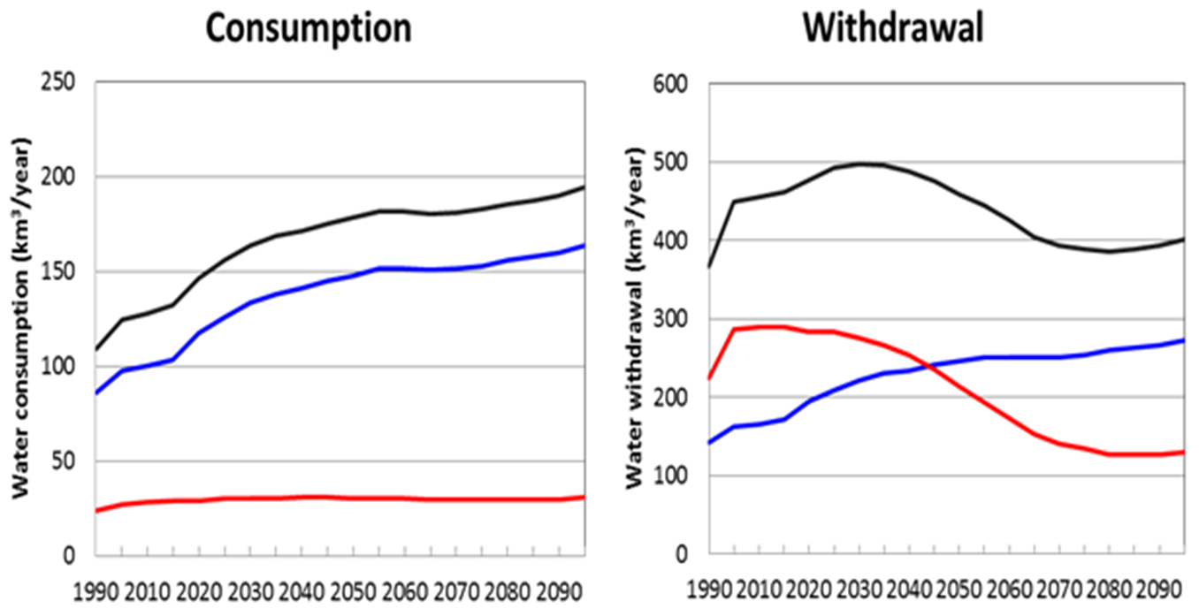
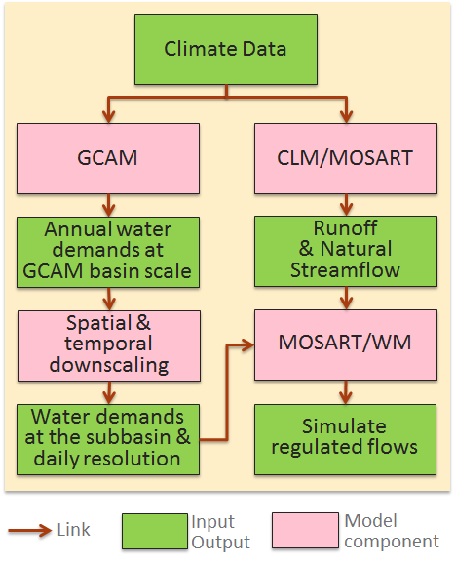
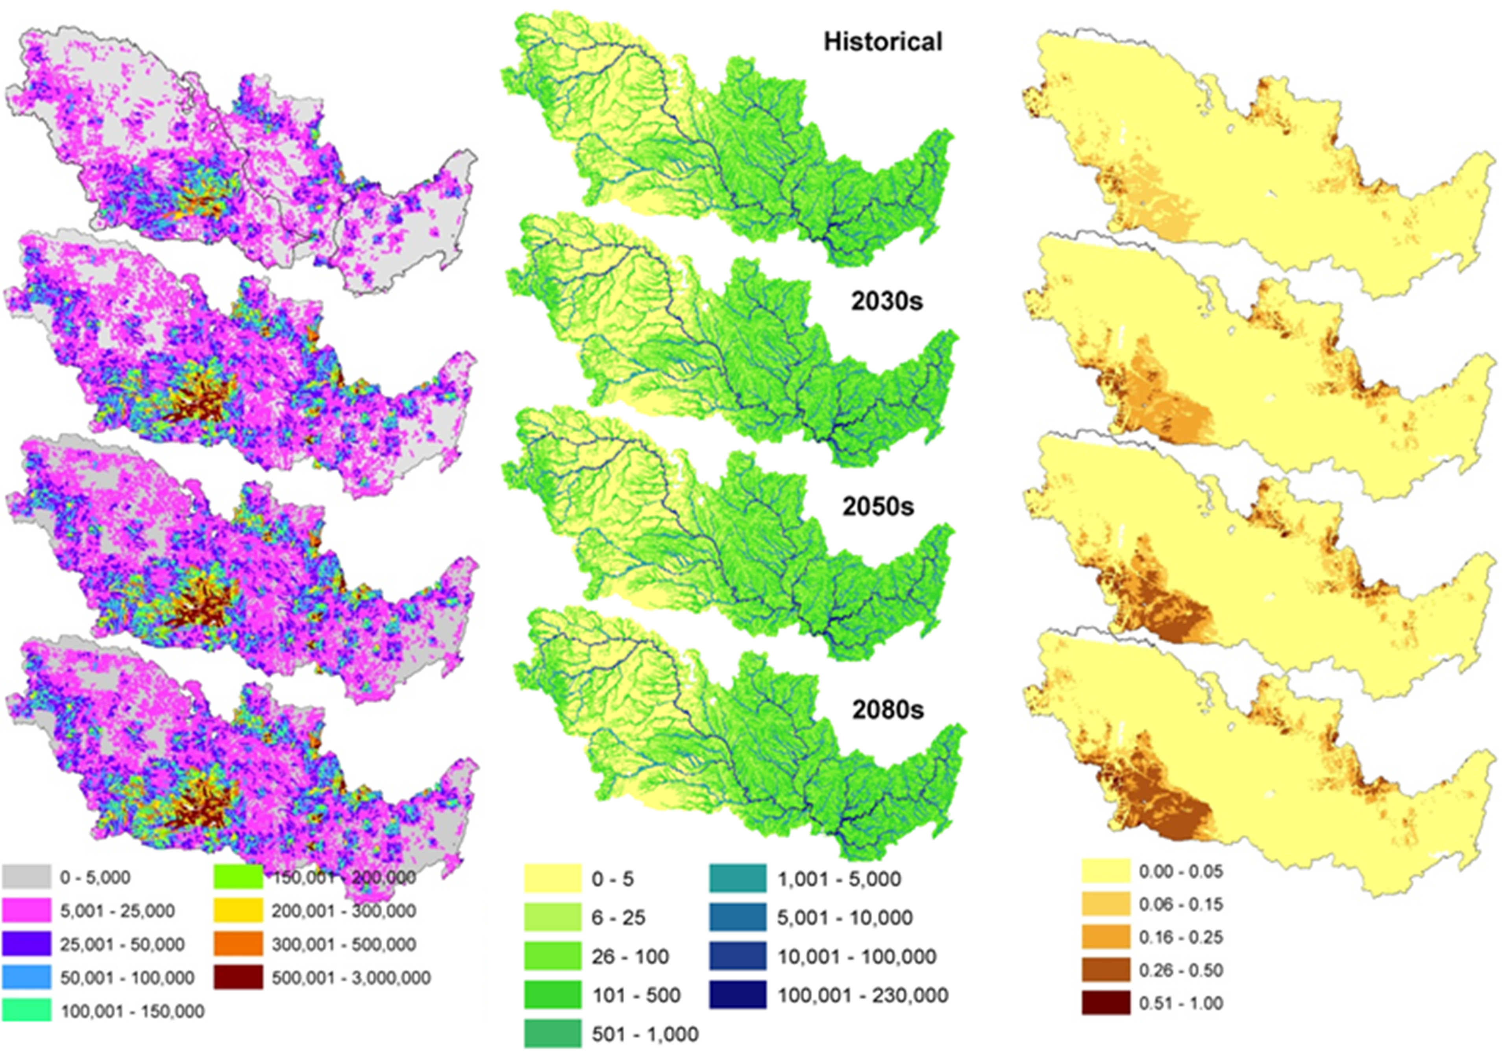
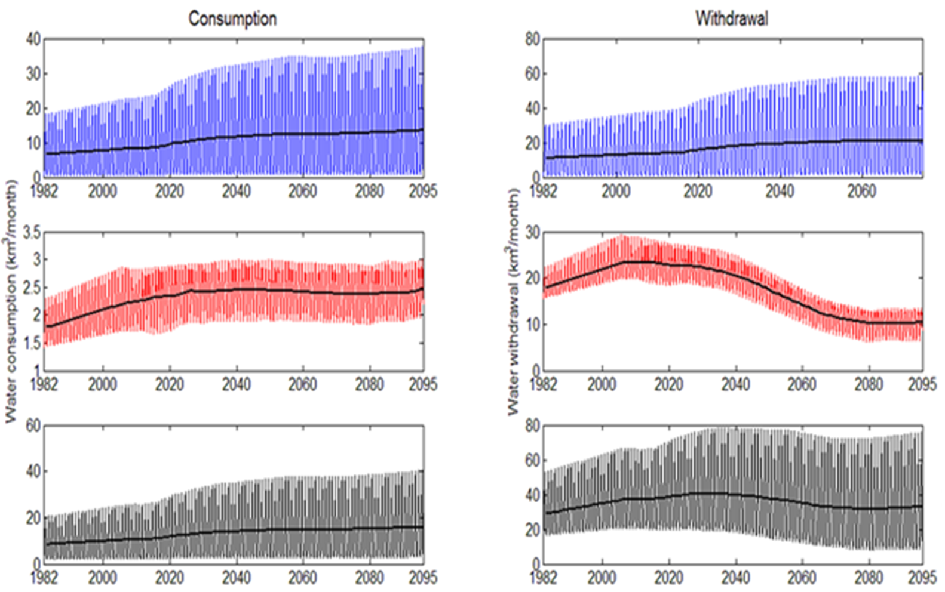
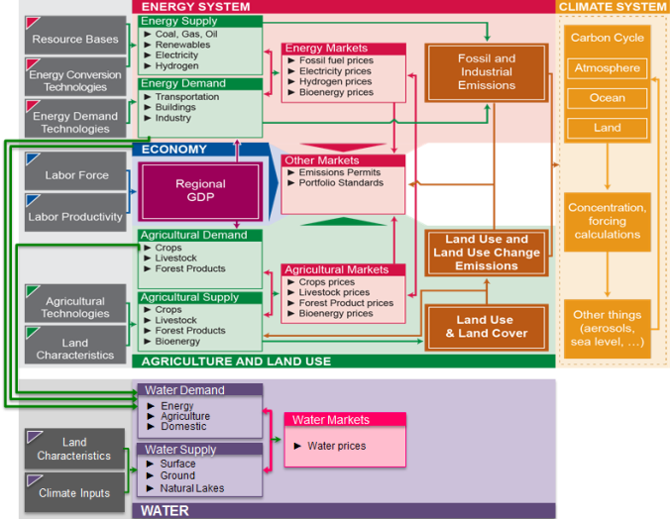
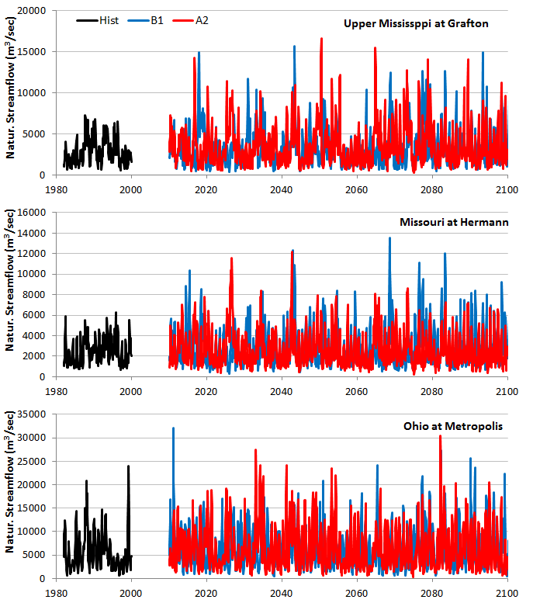
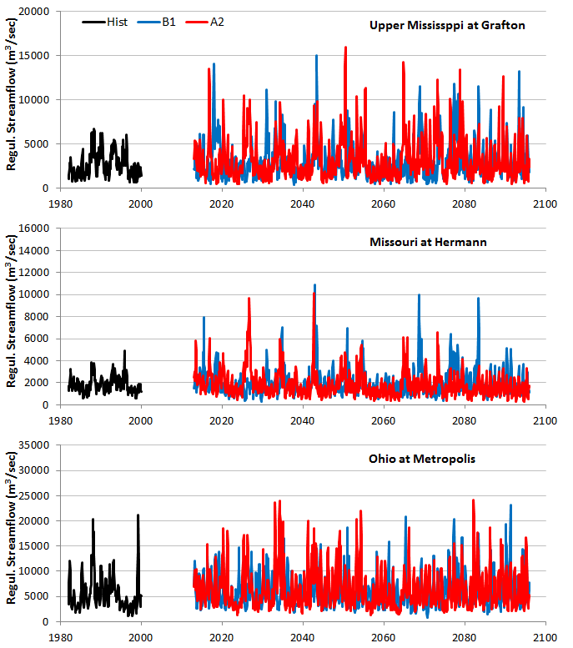
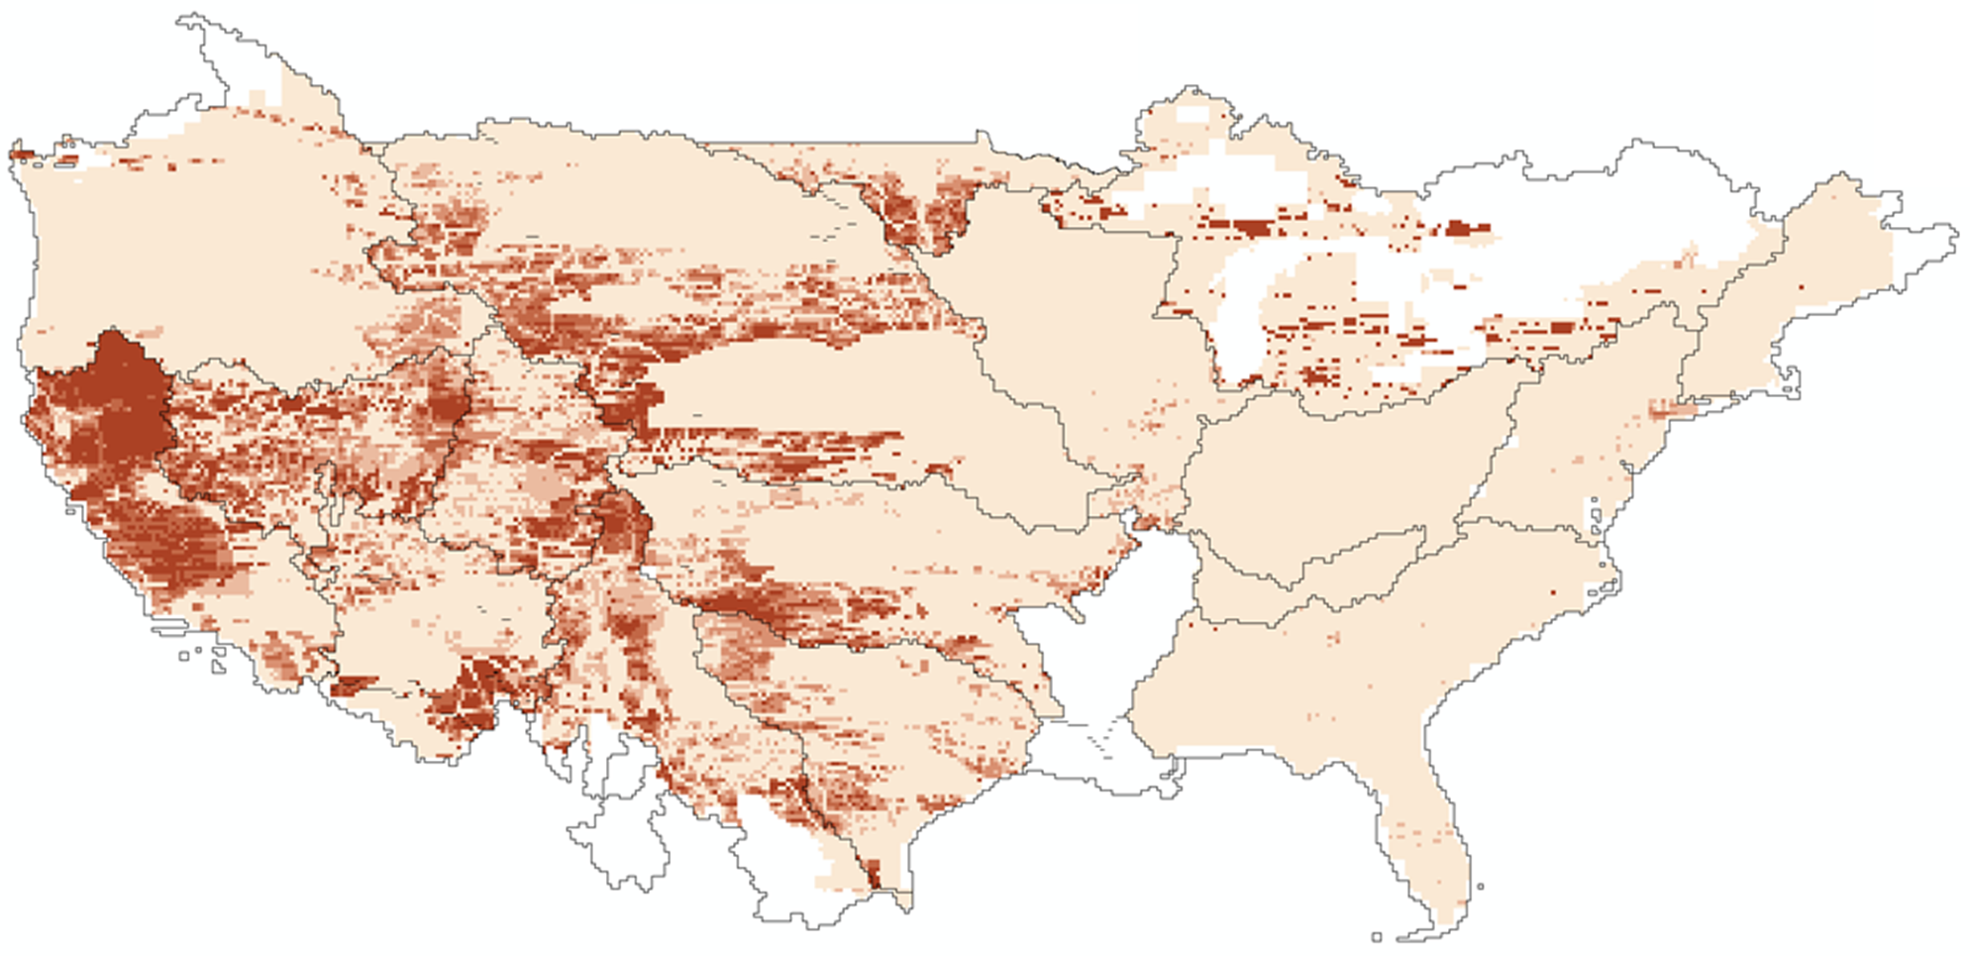
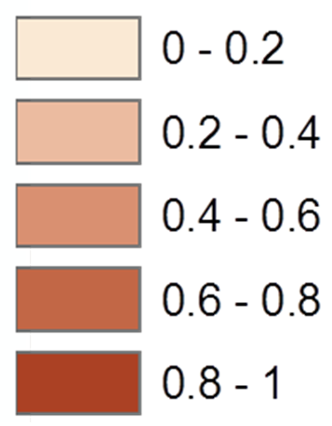
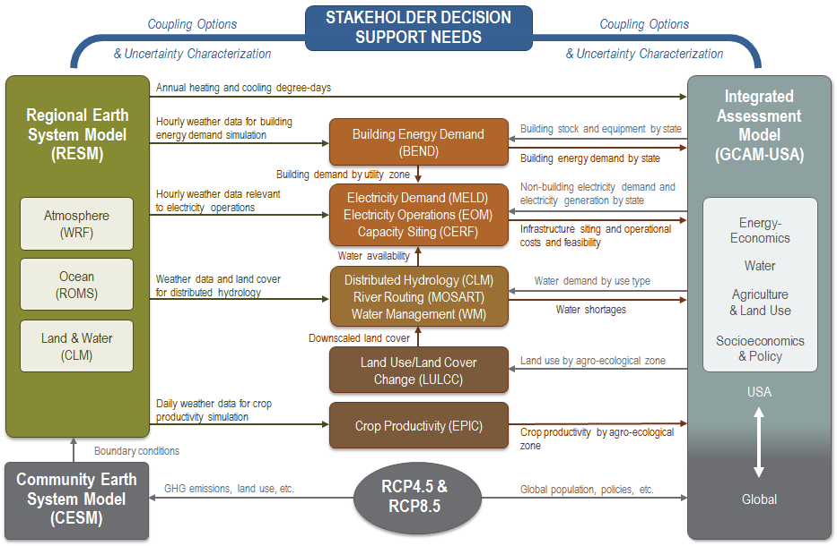
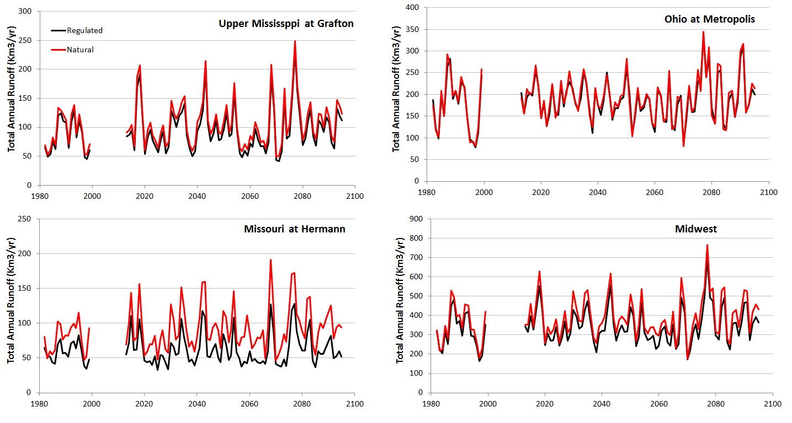
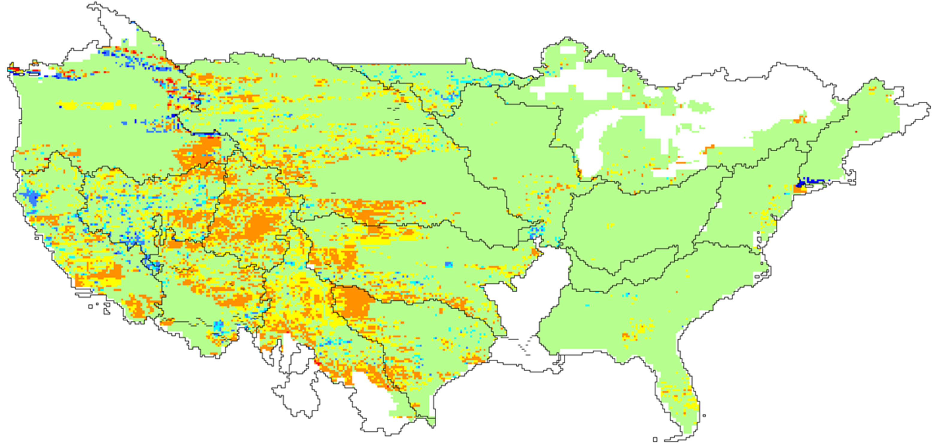
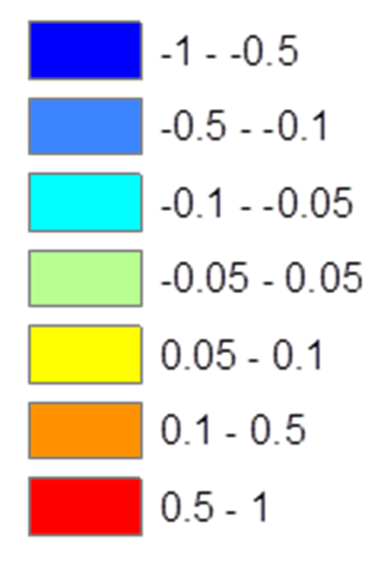
One-way coupling of the Global Change Assessment Model (GCAM) and the Community Land Model (CLM):
An outlook of future water deficits in the U.S.
M. Hejazi, N. Voisin, L. Liu, T. Tesfa, H. Li, M. Huang, Y. Liu, R.L. Leung, J. Rice
Overview
The integration of water management in integrated assessment and Earth system models at the regional scale is an important step toward improving our understanding of the interactions between human activities, terrestrial system and water cycle, and to evaluate how system interactions are affected by a changing climate at the regional scale. This integration is critical to investigate the implications of climate change impacts and adaptation and mitigation options on water resources (e.g., balances between water demand and supply) in the U.S., and how water constraints can feedback to influence other human decisions and physical processes.
Approach
Sample Analyses and Results
Total
Demand
Supply
Deficit
Irrigation
~3%
Non-irrigation
1
3
(1) Annual water demands by sector
~6-7%
Irrigation
~8-9%
Global Change Assessment Model
Community Earth System Model
2
4
Non-irrigation
~9-10%
Land Surface Scheme
Total
Sub-basin Hydrology (SCLM)
River Routing (MOSART)
Water Management (WM)
(2) Monthly water demands by sector
Reconciliation of water supply and demand in RESM/CLM and GCAM, respectively, for the upper Mississippi. Plots show annual water demand (left) and water supply (center) in cubic meters, and water supply deficit (right) in decimal percent for historical and future periods (B1).
Objectives
The development of a regional representation of water demands in the Global Climate Assessment Model (GCAM), and
The linkage of GCAM and the land surface component of Regional Earth System Model (RESM) – including the Community Land Model (CLM), the MOdel for Scale Adaptive River Transport (MOSART), and the Water Management (WM) components
decimal
percent
PRIMA Components and Interactions
(3) Monthly natural streamflow for the time periods of 1982-2009 (hist) and 2010-2100 (B1 and A2 scenarios)
(4) Monthly regulated streamflow for the time periods of 1982-2009 (hist) and 2010-2100 (B1 and A2 scenarios)
Water supply deficit in the 2080s period under RCP8.5.
8% to 11%
1% to 3%
Long term simulated time series of historical & future (B1) total annual regulated & natural streamflow for the three regions and the Upper Midwest. The percent reduction in annual streamflow due to human water consumption varies across basins
Δ decimal
percent
28% to 36%
10% to 13%
File Name // File Date // PNNL-SA-#####
Difference in water supply deficit between the 2080s period under RCP8.5 and historical
Contact:
Mohamad Hejazi
Pacific Northwest National Laboratory
5825 University Research Court, Suite 3500,
College Park, MD 20740, mohamad.hejazi@pnnl.gov
Reference:
N. Voisin, L. Liu, M. Hejazi, T. Tesfa, H. Li, M. Huang, Y. Liu, and L. R. Leung (2013). One-way coupling of an integrated assessment model and a water resources model: evaluation and implications of future changes over the US Midwest. Hydrol. Earth Syst. Sci., 17, 4555–4575, doi:10.5194/hess-17-4555-2013
Notes:
NOTE: Print this poster file at 100% SCALE to result in a physical print measuring 48” wide x 36” tall. All type size notations shown above are based on the final printed size of the poster.
• Contact Digital Duplicating (375-2969, http://digitalduplicating.pnl.gov) to order poster printing and finishing services for your completed poster design.
• Remember to have your poster cleared for public display/distribution through the ERICA Information Release system (http://erica.pnl.gov).
• Sidebar “About PNNL” box is considered optional, and can be removed if space is needed for technical content.

