Slide 1
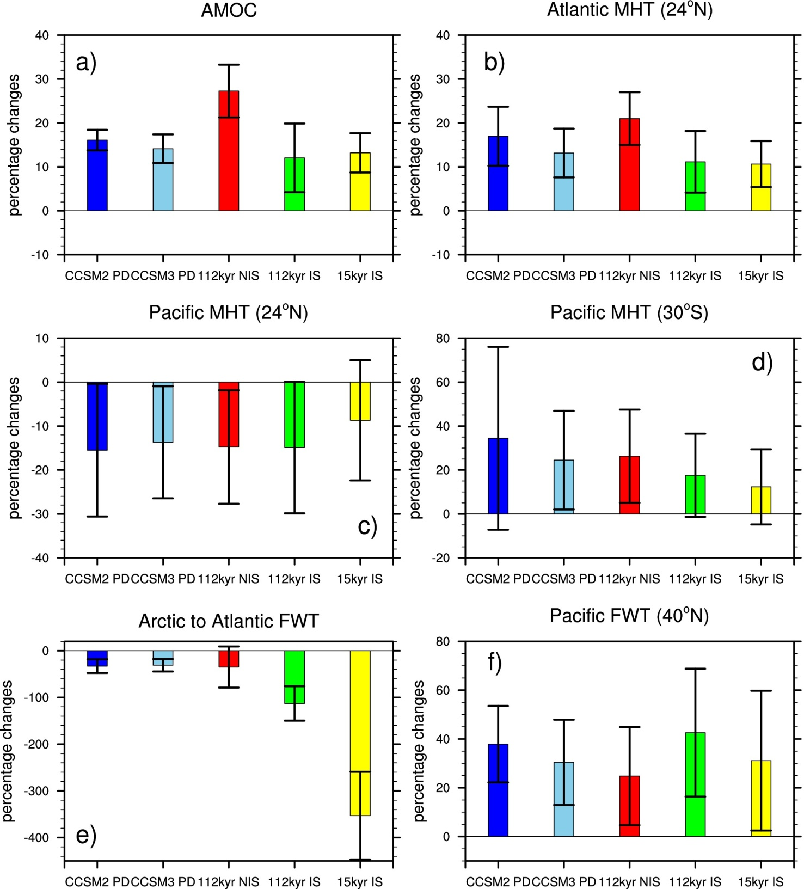
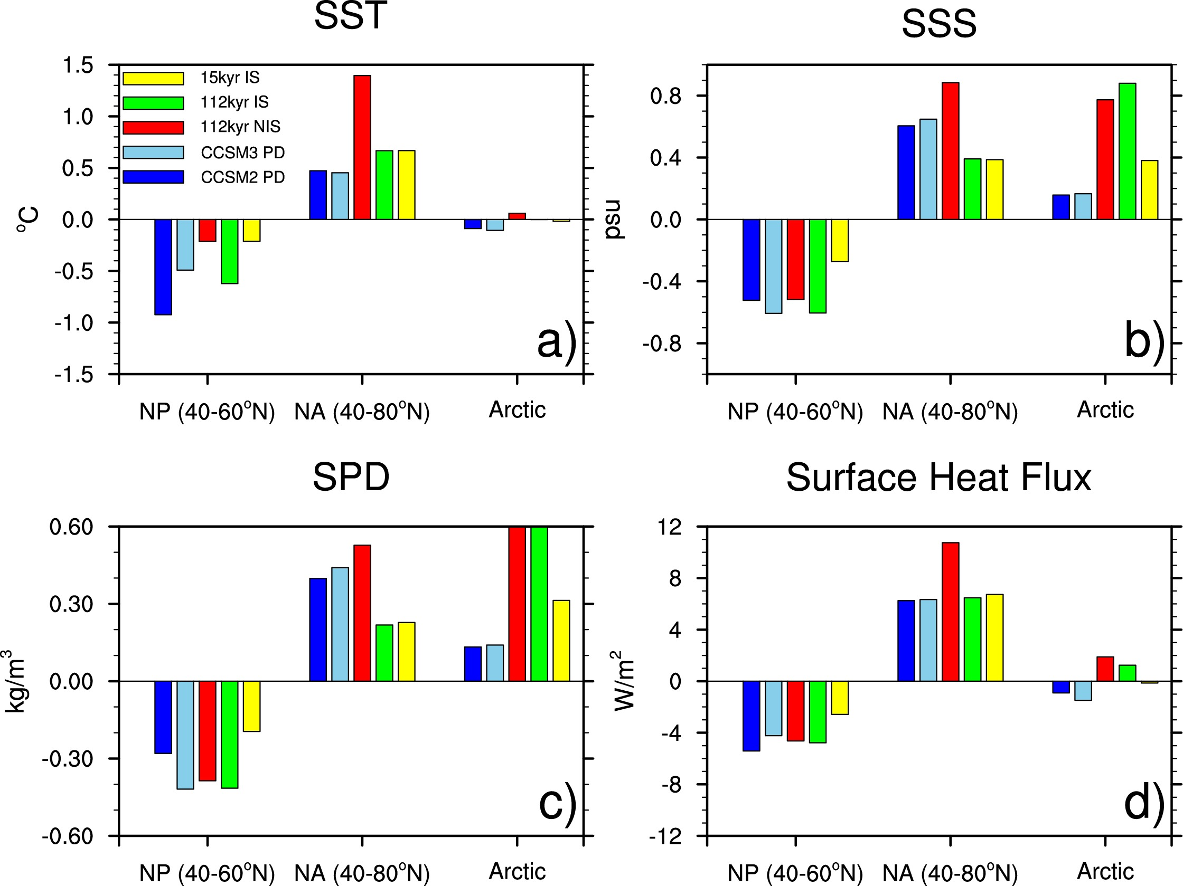
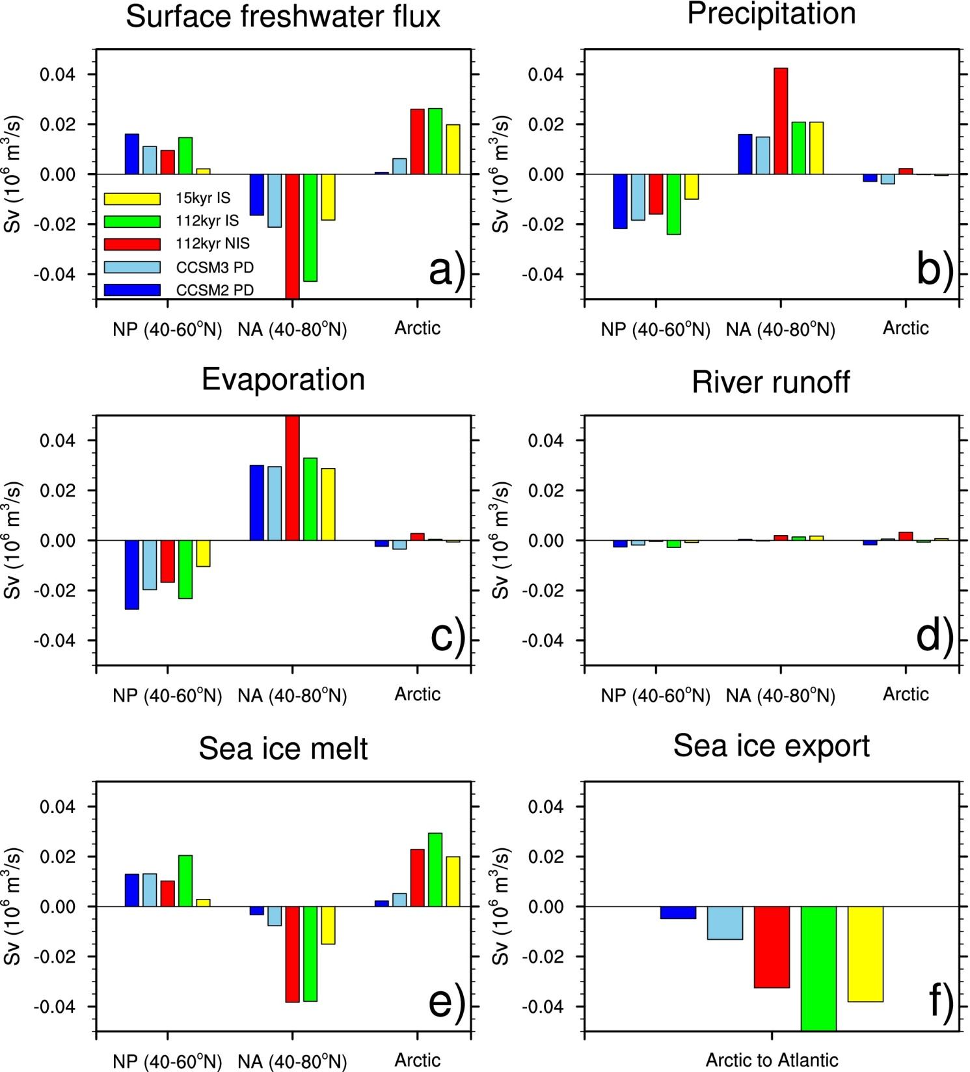
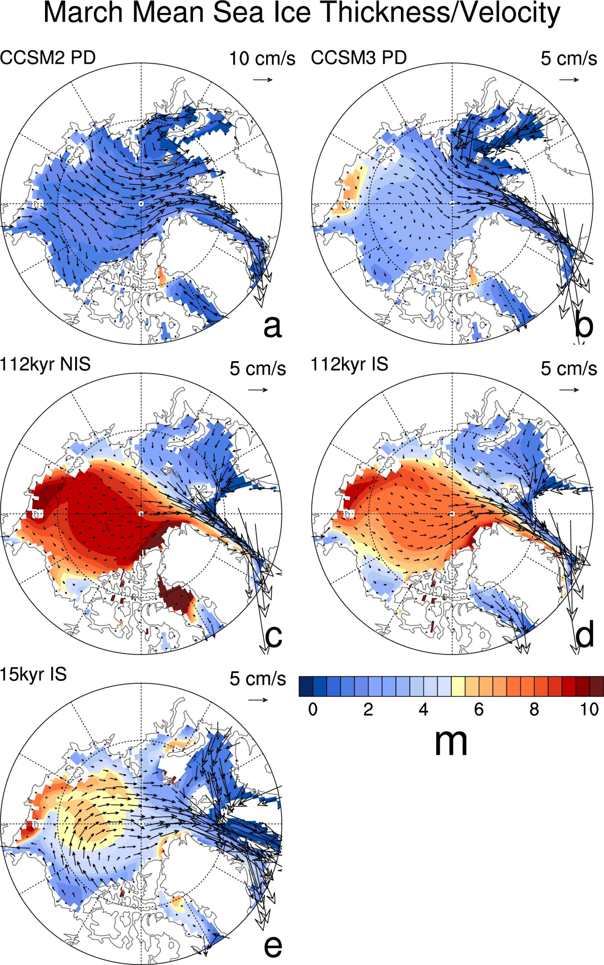
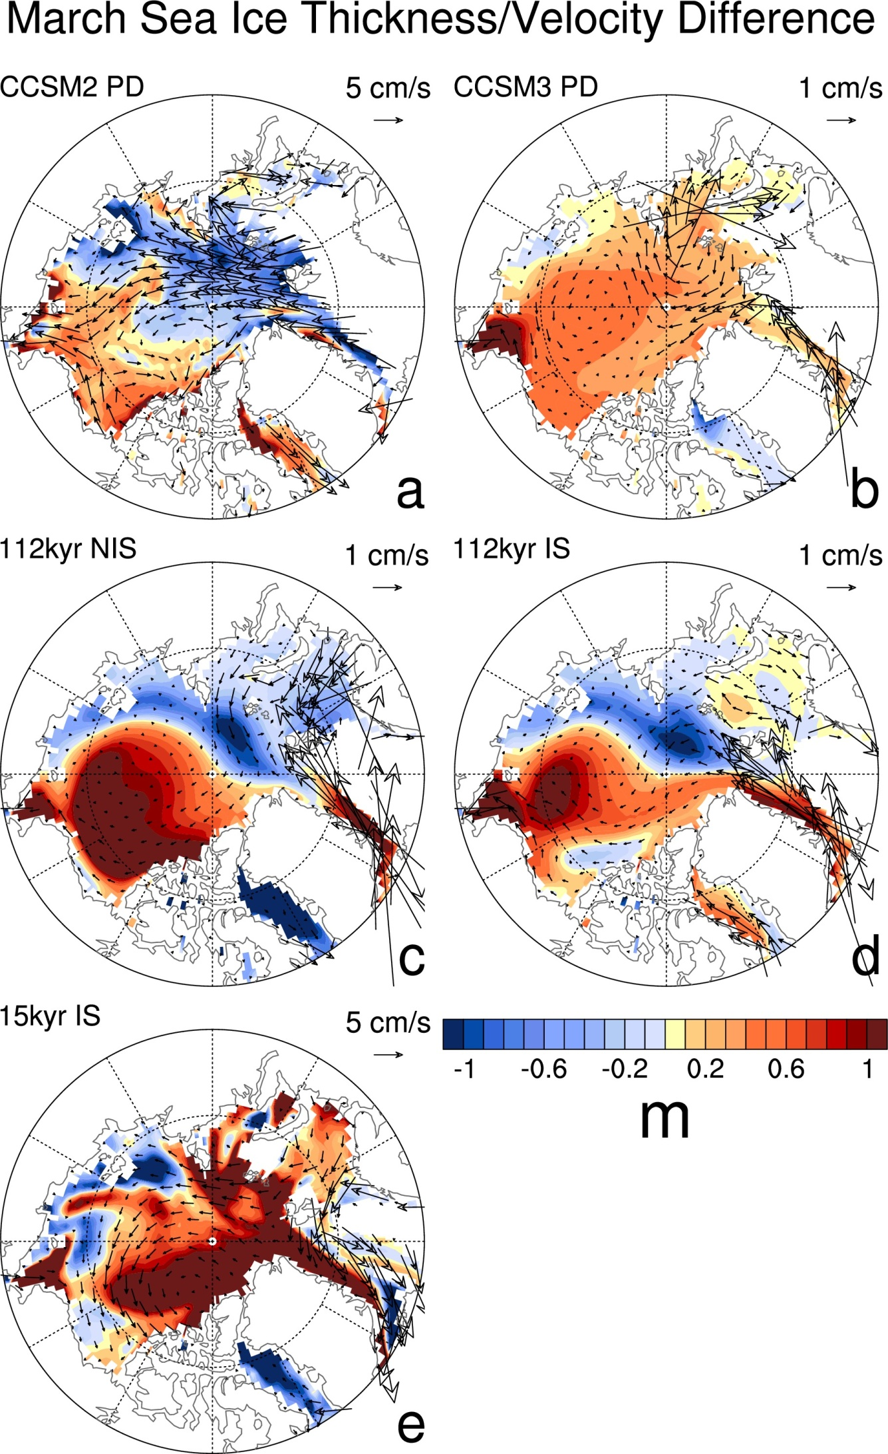
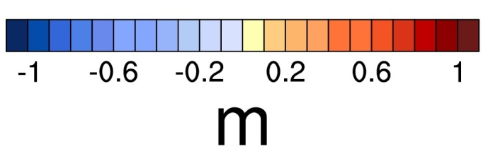
DOE/UCAR Cooperative Agreement
Regional and Global Climate Modeling Program
Effects of the Bering Strait closure on AMOC and global climate under different background climates
Aixue Hu¹, G. A. Meehl¹, W. Han², B. Otto-Bliestner¹, A. Abe-Ouchi³, N. Rosenbloom¹
¹Climate and Global Dynamics Division, National Center for Atmospheric Research, Boulder, CO 80305, USA; ²Department of Atmospheric and Oceanic Sciences, University of Colorado, Boulder, CO 80301, USA; ³Atmosphere and Ocean Research Institute, University of Tokyo, Chiba 277-8568, Japan
Conclusions
By using multiple versions of CCSM and under different background climates, we studied the impact of Bering Strait closure on global climate. Results show that regardless of the version of the model used or the widely different background climates, the Bering Strait’s closure produces a robust result of a strengthening of the AMOC, and an increase in the northward meridional heat transport in the Atlantic. As a consequence, the climate becomes warmer in the North Atlantic and the surrounding regions, but cooler in the North Pacific, leading to a seesaw-like climate change between these two basins. For the first time it is noted that the absence of the Bering Strait throughflow causes a slower motion of Arctic sea ice, a reduced upper ocean water exchange between the Arctic and North Atlantic, reduced sea ice export and less fresh water in the North Atlantic. These changes contribute positively to the increased upper ocean density there, thus strengthening the AMOC.
CCSM2 PD: CCSM2 present day; CCSM3 PD: CCSM3 present day; 112kyr NIS/IS: CCSM3 112kyr before present day without/with N. America ice sheets; 15kyr IS: 15 kyr BP with N. America ice sheet
Changes of the AMOC, meridional heat (MHT) and freshwater transport (FWT), SST, SSS, SPD, Surface heat, freshwater fluxes, and sea ice export in the closed Bering Strait simulations relative to the open ones in the Pacific, Atlantic and Arctic
Sea ice thickness and velocity in open Bering Strait simulations
Changes of sea ice thickness and velocity in closed Bering Strait simulations relative to the open ones

