Slide 1
Simulated and Observed Atmospheric Circulation Patterns Associated with Extreme Temperature Days over North America
Paul C. Loikith
California Institute of Technology/JPL
Anthony J. Broccoli
Dept. of Environmental Sciences, Rutgers University
DOE Climate Modeling PI Meeting
Potomac, MD
May 12-14, 2014

Slide 2
Project Overview
What are the large scale meteorological patterns (LSMPs) and physical processes associated with daily temperature extremes?
  Loikith, P. C., and A. J. Broccoli, 2012: Characteristics of observed atmospheric circulation patterns associated with temperature extremes over North America. J. Climate, 25, 7266–7281, doi:10.1175/JCLI-D-11-00709.1.
  Loikith, P. C., and A. J. Broccoli, 2014: The influence of recurrent modes of climate variability in the occurrence of winter and summer extreme temperatures over North America. J. Climate, 27, 1600-1618, doi: 10.1175/JCLI-D-13-00068.1.
How well do climate models simulate these LSMPs and processes?
  Loikith, P. C., and A. J. Broccoli, 2014: Comparison between observed and simulated atmospheric circulation patterns associated with extreme temperature days over North America using CMIP5 historical simulations. Under review at J. Climate.

Slide 3
Data sources
HadGHCND (Caesar et al. 2006)
  Collaboration between Hadley Centre and National Climatic Data Center
  Daily maximum and minimum temperatures and anomalies
  2.5 ° latitude by 3.75 ° longitude, global domain
  Period: 1946-2000
NCEP/NCAR Reanalysis 1 (Kalnay et al. 1996)
  2.5 ° latitude by 2.5 ° longitude, global domain
CMIP5 historical simulations
  Selection criteria based on availability of daily output

Slide 4
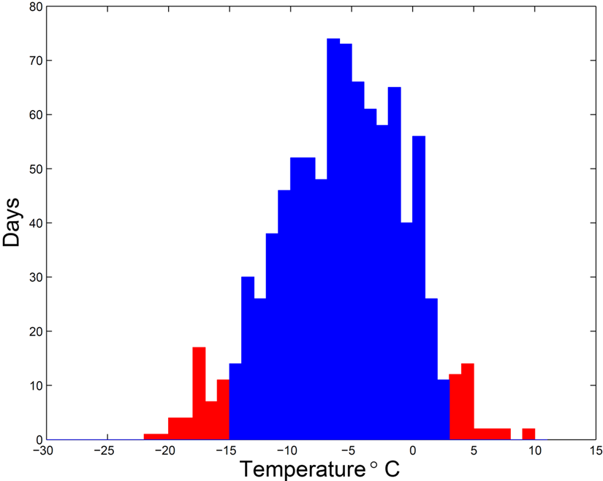
For grid points over North America, construct composite LSMPs based on events in the tails of the daily temperature distribution.
Variables:
Sea level pressure
500 mb geopotential height
Seasons:
January, July
Coldest 5%
Cold Maximum: Tx5
Cold Minimum: Tn5
Warmest 5%
Warm Maximum: Tx95
Warm Minimum: Tn95

Slide 5
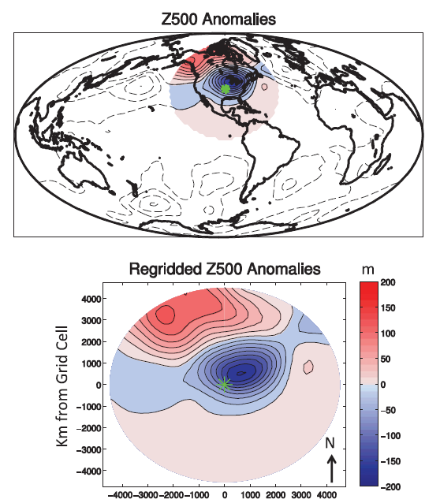
Expressing patterns in “gridcell-relative” space
Referencing circulation anomaly patterns to the location experiencing a daily temperature extreme facilitates comparisons among locations, including the construction of a “grand composite” by averaging across all locations.

Slide 6
Observed and simulated grand composites: Z₅₀₀ and SLP
Contours: Z₅₀₀ anomalies (positive in red, negative in blue, interval: 18 m)
Shading: SLP anomalies (color scale above)
Patterns correlations within composites indicated above each map (Z500, SLP)
Model results from multi-model ensemble mean
Radius of plotted area: 4500 km

Slide 7
Fidelity of individual model grand composites
1.0
0.9
0.8
0.7
Pattern correlation
January LSMPs more realistic than July
0.6
0.5
Z500 simulations more realistic than SLP
0.4
Jan Tx5
Z500
Jan Tx5
SLP
Jan Tx95
Z500
Jan Tx95
SLP
Jul Tx5
Z500
Jul Tx5
SLP
Jul Tx95
Z500
Jul Tx95
SLP

Slide 8
Pattern correlation: Local pattern vs. grand composite
Observed
Multi-model Mean

Slide 9
Interior North America: January Z500 Tn5 and Tn95
This location is relatively unaffected by coastal or topographic influences.
LSMPs are highly symmetrical and linear.
Better model is quite similar to MME mean and observed
Even the poorer model bears considerable resemblance to observed

Slide 10
Central United States: July Tx95 Z500 and SLP
Ensemble mean captures local Z500 anomaly well.
Ensemble mean also shows upstream wave train, but with spatial scale distorted.
Better model captures wave train more realistically.
Poorer model has unrealistically large amplitude for non-local anomaly centers.

Slide 11
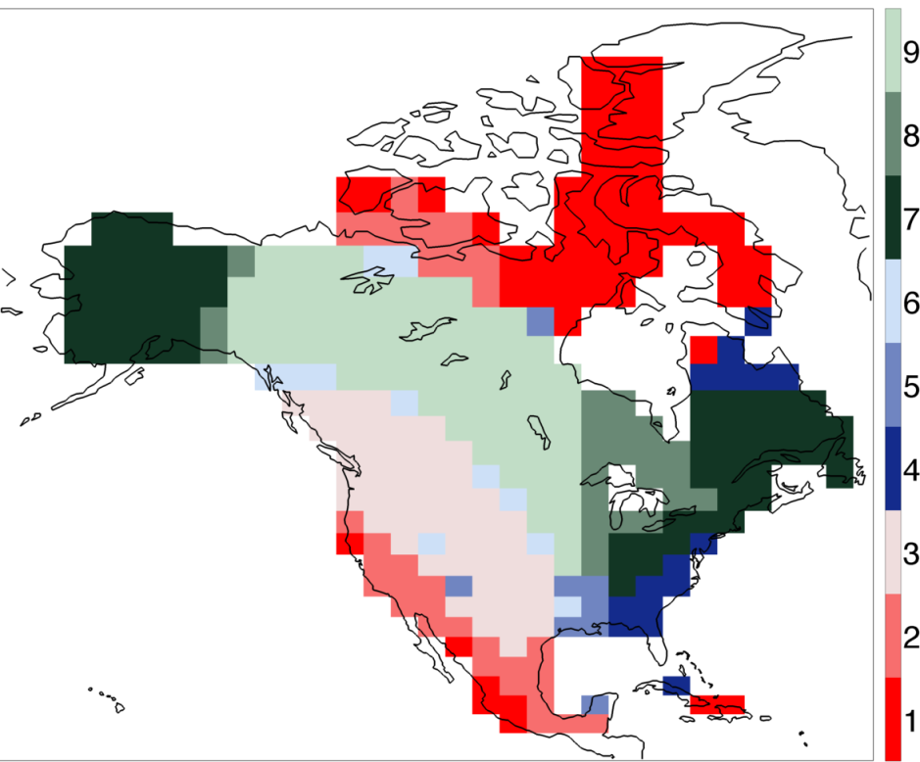
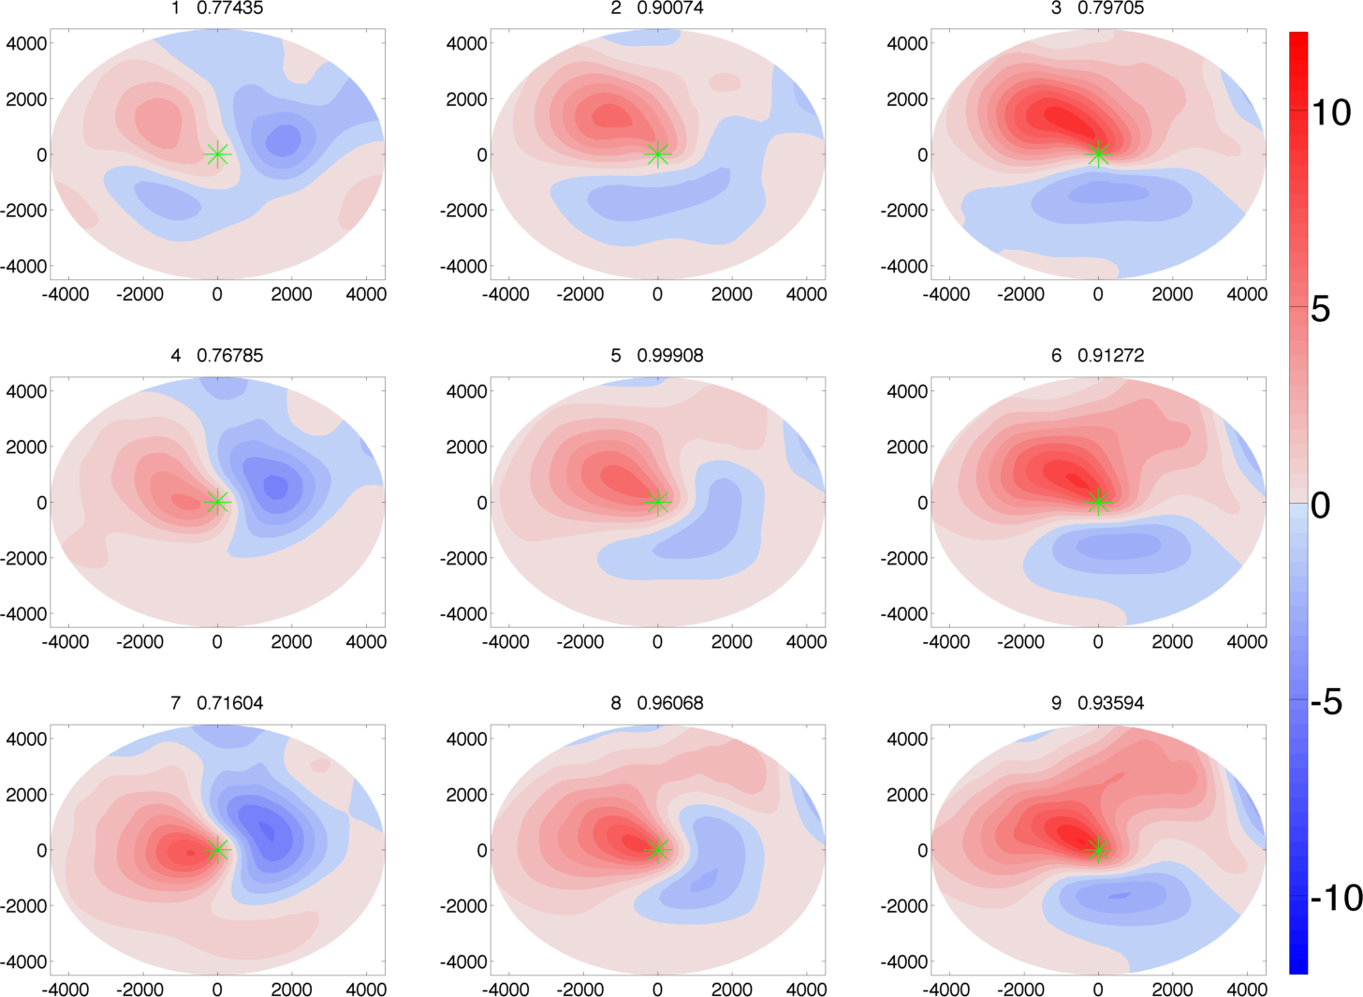
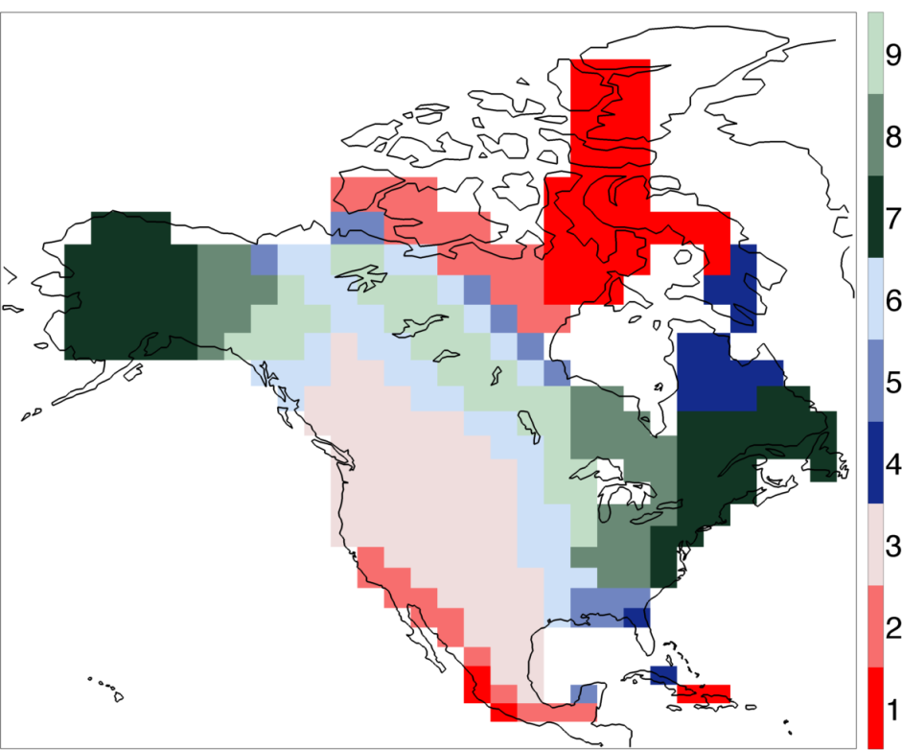
Self-organizing maps
Observed
1
2
3
4
5
6
MME Mean
7
8
9
SLP January Tx5

Slide 12
Conclusions
Most models generally capture the broad features of the LSMPs associated with extreme temperature days.
There are substantial intermodel differences in the quality of the simulation of LSMPs, with model differences greatest in areas where topography and coastal influences are important.
LSMPs are more realistically simulated in winter than in summer.
Midtropospheric circulation patterns are more realistically simulated than those at the surface.
Analysis using self-organizing maps indicates that spatial variations in the LSMPs associated with extreme temperature days are captured reasonably well by the multimodel ensemble mean.

