Slide 1
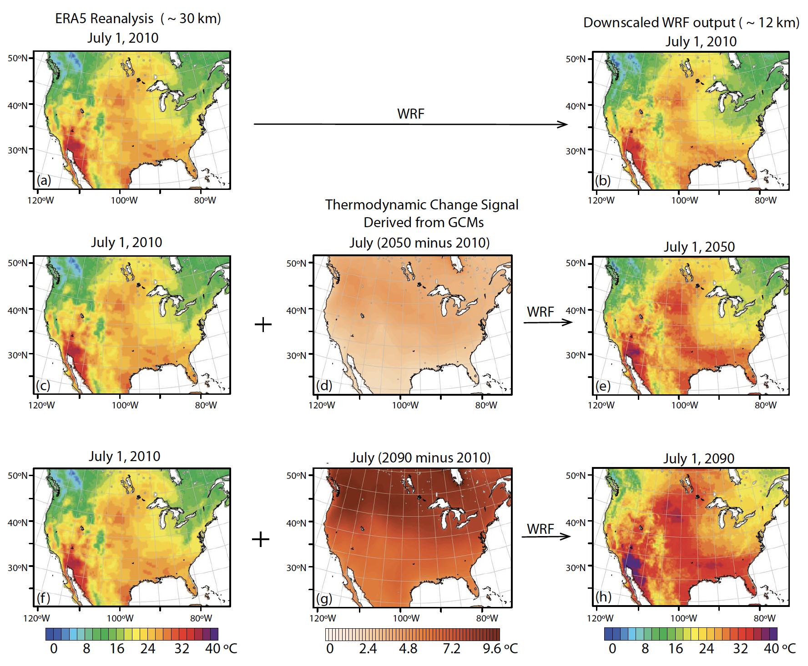
How Past Weather Events Could Replay in Future Climate Scenarios
Objective
To generate a comprehensive set of climate projections for the continental United States, using a thermodynamic global warming (TGW) approach, to explore potential future climate conditions and their impact on historical extreme weather events.
Approach
Dynamically downscale a 40-year sequence of past weather from 1980–2019 driven by atmospheric re-analysis, and then repeat this downscaling with a range of time-evolving 21st century thermodynamic warming signals based on “hotter” versus “cooler” climate sensitivity models from the CMIP6 archive for the RCP4.5. and RCP8.5 scenarios.
Impact
Physically consistent, high spatiotemporal resolution climate datasets representing a wide yet plausible range of climate futures for the United States.
Unique datasets that enable systematic exploration of how thermodynamic change influences the characteristics of historical extreme events such as heatwaves and tropical cyclones.
This figure provides a visual representation of the downscaling process applied to historical weather data, using a heat wave from July 1, 2010 as an example. This step-by-step illustration demonstrates how researchers simulate future climate conditions by modifying historical data with a thermodynamic change signal. It offers a glimpse into how similar events might unfold under future climate scenarios.
Jones, A.D., D. Rastogi, P. Vahmani, A.M. Stansfield, K.A. Reed, T. Thurber, P.A. Ullrich, & J.S. Rice. 2023. “Continental United States climate projections based on thermodynamic modification of historical weather,” Sci Data, 664. DOI: 10.1038/s41597-023-02485-5

