Slide 1
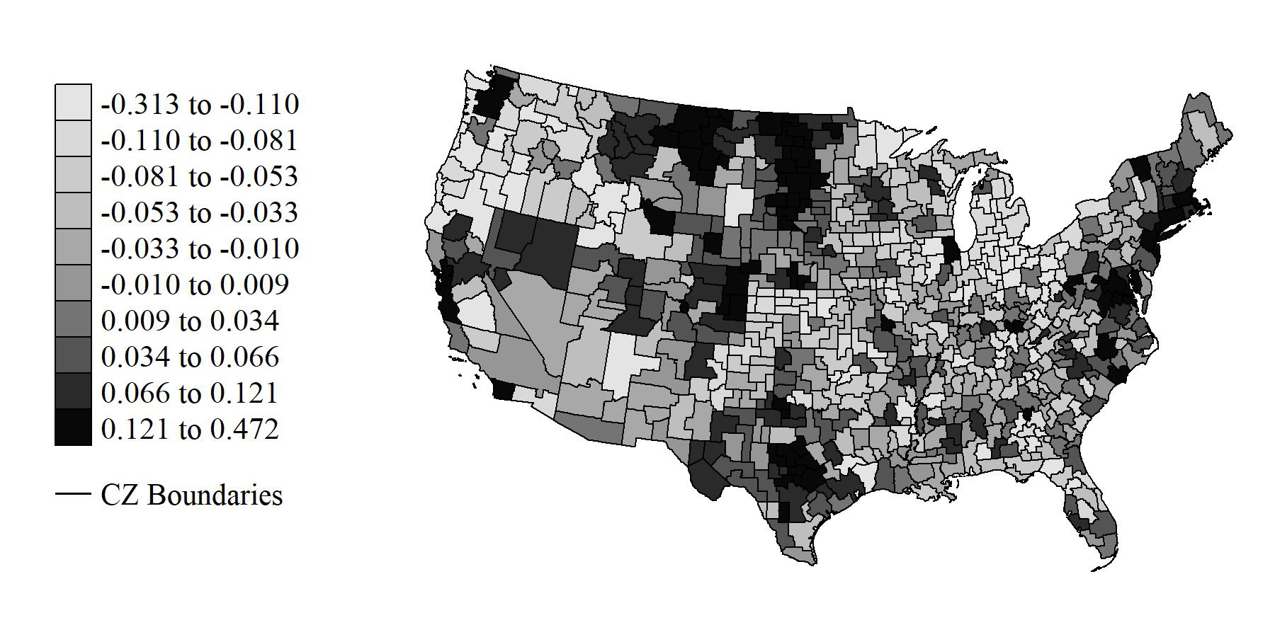
The Effect of Natural Disasters and Extreme Weather on
Household Location Choice and Economic Welfare
Objective
In recent decades, the U.S. has witnessed a population shift from the Northeast and Midwest to the Sun Belt, aligning with a rise in natural disasters. We investigate the trade-offs households face when selecting high-risk locations, analyzing the income adjustments required to mitigate the elevated risk from natural disasters and comparing these compensations with other environmental risks.
Approach
Economic and demographic household characteristics from the U.S. census (1990 and 2000) and the American Community Survey (2010-2014) are merged with disaster risk measures from the Federal Emergency Management Agency's data on Presidential Disaster Declarations (1981-2010) and extreme weather data from the PRISM Climate Group. This dataset, geographically referenced to 722 U.S. Commuting Zones (CZs), is utilized to estimate a spatial equilibrium model of household location choice.
Figure: Percentage change in yearly household wages net of expenditures on rent from 1990 to 2010.
Rent and wages are equal to average monthly household rent and wages produced by aggregating census microdata to the commuting zones (CZ) level after hedonically adjusting rents and wages for endogenous sorting.
Impact
Households may need up to 0.40% of annual income to withstand an extra disaster in a decade, and these costs vary significantly based on household skill level, with higher-skill, higher-income households willing to pay three times more annually to avoid additional natural disasters.
Wrenn D. H. (2024). The effect of natural disasters and extreme weather on household location choice and economic welfare. Journal of the Association of Environmental and Resource Economists, in press. https://doi.org/10.1086/728887.

