Slide 1
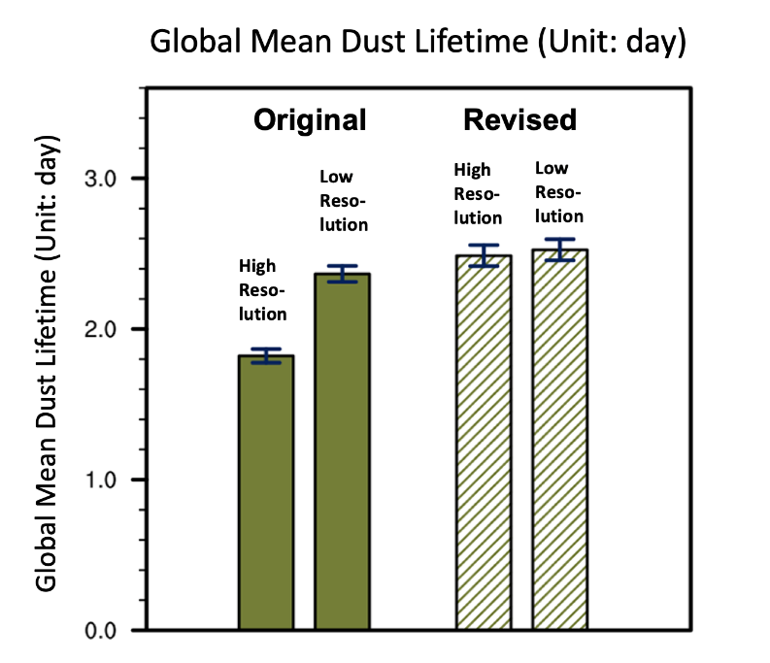
Careful Coupling Improves High-Resolution Climate Simulation
Objective
Understand and address the unexpected shorter dust lifetime in the Energy Exascale Earth System Model version 1 (E3SMv1) when a higher vertical resolution is used.
Approach
Analyze the time evolution of dust aerosol concentrations and the spatial distribution characteristics of aerosol process rates to reveal the deficiencies of the original numerical scheme used for coupling aerosol processes.
Revise the sequence of calculations of a few key processes in aerosol life cycles.
Evaluate the revised numerical scheme using E3SMv1 simulations in terms of the dust aerosol climatology and its sensitivity to vertical resolution.
Impact
Because aerosols play an important role in global climate change, accurate depictions of aerosol life cycles can help reduce numerical errors and uncertainties in climate predictions.
Resolution increase can cause non-physical changes in numerical climate simulations. Removing those non-physical changes can reap the most benefits from the computational cost of high resolutions.
A revised sequence of calculations for a few key aerosol processes reduces the unexpected and non-physical sensitivity of the simulated dust lifetime to vertical resolution in the Energy Earth System Model version 1.
Wan, H, K Zhang, CJ Vogl, CS Woodward, RC Easter, PJ Rasch, Y Feng, and H Wang, 2024: “Numerical coupling of aerosol emissions, dry removal, and turbulent mixing in the E3SM Atmosphere Model version 1 (EAMv1) – Part 1: Dust budget analyses and the impacts of a revised coupling scheme,” Geoscientific Model Development, 17, 1387–1407, DOI: 10.5194/gmd-17-1387-2024
Notes:
http://www.pnnl.gov/science/highlights/highlights.asp?division=749

