Slide 1
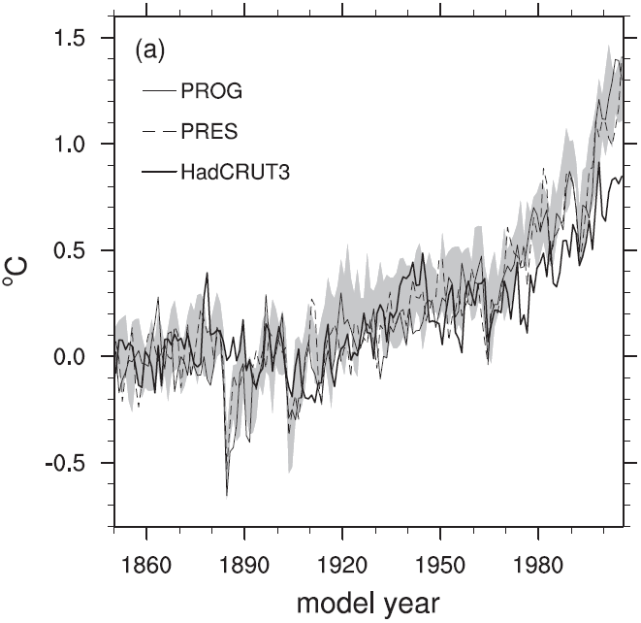
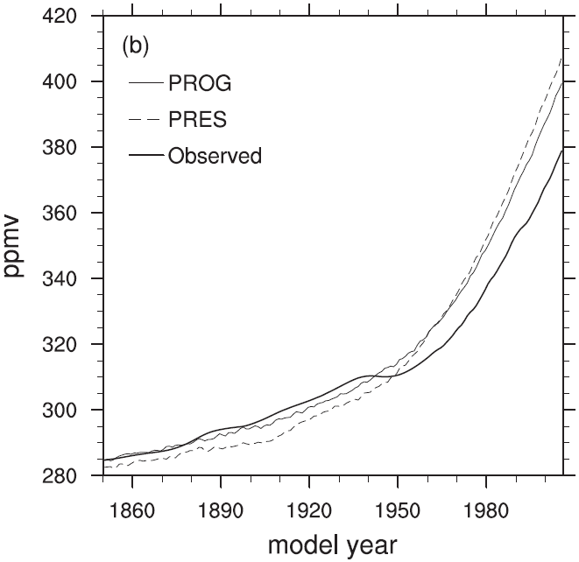
CESM1(BGC) Historical Carbon Cycle Characterized
Objective:
Characterize the fidelity of the Community Earth System Model (CESM1) carbon cycle with terrestrial carbon–nitrogen dynamics and an ocean biogeochemical model.
Approach:
Two sets of preindustrial-control and 20th century experiments were initialized and forced with prescribed CO₂ emissions (PROG) and CO₂ mole fractions (PRES).
Results/Impacts:
CESM1(BGC) configuration used for CMIP5 experiments was introduced and described.
Model broadly reproduced observed 20th century carbon cycle, but exhibited notable biases.
Model exhibited excessive increase in atmospheric CO₂ due to weak land and ocean carbon uptake.
Model had a weak seasonal cycle of atmospheric CO₂ in the Northern Hemisphere due to seasonal biases in land-to-air CO₂ fluxes.
Model response of atmospheric CO₂ to El Niño Southern Oscillation was too weak.
Lindsay, Keith, Gordon B. Bonan, Scott C. Doney, Forrest M. Hoffman, David M. Lawrence, Matthew C. Long, Natalie M. Mahowald, J. Keith Moore, James T. Randerson, and Peter E. Thornton (2014), Preindustrial-Control and Twentieth-Century Carbon Cycle Experiments with the Earth System Model CESM1(BGC), J. Clim., 27:8981–9005, doi:10.1175/JCLI-D-12-00565.1.
Time series of 20th century (a) 2-m air temperature anomalies and (b) surface net CO₂ tracer compared to observations.

