Slide 1
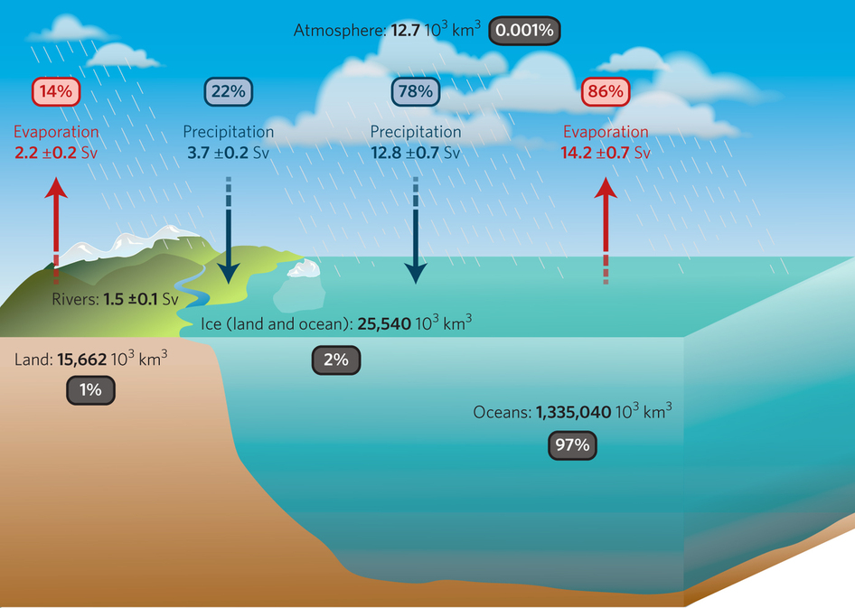
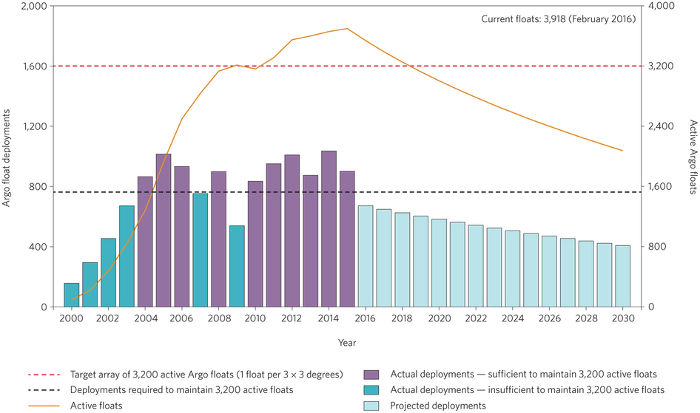
Keeping the lights on for global ocean salinity observation
Objective
The global climate observing system (GCOS) is highly dependent on the global ocean observing system (GOOS)
More than 90% of the Earth’s additional heat due to climate change is stored in the ocean
Ocean salinity provides a key insight into ongoing water cycle variability and change
Research
Recent ocean research at PCMDI has leveraged heavily off the automated float (Argo) and ship-based (GO-SHIP) observational networks
These measurements have been used to generate change estimates over the observed records and are used to evaluate and investigate the CO₂ forced response in climate model simulations
As ongoing work is dependent on these observing networks, how are they placed to continue into the near- and far-term future
Evaluate the current status of these observing networks into the coming decade
Impact
The assessment shows that significant cracks are appearing in the Argo array from 2017 onward
This is due to an observing program that has fully optimized the array to the limits of current technology and funding limitations
Renewed funding and community attention is urgently needed to maintain the existing array
How does ocean salinity relate to the global water cycle? Near-surface and subsurface ocean salinity provides a marker of freshwater changes in the ocean. As ~80% of Earth’s freshwater fluxes occur at the atmosphere-ocean interface, salinity provides a way to monitor ongoing changes in the oceanic water cycle
How do future forecasts for Argo coverage look? Significant cracks are appearing in the array when forecasting out beyond 2017 – more attention is required to maintain the existing array
Reference: P. J. Durack, T. Lee, N. T. Vinogradova and D. Stammer (2016): Keeping the lights on for global ocean salinity observation. Nature Climate Change, 6 (3), pp 228-231. doi: 10.1038/nclimate2946

